Slide 1


REPRODUCTIVE HEALTH
ASSISTED REPRODUCTIVE TECHNOLOGY
SUBJECT : BIOLOGY
CHAPTER NUMBER:04
CHAPTER NAME :REPRODUCTIVE HEALTH

Slide 2
INFERTILITY
Inability to give birth to a child or inability to conceive is called infertility.
There are some patients who have never conceived and some other who had previously conceived.
Infertility can be best defined as relative sterility .
The reasons for infertility can be physical, hereditary, drugs, psychological etc.
The couples could be assisted to have their own child through certain special techniques called as assisted reproductive technologies.(ART)

Slide 3
INFERTILITY in males
Infertility in caused by following defects in males:
(a) Low sperm count – oligospermia.
(b) Near absence of sperm – azospermia.
(c) Blockage of vasa efferentia or vas deferentia.
(d) Alcoholism inhibits spermatogenesis.
(e) Chromosomal abnormality like klineflelter’s disease causes infertility.
INFERTILITY in Females
Infertility in caused by following defects in females:
(a) Ovarian cyst or low functioning of hypothalamo - pituitary complex caused anovulation
(b) inadequate growth & functioning of corpus luteum inhibits implantation
(c) Blockage of fallopian tubule.
(d) Congenital defect in cervix, uterus leads to infertility.
(e) Sometimes ovum is not liberated but remain trapped inside the follicle.

Slide 4
ASSISTED REPRODUCTIVE TECHNOLOGY (ART)
It includes medical procedures used primarily to address infertility .
When used to address infertility, ART may also be referred to as fertility treatment.
ART mainly belongs to the field of reproductive endocrinology and infertility .
Some forms of ART may be used with regard to fertile couples for genetic purpose
With ART, the process of sexual intercourse is bypassed and fertilization of the oocyte occurs in the laboratory environment (i.e. in vitro fertilization)

Slide 5
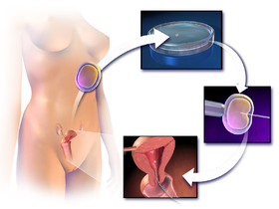
IN VITRO FERTILIZATION (IVF)
In Vitro Fertilization is the most common form of ART that is used by maximum patients than for any other ART’s today.
This method includes methods like super ovulation, monitoring follicular growth, maintenance of egg, collection of semen .
Finally the egg is combined (fertilization)
with sperm in a laboratory.
The fertilised egg then is placed
inside the woman’s uterus soon after
the embryo formed.

Slide 6
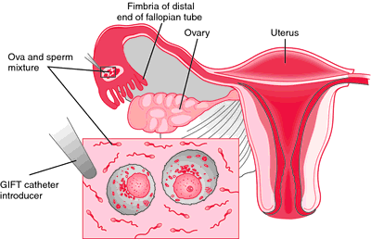
GAMETE INTRA FALLOPIAN TRANSFER (GIFT)
Gamete Intra fallopian transfer was one of the common forms of ART but not today.
The GIFT is where the retrieved man’s sperm and woman’s egg are passed into fallopian tubule through laparoscopy .
For GIFT normal fallopian tubules are required.
The fertilization occurs inside a woman’s body in
GIFT treatments and not in a lab.
This ART is a better option for the couples
who opt for a natural treatment which enables the
fertilization and implantation to occur naturally
inside the woman’s body.

Slide 7
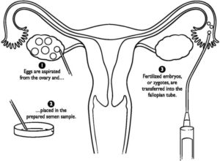
ZYGOTE INTRA FALLOPIAN TRANSFER (ZIFT)
Zygote intra fallopian transfer (ZIFT) is a combination of IVF and GIFT.
The sperm and ova are extracted with the same procedures as IVF and GIFT, and the ova are fertilized outside of the body as with IVF.
ICSI may also be used in conjunction with ZIFT.
During a ZIFT procedure, the developing embryo
(up to 8 blastomeres) is placed in the fallopian tubes
at the zygote stage (in contrast to IVF where the
developing embryo is placed in the uterus later in
its development, at the blastocyst - 32 celled stage).
Since the developing embryo is placed in the woman’s body much sooner with ZIFT, it is also considered more “natural” than IVF.

Slide 8
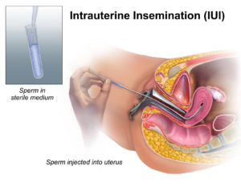
INTRAUTERINE INSEMINATION (IUI)
Intrauterine insemination is the placement of a man’s sperm in the woman’s uterus by a long narrow tube.
IUI can be performed in combination
with medications which stimulate
ovulation and this combination is capable
of increasing the chances of pregnancy
in some cases.

Slide 9
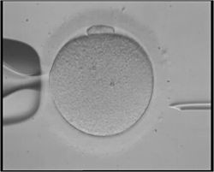
INTRA CYTOPLASM SPERM INJECTION (ICSI)
It is beneficial in the case of male factor infertility, where sperm counts are very low or failed fertilization occurred withprevious IVF attempt(s).
The ICSI procedure involves a single sperm carefully injected into the centre of an egg using a micro needle.
With ICSI, only one sperm per egg is needed.
Without ICSI, you need between 50,000 and 100,000.

Slide 10
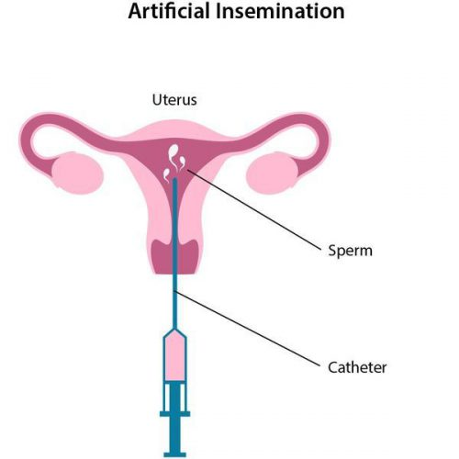
ARTIFICIAL INSEMINATION (AI)
It is the deliberate introduction of sperm into a female's cervix or uterine cavity for the purpose of achieving a pregnancy through in vivo fertilization by means
other than sexual intercourse.
Doctor inserts sperm directly into
a woman's cervix, fallopian tubes,
or uterus.

Slide 11
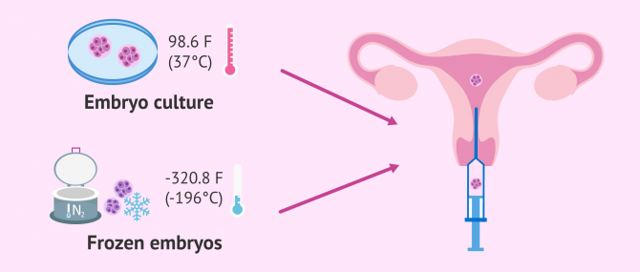
EMBRYO TRANSFER (ET)/ INTRA UTERINE TRANSFER (IUT)
Embryo transfer refers to a step in the process of assisted reproduction in which embryos are placed into the uterus of a female with the intent to establish a pregnancy.
Early embryo with more than 8 blastomeres formed from IVF are transferred.
Doctor will insert a speculum into the woman's vagina to keep the vaginal walls open.
Using ultrasound for accuracy, the doctor Will then pass a catheter through the cervix and into the womb.
From there, the embryos are passed through the tube and into the womb.

Slide 12
SURROGACY
Surrogacy is a reproductive process by which a woman, who is not going to be the mother, carries the pregnancy to term for another person or couple.
In order to achieve pregnancy, in vitro fertilization (IVF) is performed, either with eggs and semen from the future parents or from a donor.
In any case, once the embryos are obtained, they are cultivated and finally transferred to the uterus of the surrogate mother.
That way, they can implant to give rise to a pregnancy.

Slide 13
THANKING YOU
ODM EDUCATIONAL GROUP

