Slide 1


REPRODUCTIVE HEALTH
CONTRACEPTION METHODS,MTP &STDs
SUBJECT : BIOLOGY
CHAPTER NUMBER:04
CHAPTER NAME :REPRODUCTIVE HEALTH

Slide 2
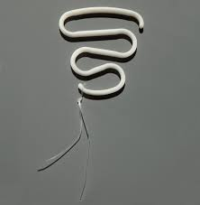
BARRIER METHODS
INTRA -UTERINE DEVICES
They are devices made of plastics, metal or a combination of the two which is inserted into the uterus to prevent conception.
IUDs are of three types – Inert, copper releasing & hormone releasing.
These devices are inserted by doctors or expert nurses to the uterus through vagina.
INERT - IUD (NON-MEDIATED IUDs)
The inert IUDs are made of impregnated stainless steel.
E.g. Lippes loop.
These IUDs increases phagocytosis of
sperms in the uterus.

Slide 3
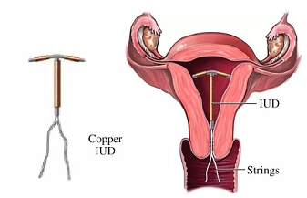
COPPER IUDs
These IUDs have ionized copper which slowly diffuses at the rate of some 50microgm/day.
It works in following ways:
Increasing phagocytosis of sperms.
Cu ion suppresses sperm motility.
Cu ion suppresses the fertilizing
ability of the sperm.
HORMONE RELEASING IUDs
These IUDs release small quantities of hormones which suppresses endometrial changes , cervical mucus , causes anovulation with insufficient luteal activity.
e.g.-LNG-20, progestasert

Slide 4
ORAL PILLS (ORAL CONTRACEPTIVES)
Oral administration of small doses of either progestogens or progestogen-estrogen combinations is another contraceptive method used by the females.
They are used in the form of tablets and hence are popularly called the pills.
Pills have to be taken daily for a period of 21 days starting preferably within the first five days of menstrual cycle.
After a gap of 7 days (during which menstruation occurs) it has to be repeated in the same pattern till the female desires to prevent conception.
They inhibit ovulation and implantation as well as alter the quality of cervical mucus to prevent/ retard entry of sperms.

Slide 5
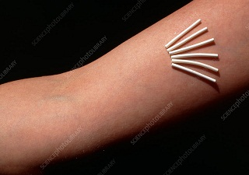
Pills are very effective with lesser side effects.
Saheli - the new oral contraceptive for the females contains a non-steroidal preparation.
It is a 'once a week' pill with very few side effects and high contraceptive value.
IMPLANTS
Progestogens alone or in
combination with estrogen can
also be used by females as injections
or implants under the skin .
Their mode of action is similar to that of pills and their effective periods are much longer.

Slide 6
EMERGENCY CONTRACEPTION
Administration of progestogens or progestogen-estrogen combinations or IUDs within 72 hours of coitus have been found to be very effective as emergency contraceptives as they could be used to avoid possible pregnancy due to rape or casual unprotected intercourse.
These pills are also known as morning after pills.
SURGICAL METHODS
These are permanent methods of family planning where there is no need of replacement but the reversibility is poor.
The methods are operative procedures which block the passage of semen in males and ova in females.
They are called as sterilization procedures, vasectomy in males and tubectomy in females.

Slide 7
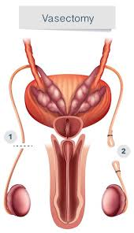
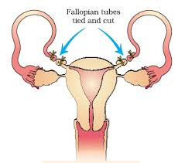
VASECTOMY
It is a surgical method of sterilization of males .
Vasa deferentia cut and tied up by making a small incision upon scrotum .
So that sperms are unable to pass down the male reproductive system.
TUBECTOMY
It is a surgical method of female sterilization .
In this method the fallopian tubes are excised and ligated to block the passage of ovum through them to reach the site of fertilization .

Slide 8
SIDE EFFECTS
Except for natural methods, all other contraceptive procedures are unnatural.
Therefore they must have some side effects like:
Nausea,
Abdominal pain,
Breakthrough bleeding,
Irregular menstruation .
Even breast cancer, though not very significant. should not be totally ignored.

Slide 9
MEDICAL TERMINATION OF PREGNANCY:
Intentional or voluntary termination of pregnancy before full term is called medical termination of pregnancy (MTP) or induced abortion.
Nearly 45 to 50 million MTPs are performed in a year all over the world which accounts to l/5th of the total number of conceived pregnancies in a year.
Obviously MTP has a significant role in decreasing the population though it is not meant for that purpose.
Government of India legalized MTP in 1971 with some strict conditions to avoid its misuse.
Such restrictions are all the more important to check indiscriminate and illegal female foeticides which are reported to be high in India.
This procedure is to get rid of unwanted pregnancies either due to casual unprotected intercourse or failure of the contraceptive used during coitus or rapes or is essential where continuation of the pregnancy could be harmful or even fatal either to the mother or to the foetus or both.
MTPs ore considered relatively safe during the first trimester. i.e. up to 12 weeks of pregnancy. Second trimester abortions are much more riskier.
Majority of the MTPs are performed illegally by unqualified quacks which are not only unsafe but could be fatal too.
Another trend is the misuse of amniocentesis to determine the sex of the unborn child frequently. if the foetus is found to be female, it is followed by MTP - this is totally against what is legal.

Slide 10
SEXUALLY TRANSMITTED DISEASES (STDs)
Diseases or infections which are transmitted through sexual intercourse are collectively called sexually transmitted diseases (STDs) or venereal diseases (VD) or reproductive tract infections (RTI).
E.g.- Gonorrhea , syphilis. genital herpes, chlamydiasis, genital warts, trichomoniasis , hepatitis-B & HIV.
Some of these infections like hepatitis-B and HIV can also be transmitted by sharing of injection needles, surgical instruments, etc , with infected persons, transfusion of blood or from on infected mother to the foetus too.
Except for hepatitis-B, genital herpes and HIV infections other diseases are completely curable if detected early and treated properly.
Early symptoms of most of these are minor and include:
Itching, fluid discharge, slight pain, swellings etc, in the genital region.
Infected females may often be asymptomatic and hence may remain undetected for long.
Absence or less significant symptoms in the early stages of infection and the social stigma attached to the STDs not allow the infected persons from going for timely detection and proper treatment.

Slide 11
PELVIC INFLAMMATORY DISEASES (PID)
This could lead to complications later, which include pelvic inflammatory diseases (PID), abortions, still births, ectopic pregnancy, infertility or even cancer of the reproductive tract. STDs are a major threat to a healthy society.
The incidences are reported to be very high among persons in the age group of 15-24 year age group.
Don't panic. Prevention is in your hands.
It is required to follow the Simple principles given below:
Avoid sex With unknown partners /multiple partners.
Always use condoms during coitus.
In case of doubt go to a qualified doctor for early detection and get complete treatment if diagnosed with disease.

Slide 12
THANKING YOU
ODM EDUCATIONAL GROUP

