Slide 1


REPRODUCTIVE HEALTH
PROBLEMS,STRATEGIES AND BIRTH CONTROL
SUBJECT : BIOLOGY
CHAPTER NUMBER:04
CHAPTER NAME :REPRODUCTIVE HEALTH

Slide 2
INTRODUCTION
What do we understand by reproductive health?
Reproductive health is a state of physical, emotional, behavioural and social fitness for leading responsible, safe and satisfying reproductive life .
According to WHO reproductive health means a total well-being in all aspects of reproduction. i.e. physical , emotional , behavioural and social.
Therefore. a society with people having physically and functionally normal reproductive organs and normal emotional and behavioural interactions among them in all sex-related aspects might be called reproductively healthy.
SIGNIFICANCE:
Awareness is provided to both males and females to lead healthy life.
Providing information as to keep proper hygiene
Protection against reproductive tract infections or STD.
Obtaining treatment for at the earliest reproductive disorders .

Slide 3
PROBLEMS
1.Believes – In India, religions, traditions do not allow much dissemination knowledge about reproductive health.
2.Early marriage – Children were often married off as soon as they attained puberty.
3.Personal hygiene – There is little knowledge of personal hygiene of gonads leading to STDs.
4.MMR & IMR - The maternal and infant mortality rates are high.
5.Population growth – There has been a increase in population size.

Slide 4
STRATEGIES
Family planning & RCH: India was the first country of the world to initiate plans and programmes for attaining reproductive health as social goal through family planning in 1951.
An improved programmes covering under reproduction-related areas are currently in operation under the popular name 'Reproductive and Child Health Care’ (RCH) programmes.
General awareness : The audio visual aids, print media, primary health centre both government & non government agencies (NGO) are engaged in creating general awareness among people about reproduction.
SEX EDUCATION : it has been included in school curricula which helps in removing myths and misconceptions about various sex related aspects.

Slide 5
PARENTAL GUIDE : It is the duty of parents , elders and close relatives to provide sex related information to young ones.
SOCIAL EVILS : Sex abuse and sex related crimes can occur only due to reproductively unhealthy members of the society. Therefore spreading message of reproductive health is important .
INFRA-STRUCTURE : Strong infrastructure facilities, professional expertise and material support are required to attain proper reproductive health through providing assistance in reproductive health related problems like pregnancy, delivery, contraception, abortions .
FAMILY WELFARE INFORMATION : All other persons of marriageable age must be educated about available birth control options, reasons for fertility control, post natal care of child, importance of breast feeding.

Slide 6
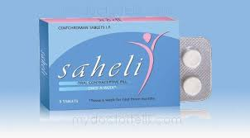
UNCONTROLLED POPULATION : The harmful effect of
uncontrolled population explosion must be known to everybody
so that one should not only feel responsible but also act responsible.
AMNIOCENTESIS : There is now a statutory ban on determination of foetal sex through this technique. Amniocentesis is a technique of foetal sex determination test based on the chromosomal pattern in amniotic fluid surrounding the developing embryo.
Legally it checks increasing female foeticides , massive child immunization etc.
RESEARCH : Research into improved techniques
of contraceptions is a continuing process. ‘Saheli’
- a new oral contraception for the females
was developed by scientists at
Central Drug Research Institute (CDRI) in Lucknow.

Slide 7
POPULATION EXPLOSION AND BIRTH CONTROL
In the last century an all-round development in various fields
significantly improved the quality of life of the people. However increased health facilities along With better living conditions had an explosive impact on the growth of population.
The world population which was around 2 billion (2000 million) in 1900 rocketed to about 6 billions by 2000. A similar trend was observed in India too.
Our population which was approximately 350 million at the time of our independence reached close to the billion mark by 2000 and crossed 1 billion in May 2000. That means every sixth person in the world is an Indian and this tremendous growth in size is called population explosion .
REASONS FOR HIGH POPULATION GROWTH
LONGER LIFE SPAN : Life expectancy has increased progressively over years.
LACK OF EDUCATION: Education has been found to have major impact over size of family.

Slide 8
MATERNAL MOTALITY RATE(MMR)& INFANT MOTALITY RATE(IMR)
A rapid decline in detail rate maternal mortality rate (MMR) and Infant mortality rate (IMR) as well as an increase in number of people in reproducible age are probable reasons for this.
Through our RCH programmes though we could bring down the population growth rate. it was only marginal.
According to the 2001 census report. the population growth rate was still around I.7 Percent i.e.17 /1000/year a rate at which our population could double in 33 years.
CONSEQUENCES OF POPULATION EXPLOSION
The increase in population increases unemployment, poverty, shortage in food, pollution, shortage of natural resources, demand for housing and many more.

Slide 9
MOTIVATION
There is a need to halt the population growth so that the benefits of development may reach every citizen and standard of living for majority of the citizens improved.
The most important steps to overcome this problems to motivate smaller families by using various contraceptive methods.
The advertisements in the media as well as posters/bills. etc , showing a happy couple with two children with a slogan “Hum Do Humare Do” (we two, our two).
Many couples. mostly the young, urban working ones have even adopted on 'one child norm'.
Statutory raising of marriageable age of the female to 18 years and that of males to 21 years.
Incentives given to couples with small families is another measure taken to tackle this problem

Slide 10
CONTRACEPTIVES
They are devices which prevent conception or pregnancy without in any way interfering in reproductive health of the individuals.
CHARACTERISTIC OF IDEAL CONTRACEPTIVES
1)User friendly i.e. Comfortable and easy to use.
(2)Without any side effect.
(3)Reversible.
(4)Completely effective against pregnancy.

Slide 11
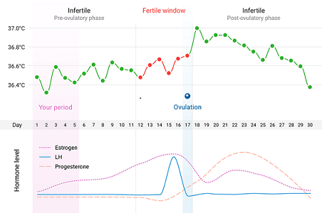
NATURAL METHODS
They are methods which do not requireany device or medicine for preventing pregnancy. Natural methods are of three kinds :
PERIODIC ABSTINENCE (RHYTHM METHOD)
Ovulation occurs roughly about the middle of menstrual cycle . Fertility period when fertilisation can occur is up to 48 hours after ovulation.
Ovulation period can be known simply
by remembering the time and date of
menstrual cycle.
Avoiding sex during the fertility period
will naturally prevent conception.
It is however always better to avoid sex
from day 10-17 of menstrual cycle.

Slide 12
COITUS INTERRUPTUS
This method is otherwise known as withdrawal method.
This is another method in which the male partner withdraws his penis from the vagina just before ejaculation so as to avoid insemination.
LACTATIONAL AMENORRHEA
This method is based on the fact that ovulation and therefore the absence of menstrual cycle do not occur during the period of intense lactation following parturition.
Therefore as long as the mother breast-feeds the child fully chances of conception are almost nil .
However this method has been reported to be effective only up to a maximum period of six months following parturition. As no medicines or devices are used in these methods, side effects are almost nil.

Slide 13
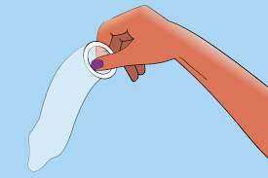
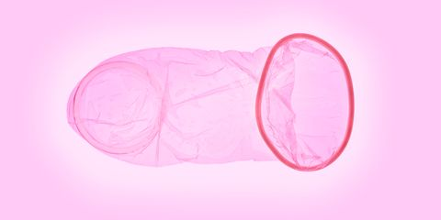
BARRIER METHODS
In barrier methods ovum and sperms are prevented from physically meeting with the help of barriers. Such methods are available for both males and females.
Condoms : They are barriers made of the rubber/ latex sheath that are used to cover the penis in the male, Just before coitus so that
the ejaculated semen would not enter into the female
reproductive tract. Thus can prevent conception.
‘Nirodh’ is a popular brand of condom for the male.
Use of condoms has increased in recent years due to its additional benefit of protecting the user from contracting STDs and AIDS.
Both the male and the female condoms are disposable & can be self-Inserted and thereby gives privacy to the user .
Femidom : The device is latex pouch with a ring at
either end .This device covers the external genitalia
and lines the vagina .

Slide 14

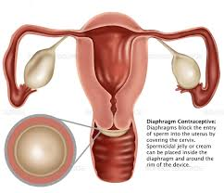
CERVIVAL CAPS :
It is rubber cap which is fitted over the cervix and is designed to
remain there by suction.
This device prevents the entry of sperms into uterus
DIAPHRAGM :
It is a tubular rubber sheath with a flexible metal or
spring ring at the margin which is fitted inside the vagina.
These devices prevent conception by blocking the entry
of sperms through the cervix. They are reusable.
Spermicidal creams, jellies and foams are usually used
along with these barriers to Increase their
contraceptive efficiency.

Slide 15
THANKING YOU
ODM EDUCATIONAL GROUP

