Slide 1


HUMAN REPRODUCTION
FERTILISATION AND IMPLANTATION
SUBJECT : BIOLOGY
CHAPTER NUMBER:03
CHAPTER NAME :HUMAN REPRODUCTION

Slide 2
LECTURE-5
RECAPITULATION
Gametogenesis
Structure of Ovum and Egg
Menstrual phase
Follicular phase
Luteal phase FERTILIZATION AND IMPLANTATION
Insemination
Acromosomal reaction
Cortical reaction
Fertilisation
Implantation
Parturition

Slide 3
LEARNING OUTCOME
Students will able to know about
Insemination
Acromosomal reaction
Cortical reaction
Fertilisation
Implantation
Parturition

Slide 4
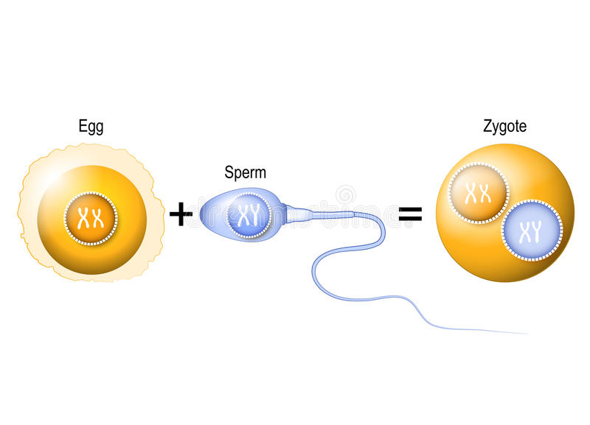
FERTILISATION IN HUMANS
Human fertilization is the union of a Human egg and sperm, usually occurring in the ampulla of the fallopian tube.
The result of this union is the production of a zygote cell.

Slide 5
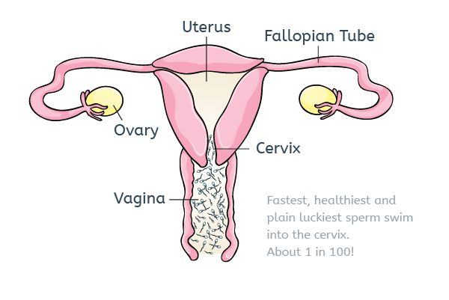
STEPS INVOLVED IN FERTILISATION
The fertilization process in humans takes place in several stages involving both the chemical and physical events.
The different stages of fertilization in humans are mentioned below:
INSEMINATION
MOVEMENT OF SPERMS

Slide 6
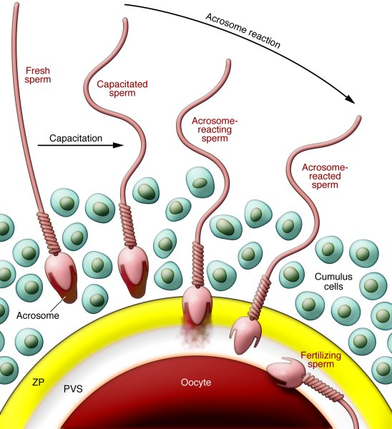
ACROSOMAL REACTION
The sperms capacitation undergo acrosomal reactions and release certain chemicals known as sperm lysins present in the acrosome.
Calcium ions play a significant role in the acrosomal reaction.
The main factors essential for acrosomal reactions - optimum pH, temperature and calcium and magnesium concentration

Slide 7
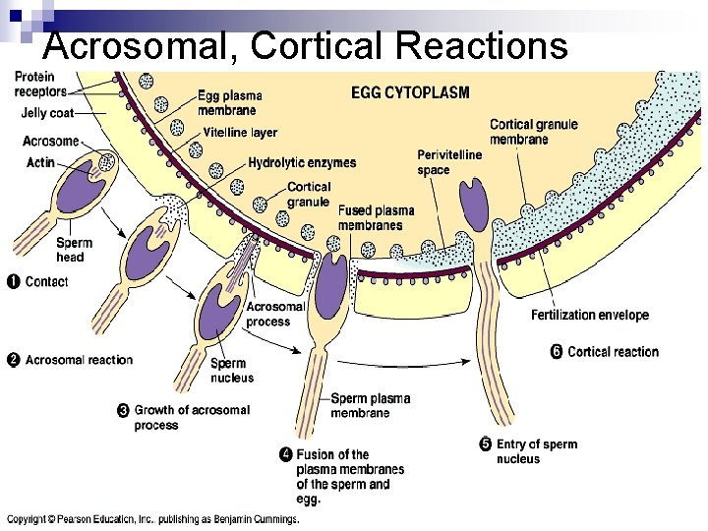
CORTICAL REACTION:
Soon after the fusion of the plasma membranes, the oocyte shows cortical reaction.
Cortical granules found under the plasma membrane of the oocyte.
The zona pellucida is hardened by the cortical enzymes that prevent polyspermy and ensures monospermy.

Slide 8
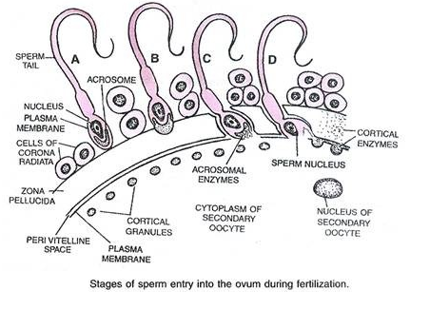
SPERM ENTRY:
A projection known as the cone of reception
is formed by the secondary oocyte. at the point of sperm contact.
This cone of reception receives the sperm.
ACTIVATION OF EGGS:
The entry of sperm triggers the metabolism in the zygote.
Consequently, protein synthesis increases.

Slide 9
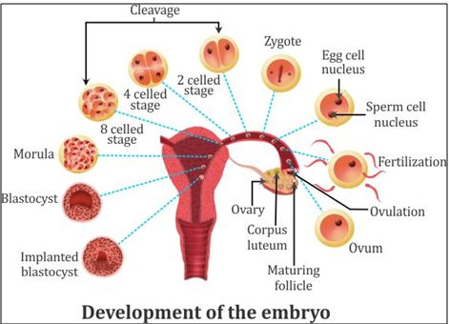
POST FERTILISATION CHANGES
The development of multi-cellular organisms begins from a single-celled zygote, which undergoes rapid cell division.
This is termed cleavage.
Division starts form cleavage to change into 2, 4,8,16 celled blastomeres.

Slide 10
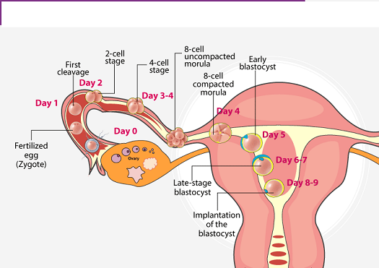
DIAGRAM SHOWING OVULATION,FERTILISATION,CLEAVAGE IMPLANTATION

Slide 11
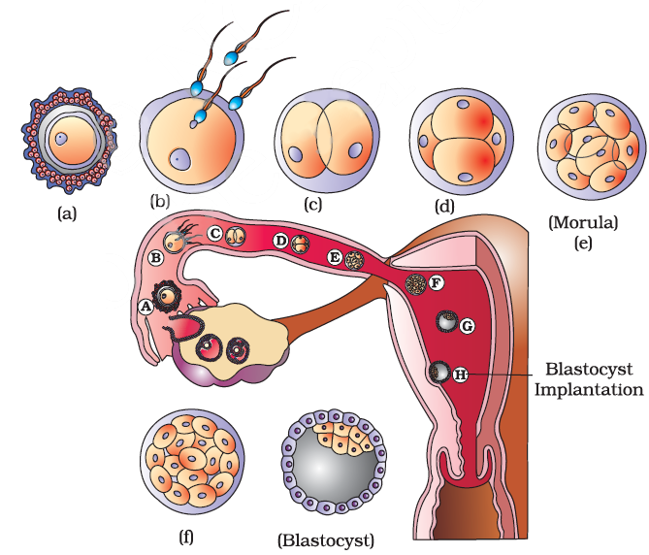
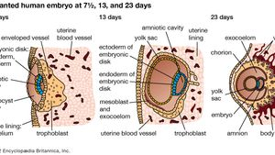
DIAGRAM SHOWING IMPLANTATION OF BLASTOCYST
In humans, implantation is the stage of pregnancy at which the embryo adheres to the wall of the uterus.
After implantation, finger like projections appear on the trophoblast called as chorionic villi.

Slide 13
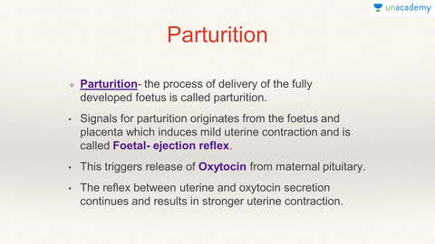
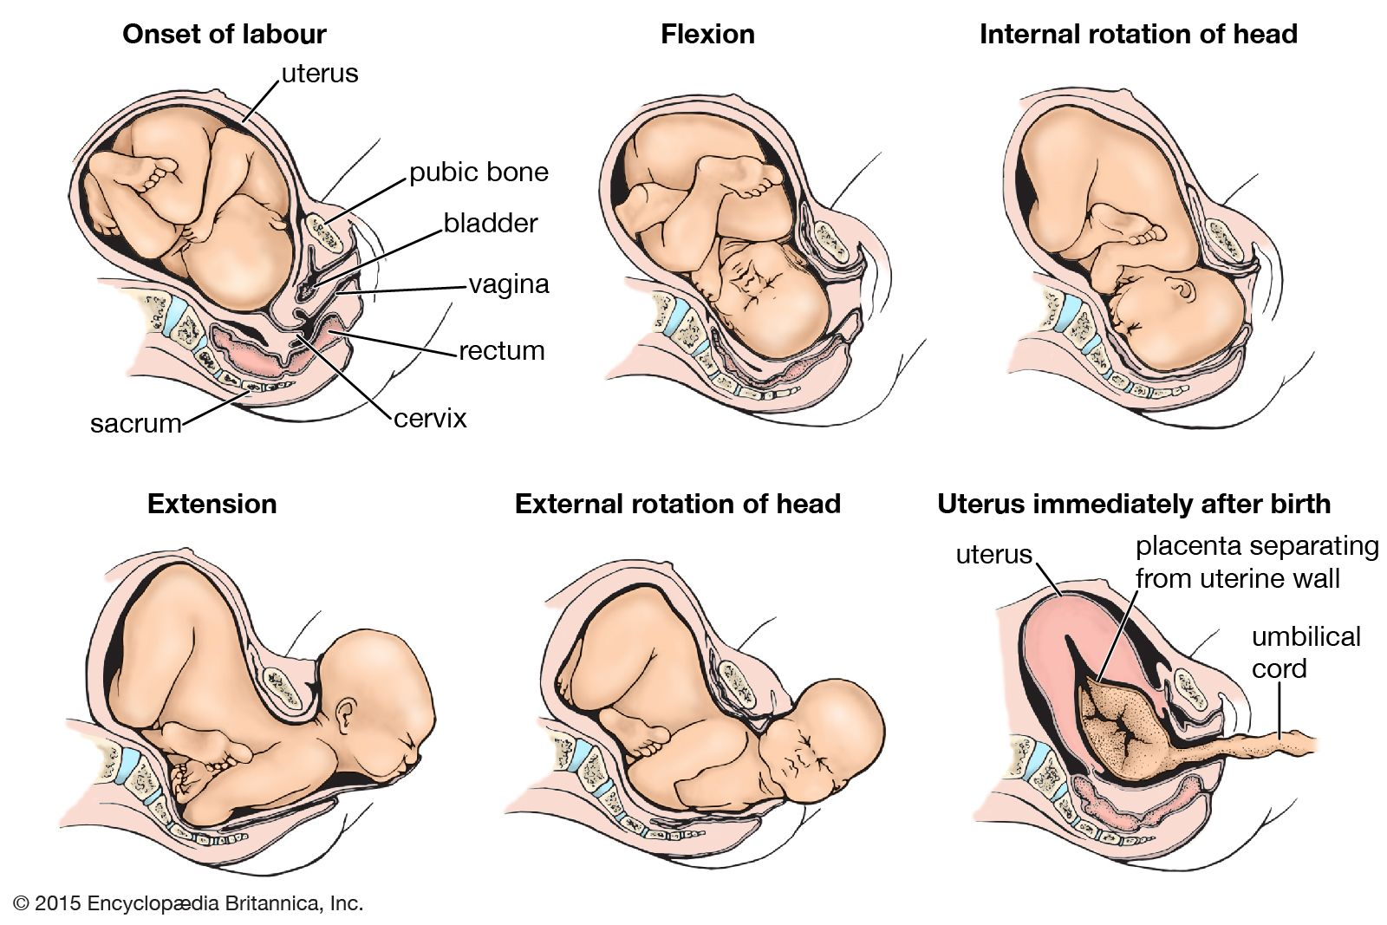

Slide 14

SUMMARY
Insemination
Acromosomal reaction
Cortical reaction
Fertilisation
Implantation
Parturition

Slide 15
HOME ASSIGNMENT
1.Not all copulation leads to pregnancy – Justify.
2.Name the stage of human embryo at which it gets implanted.
3.Enlist the their order of occurrence
4.Differentiate between morula and blastocyst
5. What is trophoblast ?

Slide 16
THANKING YOU
ODM EDUCATIONAL GROUP

