Slide 1


HUMAN REPRODUCTION
MENSTRUAL CYCLE
SUBJECT : BIOLOGY
CHAPTER NUMBER:03
CHAPTER NAME :HUMAN REPRODUCTION

Slide 2
INTRODUCTION
Menstrual cycle is the reproductive cycle in all primates and begins at puberty.
The process of setting in of Menstrual cycle in human females at puberty is called menarche.
The climatic cessation of menstruation is called menopause.
The cycle of events starting from one menstruation till the next one is called the menstrual cycle.
Under normal conditions, in human females, the average length of the menstruation cycle is 28 to 29 days
Phases of menstrual cycle
Menstrual cycle consists of 3 phases:
i) Menstrual phase or bleeding phase
ii) Follicular phase Or proliferative phase
iii) Luteal phase or secretory phase

Slide 3
MENSTRUAL OR BLEEDING PHASE
The cycle starts with the menstrual flow (3 to 5 days), caused due to the breakdown of the endometrial of the uterus.
Blood is discharged, but this occurs only when the ovum is not fertilised.
That means the endometrial secretion, blood and unfertilized ovum constitute menstrual flow.
The titre of ovarian and gonadotropin is low.

Slide 4
FOLLICULAR PHASE OR PROLIFERATIVE PHASE
In this phase, the primary follicles mature into the Graafian follicles. This causes the regeneration of the endometrium.
These changes are brought about by ovarian and pituitary hormones.
In this phase, the release of gonadotropins from pituitary gland (LH and FSH) increases.
This causes follicular growth in the ovaries and the growing follicles produce estrogen from ovaries,which stimulate proliferation of endometrium.
It continues from day 6 to day 13 of menstrual cycle.

Slide 5
OVULATORY PHASE
Both LH and FSH attain a peak level in the middle of cycle (about 14- day).
Rapid secretion of LH (6-10 times high) induces rupturing of Graafian follicles and thereby the release of ovum.
This is called LH surge which causes ovulation.

Slide 6
LUTEAL PHASE OR SECRETORY PHASE
In this phase ruptured Graafian follicle transforms into yellow body called Corpus luteum.
The corpus luteum secretes large amounts of progesterone hormone which maintains the endometrium for implantation of the fertilized ovum.
During pregnancy all events of the menstrual cycle stop and there is no menstruation.
In the absence of fertilization, the corpus luteum degenerates hence causes disintegration of the endometrium leading to menstruation and a new cycle begins

Slide 7
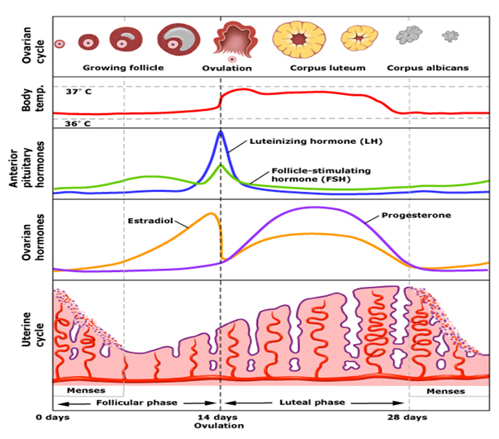
DIAGRAM SHOWING EVENTS OF OF MENSTRUATION

Slide 8
HORMONES INVOLVED IN MENSTRURATION
ROLE OF HORMONES
The same hormones that control female puberty and oogenesis also control the menstrual cycle: Estrogen, LH, and FSH.
Estrogen controls the secretion of the two pituitary hormones by acting on the hypothalamus, which controls the pituitary gland.
When the estrogen level rises in the blood, it stimulates the pituitary (via the hypothalamus) to secrete more or less LH and FSH.

Slide 9
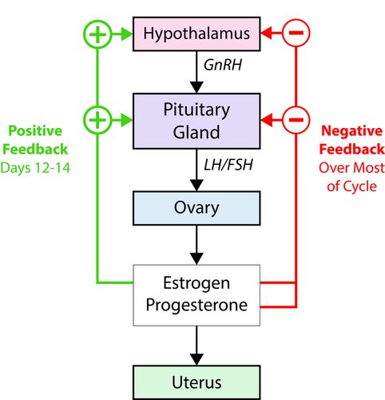
HORMONAL CONTROL OF MENSTRURATION

Slide 10
ROLE OF HORMONES
After menstruation occurs, estrogen secreted by the ovaries increases.
This causes the endometrium of the uterus to thicken.
FSH from the pituitary stimulates follicles in the ovaries to mature.
The maturing follicles produce estrogen, and the level of estrogen in the blood rises.
When estrogen reaches a high level in the blood, it stimulates the pituitary gland to release a surge of LH.
The spike in LH stimulates the one remaining mature follicle to burst open and release its oocyte
In negative feedback, rising levels of hormones feedback to the hypothalamus and pituitary gland to decrease the production of the hormones.
In positive feedback, rising levels of hormones feedback to increase hormone production.
During most of the menstrual cycle, estrogen and progesterone provide negative feedback to the hypothalamus and pituitary gland. This keeps their levels more or less constant.
During days 12–14, however, estrogen provides positive feedback to the hypothalamus and pituitary gland.

Slide 11
ROLE OF HORMONES
This causes a rapid rise in the production of estrogen by the ovaries and leads to ovulation
After the oocyte is released, LH stimulates the mature follicle to develop into a corpus luteum.
The corpus luteum then starts secreting progesterone, which maintains the endometrium of the uterus.
What happens next depends on whether the egg has been fertilized or not.
If the egg has been fertilized, it will soon start producing a hormone that helps maintain the corpus luteum.
As a result, the corpus luteum will continue producing progesterone and maintain the endometrium.
If the egg has not been fertilized, the corpus luteum will disintegrate and stop producing progesterone.
Without progesterone, the endometrium will break down, detach from the uterus, and pass out of the body during menstruation.

Slide 12
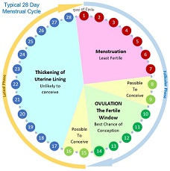
OVERVIEW OF MENSTRUAL CYCLE

Slide 13
THANKING YOU
ODM EDUCATIONAL GROUP

