Slide 1


HUMAN REPRODUCTION
MENSTRUAL CYCLE
SUBJECT : BIOLOGY
CHAPTER NUMBER:03
CHAPTER NAME :HUMAN REPRODUCTION

Slide 2
LECTURE-4
RECAPITULATION
Gametogenesis
Spermatogenesis
Hormonal control of spermatogenesis
Oogenesis
Hormonal control of Oogenesis
Structure of Ovum and Egg MENSTRUAL CYCLE
Menstrual phase
Follicular phase
Luteal phase

Slide 3

LEARNING OUTCOME
Students will able to know about
MENSTRUAL CYCLE Menstrual phase Follicular phase Luteal phase

Slide 4
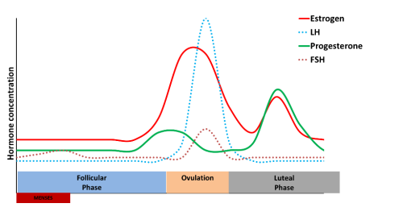
INTRODUCTION
Menstrual cycle is the reproductive cycle in all primates and begins at puberty.
The process of setting in of Menstrual cycle in human females at puberty is called menarche.
Phases of menstrual cycle
Menstrual cycle consists of 3 phases:
i) Menstrual phase or bleeding phase
ii) Follicular phase Or proliferative phase
iii) Luteal phase or secretory phase

Slide 5
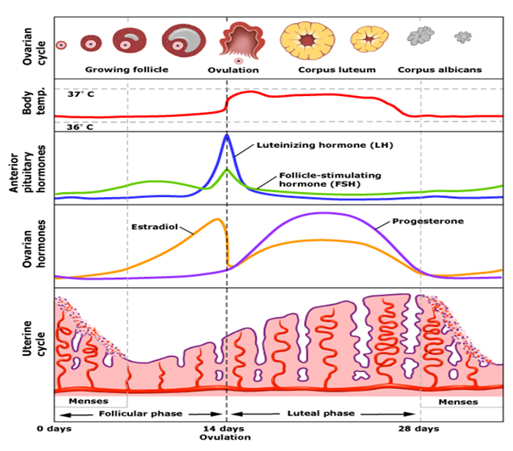
DIAGRAM SHOWING EVENTS OF OF MENSTRUATION

Slide 6
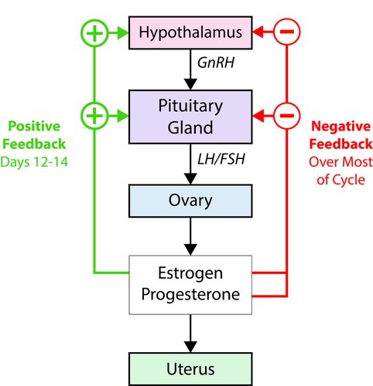
HORMONAL CONTROL OF MENSTRURATION
The same hormones that control female puberty and oogenesis also control the menstrual cycle:
Estrogens
LH
FSH.

Slide 7
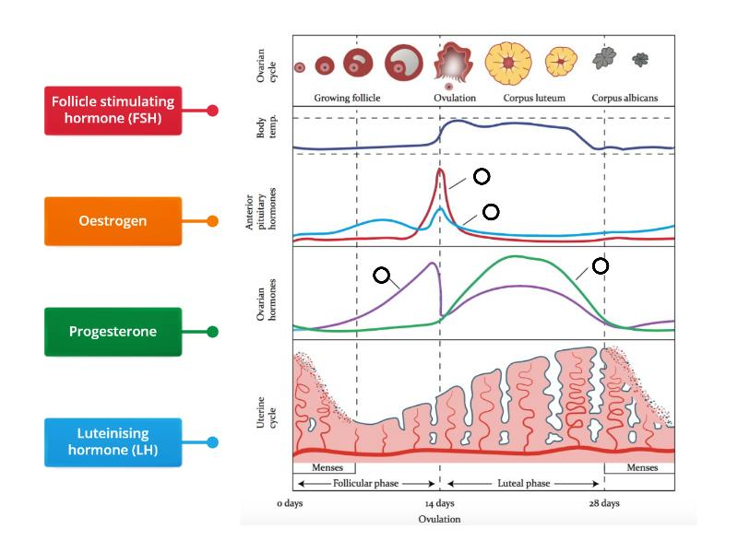

Slide 8
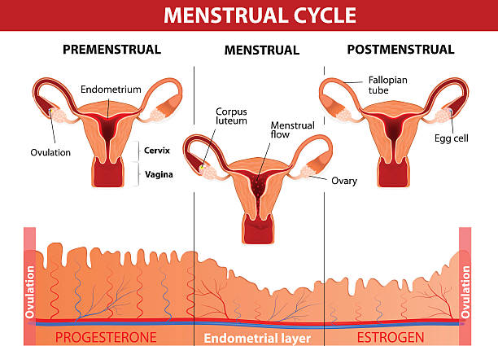
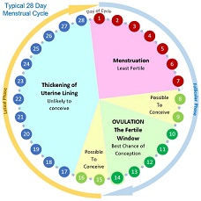
OVERVIEW OF MENSTRUAL CYCLE

Slide 9

SUMMARY
Menstrual phase
Follicular phase
Luteal phase

Slide 10
HOME ASSIGNMENT
1. What is the reason for the absence of menstrual cycle during conception or pregnancy?
2.What is the significance of LH surge through menstrual cycle?
3.State the significance of Menarche and Menopause stages during the lifetime of a female.
4.What are the different stages of the follicular phase of the menstrual cycle taking place in ovary and uterus.

Slide 11
THANKING YOU
ODM EDUCATIONAL GROUP

