Slide 1


HUMAN REPRODUCTION
GAMETOGENESIS
SUBJECT : BIOLOGY
CHAPTER NUMBER:03
CHAPTER NAME :HUMAN REPRODUCTION

Slide 2
GAMETOGENESIS
It is the process of formation of gametes which occurs in gonads.
Gamete are produced from diploid germinal cells (germ cell) accompanied by meiosis.
Gametogenesis includes 3 phases:
Multiplication phase–Germ cells undergo mitosis to increase their number.
Growth phase – They increase their size
Maturation phase – Germ cells undergo meiosis to produce gametes
Gametogenesis is of two types: Spermatogenesis & Oogenesis

Slide 3
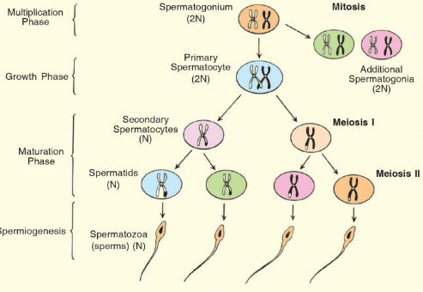
SPERMATOGENESIS
The process of formation of sperm in seminiferous tubule of the testis is called as spermatogenesis.
MULTIPLICATION PHASE: at sexual maturity the germinal cells undergo several mitotic division to produce a large number of sperm mother cell known as spermatogonia (2n).
GROWTH PHASE: Each spermatogonium actively grows to a large primary spermatocyte(2n).
MATURE PHASE: Each primary spermatocyte undergoes meiosis consisting of meiosis-I and meiosis—II.
The primary spermatocyte undergoes meiosis-I to form 2 haploid secondary spermatocytes (n).
Both secondary spermatocytes undergoes meiosis-II to form4 haploid spermatids (n).

Slide 4
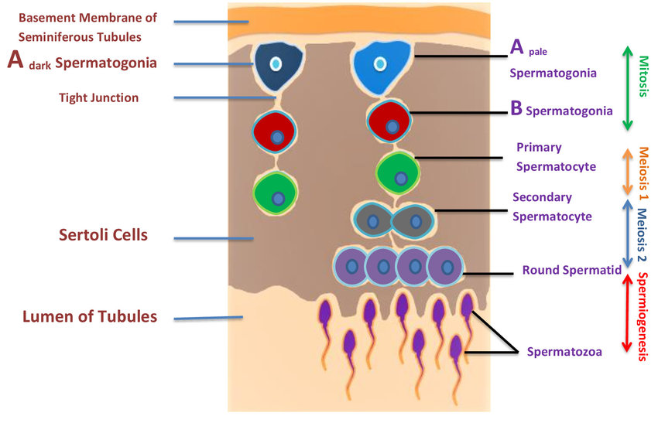
The transformation (change) of spermatides to spermatozoa is called spermiogenesis.
The changes are formation of tail, elongation & condensation of nucleus.
The spermatozoa later on know
as sperms.
SPERMIATION:
After spermiogenesis sperm heads become embedded in the
sertoli cells & are finally releasedfrom seminiferous tubules by the process called spermiation.

Slide 5
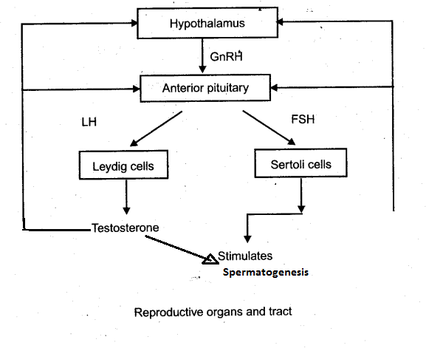
HORMONAL CONTROL OF SPERMATOGENESIS

Slide 6
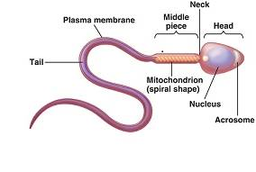
STRUCTURE OF SPERM
It consists of a head, neck, middle piece and a tail.
Plasma membrane covers the whole body of the sperm.
The head portion of the spermcontains a haploid nucleus .
The anterior portion of the head contains an acrosome.
Acrosome: It is a structure that is filled with digestive enzymes (sperm lysin) that help in the dissolving the membrane of the egg cell and help in fertilization of the ovum.
Middle Piece: It contains numerous mitochondria that
produce energy for the movement of the tail.
This is important for the motility of the sperm which is essential for fertilization.
TAIL: It is the longest and vibratile part of the sperm.
During ejaculation 200-300 million sperms are released. At least 60% of them should have normal shape and size and at least 40% should show vigorous motility.
Semen: Semen is a milky white organic fluid released by the penis during ejaculation. It consists of the sperms and the fluids secreted by the accessory ducts and the accessory glands

Slide 7
OOGENESIS
The process of formation of a mature female gamete (ovum) inside ovary is called oogenesis.
MULTIPLICATION PHASE: In the foetal life , certain cells in the germinal epithelium of the ovary of the foetus are larger than others.
These cells divide by mitosis, producing million of egg mother cell (oogonia) in each ovary.
The oogonia multiply by mitotic division forming primary oocyte.
GROWTH PHASE: This phase is very long. Each primary oocyte then gets surrounded by a layer of granulosa cells to form primary follicle.
A large number of these follicles degenerate during the period from birth to puberty and only 60,000-80,000 primary follicles are left as each ovary.
The primary follicles get surrounded by more layers of granulosa cells and a new theca and called secondary follicles.
The secondary follicle soon transforms into a tertiary follicle which is characterized by a fluid filled cavity called antrum.
The theca layer is organized into an inner theca interna and an outer theca externa.

Slide 8
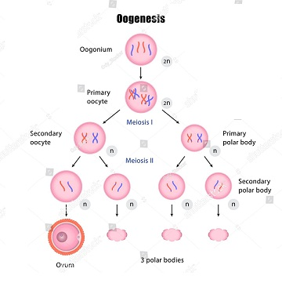
MATURATION PHASE: Each primary oocyte inside tertiary follicle now undergoes meiosis.
In first meiotic division the primary oocyte divides into 2 unequal haploid daughter cells- a large secondary oocyte and a small 1st polar body.
The 1st polar body may divide to form 2 small polar bodies but they never take part in reproduction.
In second meiotic division the secondary oocyte divides unequally to produce a large ootid and a small 2nd polar body.
The ootid further grows into mature ovum and the polar bodies degenerate.
The tertiary follicle further changes into the mature follicle or Graafian follicle.
The Graafian follicle now ruptures to release the secondary oocyte (ovum) from the ovary by the process called ovulation .

Slide 9
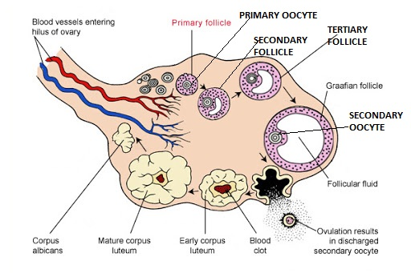
DIAGRAMATIC SECTION VIEW OF OVARY

Slide 10
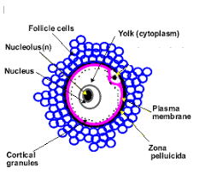
STRUCTURE OF OVUM
It is a non motile female gamete.
It is covered by plasma membrane and is rich in ooplasm.
In the outer region ooplasm
contains cortical granules.
It’s nucleus is large.
Ovum is covered with a non cellular zona pellucida
(glycoprotein)& a multicellular corona radiata

Slide 11
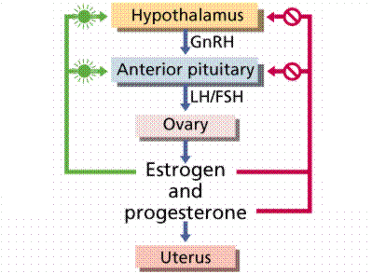
HORMONAL CONTROL OF OOGENESIS

Slide 12
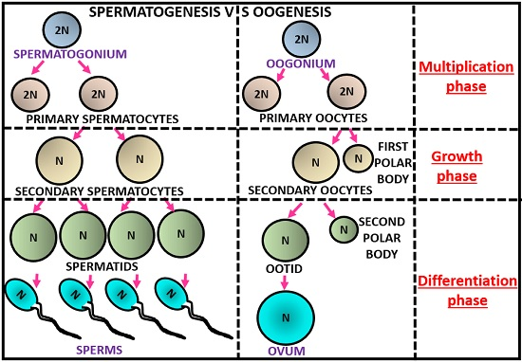
COMPARISION : SPERMATOGENESIS & OOGENESIS

Slide 13
THANKING YOU
ODM EDUCATIONAL GROUP

