Slide 1


HUMAN REPRODUCTION
FEMALE REPRODUCTIVE SYSTEM
SUBJECT : BIOLOGY
CHAPTER NUMBER:03
CHAPTER NAME :HUMAN REPRODUCTION

Slide 2

LECTURE-2
RECAPITULATION
Sexual dimorphism
Primary sex organ
Secondary sex organ
External genetilia
FEMALE REPRODUCTIVE ORGAN
Ovaries
Fallopian tube
Uterus
Vagina

Slide 3
LEARNING OUTCOME
Students will come to know about
Sexual Dimorphism
Female reproductive system
Primary sex organ (Ovaries)
Accessory ducts (Fallopian tube
Accessory glands
External genetelia

Slide 4
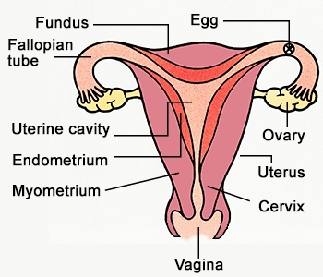
FEMALE REPRODUCTIVE SYSTEM
The female reproductive system is located in the pelvis region.
The system also include
primary sex organs
accessory ducts, glands
external genitalia.

Slide 5
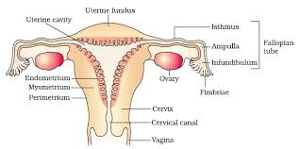
FEMALE REPRODUCTIVE SYSTEM

Slide 6
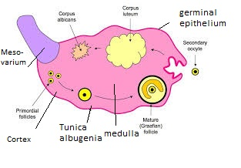
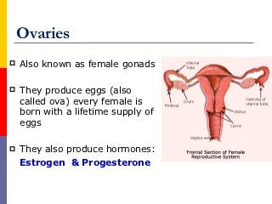
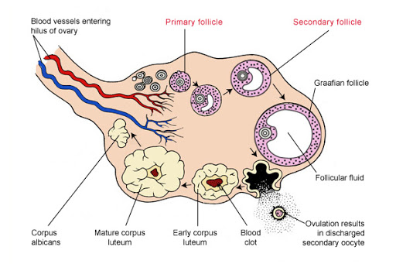
PRIMARY SEX ORGAN-OVARIES

Slide 7
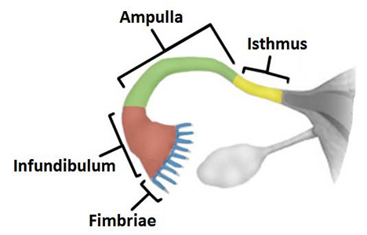
ACCESSORY DUCTS:OVIDUCTS(FALLOPIAN TUBULES)
It has following parts:
Infundibulum
Ampulla
Isthmus
Uterine part

Slide 8
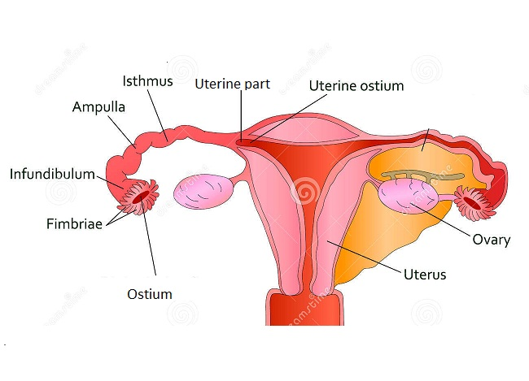
DIAGRAM SHOWING FALLOPIAN TUBULE

Slide 9
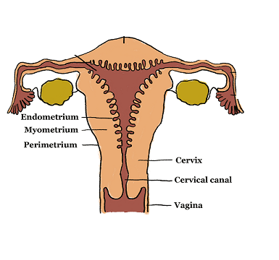
DIAGRAM SHOWING UTERUS, CERVIX, VAGINA
It is an inverted pear shaped large distensible part which anchors and nourishes developing foetus
The wall of the uterus has 3 layers
Perimetrium,
Myometrium Endometrial

Slide 10
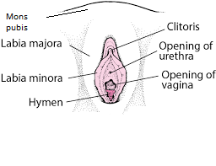
EXTERNAL GENITALIA
The female external genitalia include :
Mons pubis
Labia majora
Labia minora
Hymen and clitoris .
.

Slide 11
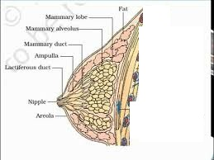
ACCESSORY GLAND: MAMMARY GLAND:
A functional mammary gland is characteristic of all female mammals.
It consists of-
Mammary lobes
Mammary ducts
Alveoli
Lactiferous ducts

Slide 12

SUMMARY
Sexual Dimorphism
Female reproductive system
Primary sex organ (Ovaries)
Accessory ducts (Fallopian tube)
Accessory glands
External genetelia

Slide 13
HOME ASSIGNMENT
1.Discuss the parts of female primary sex organ in human.
2.Describe the oviducts or fallopian tubes.
3.Mention two primary role of ovaries.
4.Where is ovary located in human female
5.What is the role of Fimbriae at the end of Infundibulum ?
6.Write the three layers of tissue present in uterus wall.

Slide 14
THANKING YOU
ODM EDUCATIONAL GROUP

