Slide 1


HUMAN REPRODUCTION
MALE REPRODUCTIVE SYSTEM
SUBJECT : BIOLOGY
CHAPTER NUMBER:03
CHAPTER NAME :HUMAN REPRODUCTION

Slide 2
INTRODUCTION
SEXUAL DIMORPHISM:
When male and female individuals are differentiated externally, the phenomenon is called sexual dimorphism.
Human beings show sexual dimorphism and the characters which distinguish the males from females externally are known as secondary sex characters.
MAJOR REPRODUCTIVE EVENTS:
Gametogenesis Implantation
Insemination Placentation.
Fertilization Parturition
Cleavage lactation

Slide 3
PUBERTY
It is the period when primary sex organ become functional and start secreting sex hormones which bring about development of secondary sex organs and appearance of secondary sex characters.
Hence sexual maturity is attained.
In male period of puberty is 13-16 years and changes include enlargement of testis, scrotum.
It also include development of beard, moustaches, growth of larynx and many more.

Slide 4
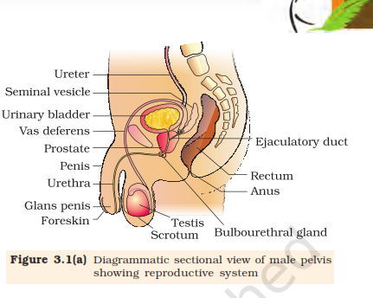
MALE REPRODUCTIVE SYSTEM
The male reproductive system is located in the pelvis region.
It includes a pair of testes which are primary sex organs in human males.
The system also include accessory ducts, glands and the external genitalia.
They are accessory sex organs.
Accessory ducts are rete testis, vasa efferentia, vasa deferentia, ejaculatory duct and urethra.
Seminal vesicle, prostate and cowper’s glands are accessory glands.
Penis is the external
genitalia.

Slide 5
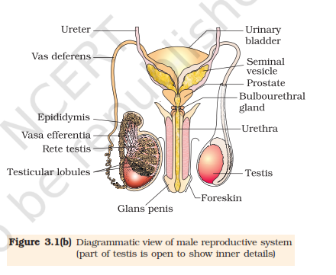
DIAGRAM SHOWING MALE REPRODUCTIVE SYSTEM

Slide 6
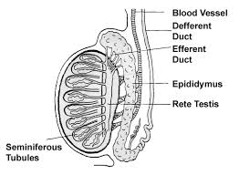
PRIMARY SEX ORGAN-TESTIS
The testes are situated outside the abdominal cavity within a pouch called scrotum.
The scrotum helps in maintaining the low temperature of the testes (2–2.5º C lower than the normal internal body temperature) necessary for spermatogenesis.
In adults, each testis is oval in shape, with a length of about 4 to 5 cm and a width of about 2 to 3 cm. The testis is covered by a dense covering (Tunica albugenia) .
Each testis has about 250 compartments called testicular lobules.
Each lobule contains one to three highly coiled seminiferous tubules in which sperms are produced

Slide 7
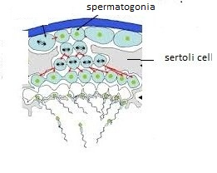
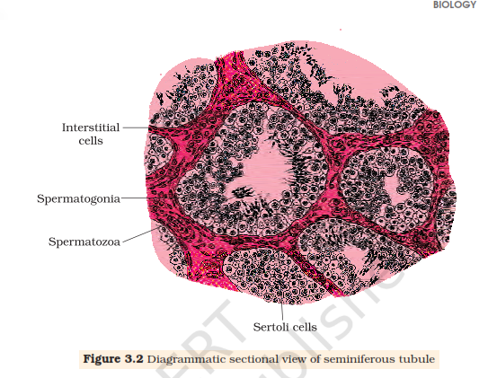
SEMINIFEROUS TUBULE
Each seminiferous tubule is lined on its inside by two types of cells called male germ cells (spermatogonia) and Sertoli cells.
The male germ cells undergo meiotic
divisions finally leading to sperm
formation, while Sertoli cells
provide nutrition to the germ cells.
The regions outside the seminiferous tubules called
interstitial spaces, contain small blood vessels and interstitial cells or Leydig cells.
Leydig cells synthesise and secrete testicular hormones called androgens.
Other immunologicallycompetent cells are also present.
Interstitial cell

Slide 8
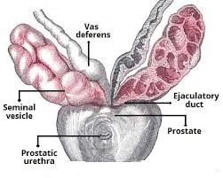
ACCESSORY DUCTS
The seminiferous tubules of the testis open into the vasa efferentia through rete testis.
The vasa efferentia leave the testis and open into
epididymis located along the posterior surface
of each testis.
The epididymis leads to vas deferens that ascends
to the abdomen and loops over the urinary bladder.
Vas deferens receives a duct from seminal vesicle and opens into urethra as the ejaculatory duct.
These ducts store and transport the sperms from the testis to the outside through urethra.
The urethra originates from the urinary bladder and extends through the penis to its external opening called urethral meatus.

Slide 9
ACCESSORY GLANDS
The male accessory glands include paired seminal
vesicles, a prostate and paired bulbourethral glands.
Secretions of seminal vesicle constitute the seminal plasma which is rich in fructose, fibrinogen and proteins. Seminal fluid activates sperm.
Secretions of prostate gland is milky and alkaline which constitute calcium, phosphate and certain enzymes.
The secretions of bulbourethral glands are alkaline and is rich in mucus which helps in the lubrication of the penis.

Slide 10
EXTERNAL GENITALIA
The penis is the male external genitalia.
It is made up of special tissue (corpora cavernosa and corpora spongiosum).
This helps in erection of the penis to facilitate insemination.
The enlarged end of penis called the glans penis is covered by a loose fold of skin called foreskin.

Slide 11
THANKING YOU
ODM EDUCATIONAL GROUP

