Slide 1


HUMAN REPRODUCTION
MALE REPRODUCTIVE SYSTEM
SUBJECT : BIOLOGY
CHAPTER NUMBER:03
CHAPTER NAME :HUMAN REPRODUCTION

Slide 2
LECTURE-1
RECAPITULATION
REPRODUCTION
TYPES OF REPRODUCTION
STEPS OF REPRODUCTION
HUMAN REPRODUCTION
MALE REPRODUCTIVE SYSTEM
PRIMARY SEX ORGAN
ACCESSORY DUCTS
ACCESSORY GLANDS
EXTERNAL GENITILIA

Slide 3
LEARNING OUTCOME
Students will able to know about
Sexual Dimorphism
Male reproductive system
Primary sex organ
Accessory ducts
Accessory glands
External genitilia

Slide 4
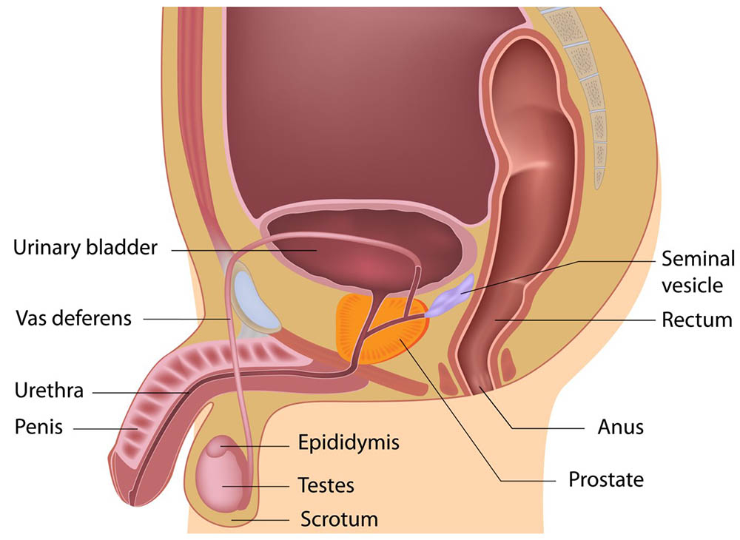
MALE REPRODUCTIVE SYSTEM
KEY POINTS
TESTES
ACCESSORY DUCTS
ACCESSORY GLANDS
EXTERNAL GENITALIA

Slide 5
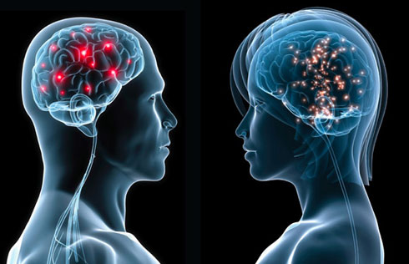
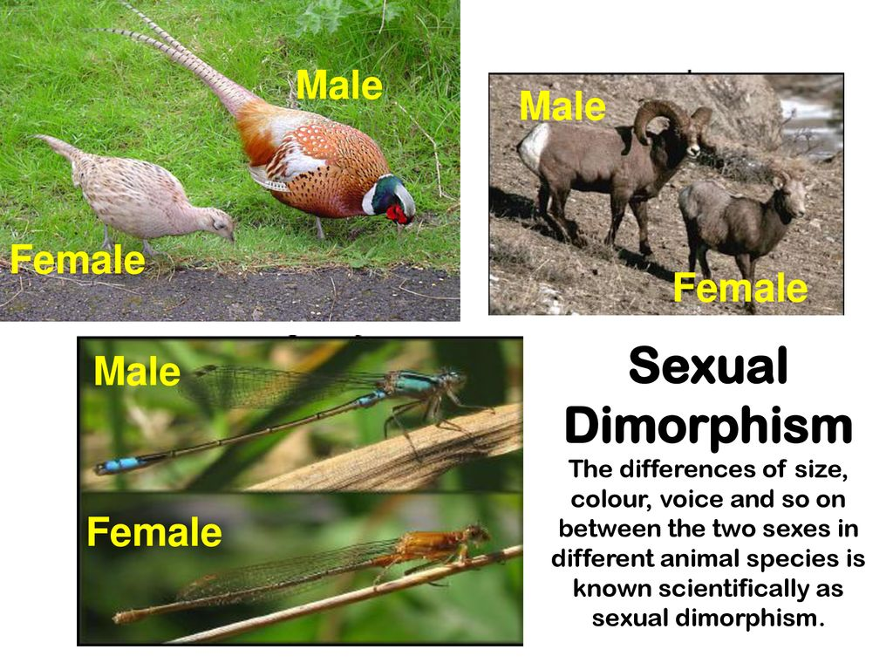
INTRODUCTION
SEXUAL DIMORPHISM

Slide 6

PUBERTY
1.In male period of puberty is 13-16 years and changes include enlargement of testis, scrotum.
2.It also include development of beard, moustaches, growth of larynx and many more.

Slide 7
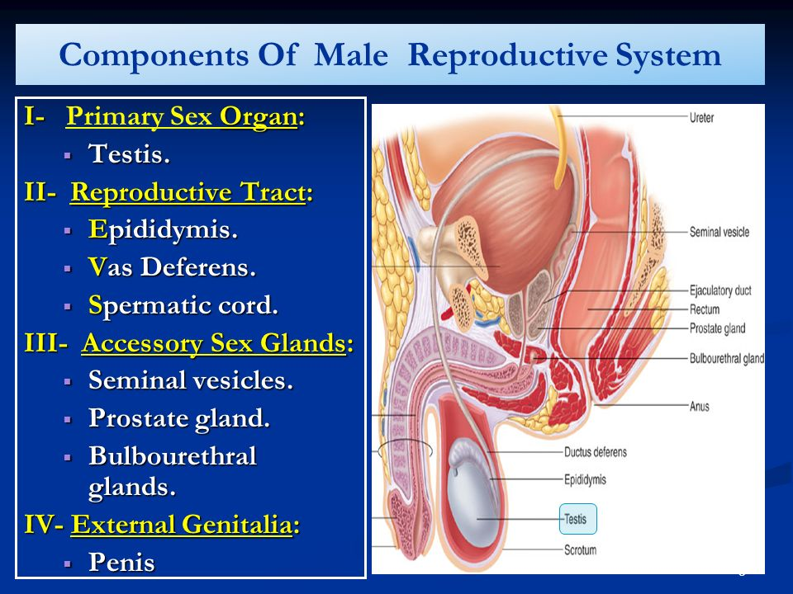

Slide 8
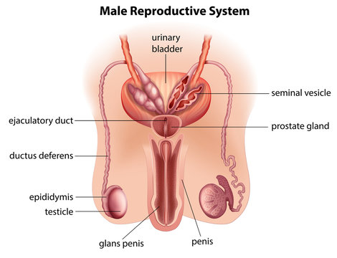
MALE REPRODUCTIVE SYSTEM
It includes a pair of testes which are primary sex organs in human males.
Accessory ducts are: rete testis, vasa efferentia, vasa deferentia, ejaculatory duct and urethra.
Accessory glands: Seminal vesicle, prostate and Cowper's glands.
Eternal genetelia: penis

Slide 9
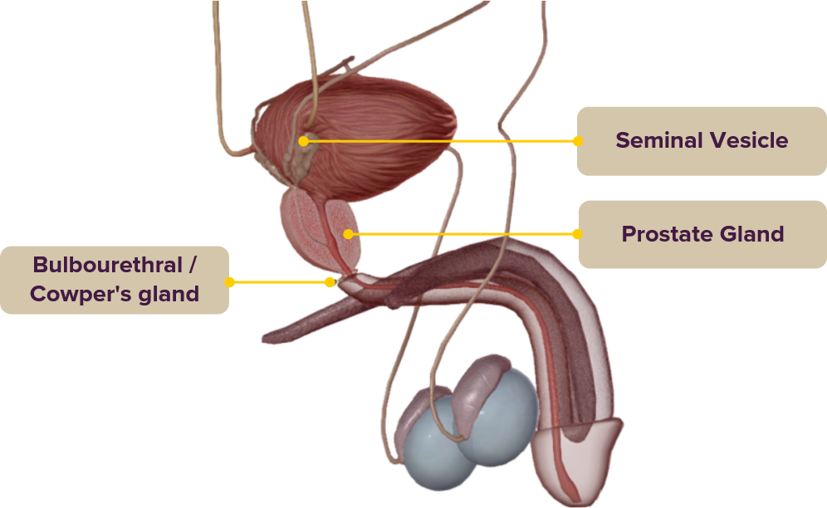
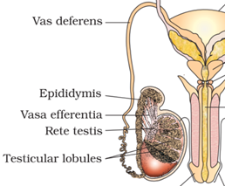
Accessory glands
Accessory ducts

Slide 10
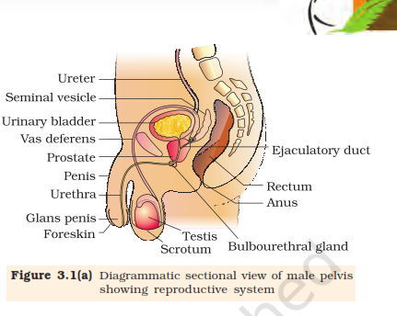

Slide 11
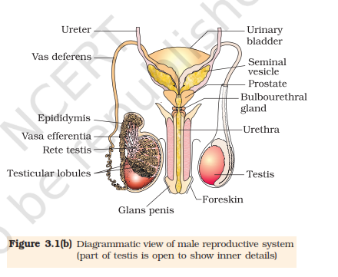
MALE REPRODUCTIVE SYSTEM

Slide 12
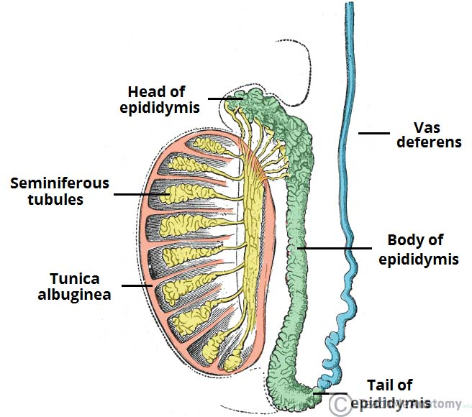
PRIMARY SEX ORGAN-TESTIS
The testes are situated outside the abdominal cavity within a pouch called scrotum.
Each testis has about 250 compartments called testicular lobules.
Each lobule contains one to three highly coiled seminiferous tubules in which sperms are produced

Slide 13
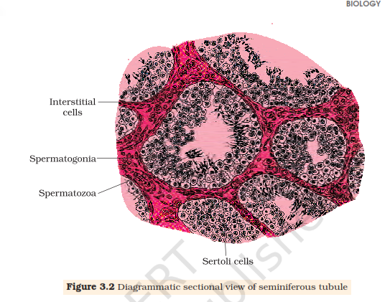
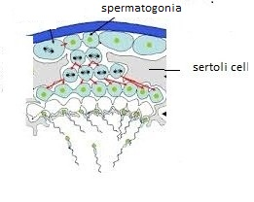
SEMINIFEROUS TUBULE
Each seminiferous tubule is lined on its inside by two types of cells called male germ cells (spermatogonia) and Sertoli cells.
The regions outside the seminiferous tubules called
interstitial spaces, contain small blood vessels and interstitial cells or Leydig cells.

Slide 14
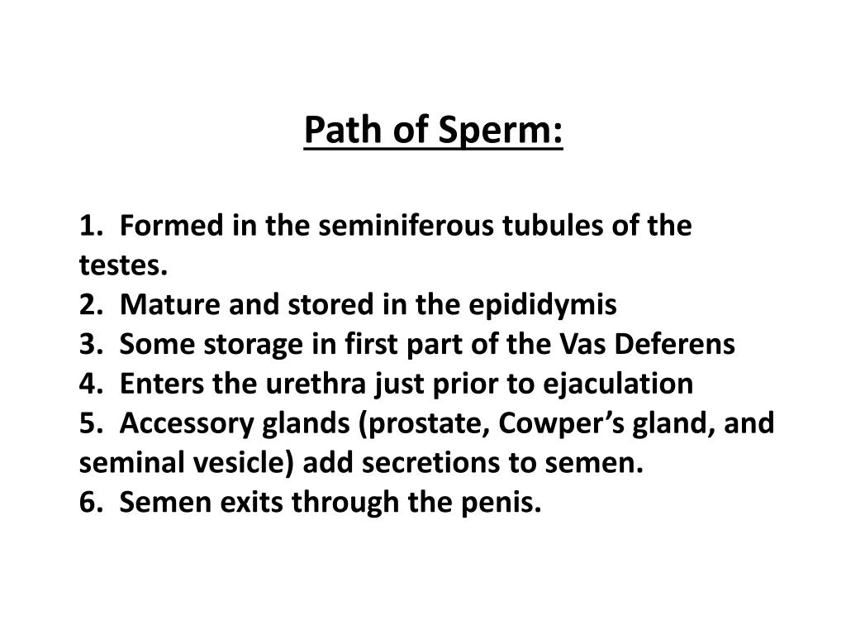
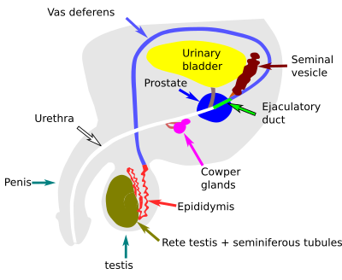
ACCESSORY DUCTS
.

Slide 15
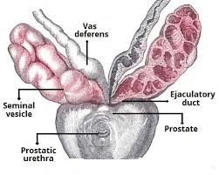
ACCESSORY GLANDS
The male accessory glands include
paired seminal vesicles
a prostate
and paired bulbourethral glands.

Slide 16
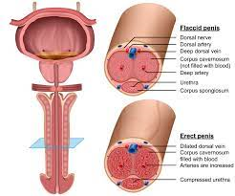
EXTERNAL GENITALIA

Slide 17

SUMMARY
MALE REPRODUCTIVE SYSTEM
PRIMARY SEX ORGAN
ACCESSORY DUCTS
ACCESSORY GLANDS
EXTERNAL GENITILIA

Slide 18
HOME ASSIGNMENT
1.Discuss the parts of human male reproductive system.
2.Describe the structure and human functions of the parts of primary sex organ i.e. testes.
3.Why are human testes located outside the abdominal cavity ?
4. How many lobules are present in testes ?
5. What are the two types of cells found in seminiferous tubules.
6.Name the hormone secreted by the Leydig cells.

Slide 19
THANKING YOU
ODM EDUCATIONAL GROUP

