Slide 1


Relation of drift velocity, mobility with electric current
CLASS-XII
SUBJECT : PHYSICS
CHAPTER NUMBER: 03
CHAPTER NAME : CURRENT ELECTRICITY

Slide 2
LEARNING OUTCOME
After this lesson, students will be able:
To derive relationship between drift velocity and mobility.
To state the mathematical definition of current density.
To use an understanding of the convention for electric field direction to identify the electric field direction around a source charge.
To derive relationship of Mobility in terms of relaxation time
To derive relationship between Mobility and conductivity.

Slide 3
REVIEW
What is a drift velocity?
Are the paths of electrons straight lines between successive collisions (with positive ions of the metal) in the
(i) Absence of electric field
(ii) Presence of electric field.
3. How does drift velocity depend upon temperature?
4. How is drift velocity related to current?

Slide 4
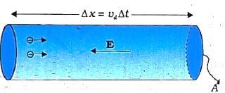

THE RELATION BETWEEN ELECTRIC CURRENT AND DRIFT VELOCITY :
Hence current through the conductor is
$$I=\frac{Δq}{Δt}=\frac{nA(Δx)e}{Δx/v_{d}}=nAv_{d}e⇒I=nAv_{d}e$$

Slide 5

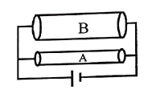
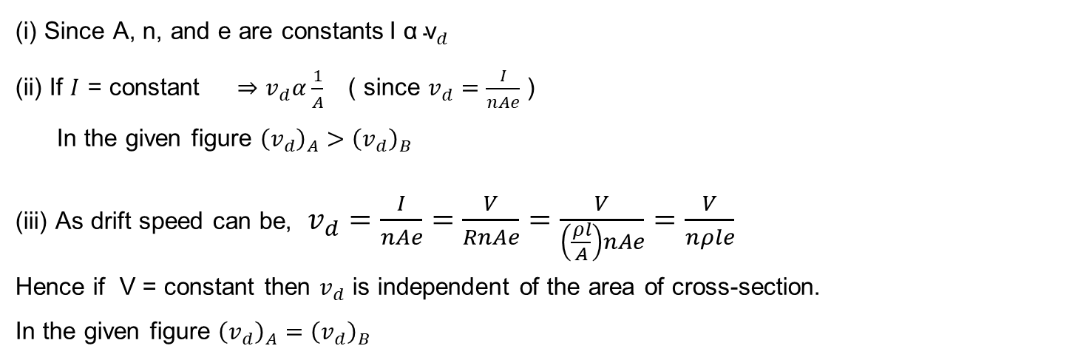
NOTE
(i) Since A, n, and e are constants$\text{I} \text{α} {\text{v}}_{d}$
(ii) If $I$ = constant $⇒$ $v_{d}α\frac{1}{A}$ ( since $v_{d}=\frac{I}{nAe}$ )
In the given figure ${\left(v_{d}\right)}_{A}>{\left(v_{d}\right)}_{B}$
(iii) As drift speed can be, $v_{d}=\frac{I}{nAe}=\frac{V}{RnAe}=\frac{V}{\left(\frac{ρl}{A}\right)nAe}=\frac{V}{nρle}$
Hence if V = constant then $v_{d}$ is independent of the area of cross-section.
In the given figure ${\left(v_{d}\right)}_{A}={\left(v_{d}\right)}_{B}$

Slide 6
Numerical
Question: For two nichrome wires connected in series with a battery, how does the ratio of drift velocities of electrons in them depend on their (i) lengths (ii) diameters.

Slide 7
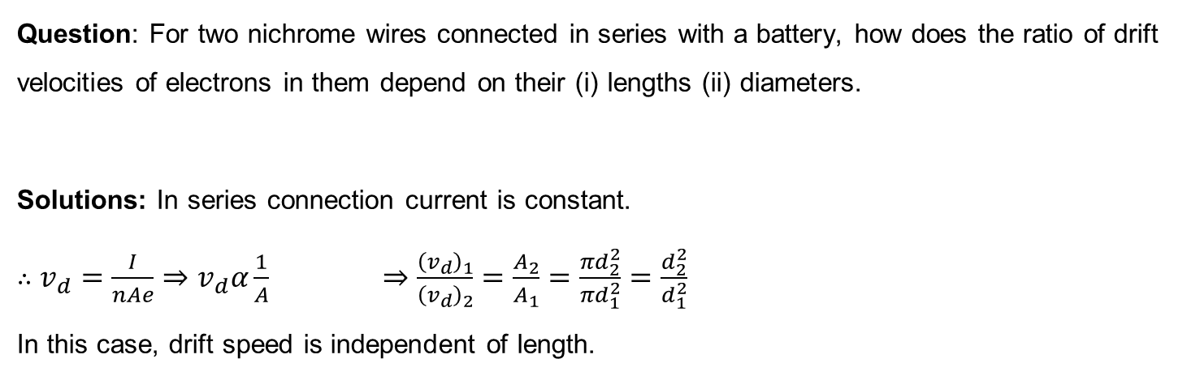
Numerical
Question: For two nichrome wires connected in series with a battery, how does the ratio of drift velocities of electrons in them depend on their (i) lengths (ii) diameters.
Solutions: In series connection current is constant.
$∴$ $v_{d}=\frac{I}{nAe}⇒v_{d}α\frac{1}{A}$ $⇒\frac{{\left(v_{d}\right)}_{1}}{{\left(v_{d}\right)}_{2}}=\frac{A_{2}}{A_{1}}=\frac{πd_{2}^{2}}{πd_{1}^{2}}=\frac{d_{2}^{2}}{d_{1}^{2}}$
In this case, drift speed is independent of length.

Slide 8
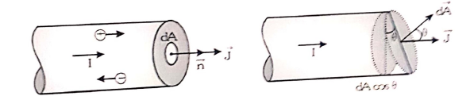
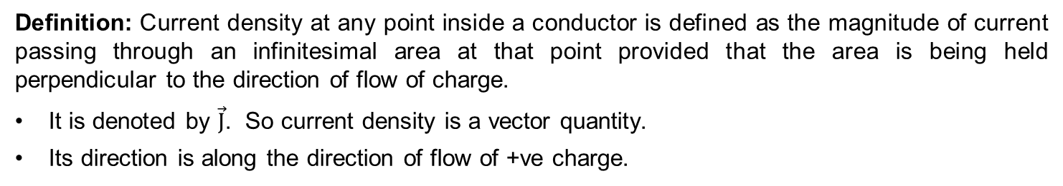
Current Density ($\vec{J}$)
Definition: Current density at any point inside a conductor is defined as the magnitude of current passing through an infinitesimal area at that point provided that the area is being held perpendicular to the direction of flow of charge.
It is denoted by $\vec{J}$. So current density is a vector quantity.
Its direction is along the direction of flow of +ve charge.

Slide 9
Numerical
Question: A steady current of 2 A flows through a conductor of the uniform circular cross-section of radius 2mm. Find
(i) The current density at any point inside the conductor
(ii) Total number of free electrons crossing a cross-section in 5 minutes.

Slide 10
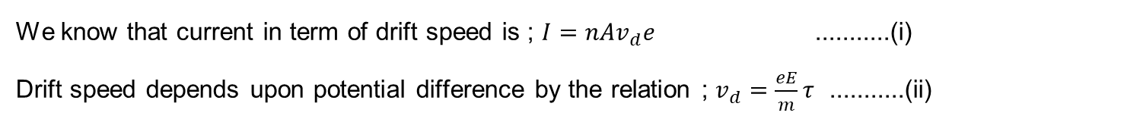
Expression for conductivity in term of average relaxation time
We know that current in term of drift speed is ; $I=nAv_{d}e$ ...........(i)
Drift speed depends upon potential difference by the relation ; $v_{d}=\frac{eE}{m}τ$ ...........(ii)

Slide 11
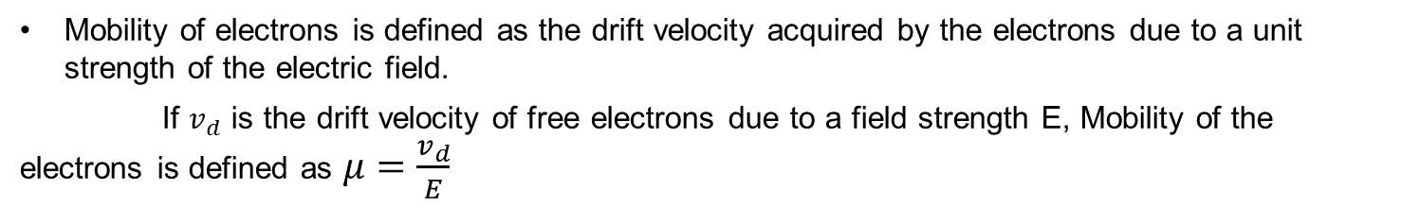

Mobility
Mobility of electrons is defined as the drift velocity acquired by the electrons due to a unit strength of the electric field.
If $v_{d}$ is the drift velocity of free electrons due to a field strength E, Mobility of the electrons is defined as $μ=\frac{v_{d}}{E}$
Mobility in terms of relaxation time
As $μ=\frac{v_{d}}{E}$ $⇒μ=\frac{eEτ}{mE}=e\frac{τ}{m}$ ( As $v_{d}=\frac{\text{eE}τ}{m}$ )
Relation between conductivity and mobility
$$σ=neμ$$

Slide 12
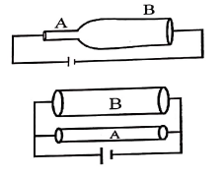
Numerical
Question: In the given figures between the points A and B
(i) where drift velocity is high
(ii) where current is high
(iii) where the current density is high.
Explain the cause.

Slide 13
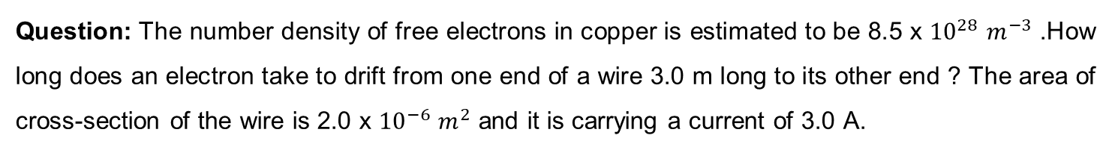
Numerical
Question: The number density of free electrons in copper is estimated to be 8.5 x ${10}^{28}$ $m^{−3}$ .How long does an electron take to drift from one end of a wire 3.0 m long to its other end ? The area of cross-section of the wire is 2.0 x ${10}^{−6}$ $m^{2}$ and it is carrying a current of 3.0 A.

Slide 14
HOME ASSIGNMENT
Using the concept of drift velocity of charge carriers in a conductor, deduce the relationship between current density and resistivity of the conductor.
Define mobility of a charger carrier. Write the relation expression mobility in terms of relaxation time. Give its SI unit.
3. Answer the following.
Derive an expression for drift velocity of electrons in a conductor. Hence, deduce Ohm’s law.
A wire whose cross-sectional area is increasing linearly from its one end to the other, is connected across a battery of V volts. Which of the following quantities remain constant in the wire?
Drift speed
Current density
Electric current
Electric field
Justify your answer.

Slide 15
THANKING YOU
ODM EDUCATIONAL GROUP

