Slide 1


SEXUAL REPRODUCTION IN FLOWERING PLANTS
FRUIT AND SEEDS
SUBJECT :BIOLOGY
CHAPTER NUMBER:02
CHAPTER NAME :SEXUAL REPRODUCTION IN FLOWERING PLANTS

Slide 2
LEARNING OUTCOME
Students will be able to know about the structure of seed.
Students will be familiar with the terms like albuminous, non-albuminous, perisperm, endosperm, seed viability and parthenogenesis.
They can differentiate between: albuminous and non-albuminous seeds, perisperm, and endosperm.
They will have basic ideas about seed dormancy and viability.
They will learn about the structure and importance of fruit.
Students can recognize and differentiate between true and false fruit.

Slide 3
LECTURE- 6

Slide 4
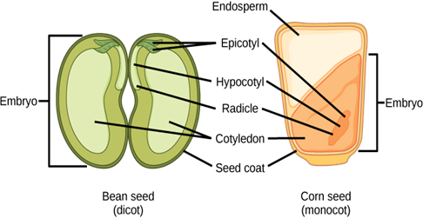
SEEDS
SEEDS: a fertilized ovule.
STRUCTURE OF A SEED: A seed typically consists of seed coat(s), cotyledon(s) and an embryo axis.
The cotyledons of the embryo are simple structures, thick and swollen due to storage of food reserves (as in legumes).

Slide 5
MATURE SEEDS
ALBUMINOUS SEEDS
NON ALBUMINOUS SEEDS
Seed which retain a part of endosperm are called albuminous seeds.
Endosperm is not completely used up during embryo development.
e.g. wheat, maize, Sunflower
Seeds with no residual endosperm are called non-albuminous seeds.
It is completely consumed during embryo development in these seeds.
e.g. pea, groundnut, etc.

Slide 6
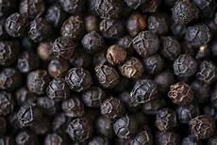
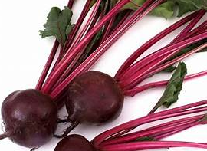
PERISPERM
In some seeds, remnants of nucellus are also persistent, e.g. black pepper and beet. This residual, persistent nucellus is the perisperm.
PEPPER
BEET

Slide 7
PERISPERM AND ENDOSPERM
PERISPERM | ENDOSPERM
It represents persistent remains of nucleus | It develops from PEN
It is a part of a seed | It contains reserve food materials
It is usually dry | It is usually in fluid form or soft
Example- black pepper | Example; water of coconut

Slide 8
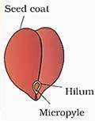
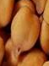
SEED COAT AND MICROPYLE
Seed Coat: Integuments of ovules harden as tough protective seed coats (testa and tegmen).
The micropyle remains as a small pore in the seed coat which facilitates entry of oxygen and water into the seed during germination.
Micropyle
Gram seed

Slide 9
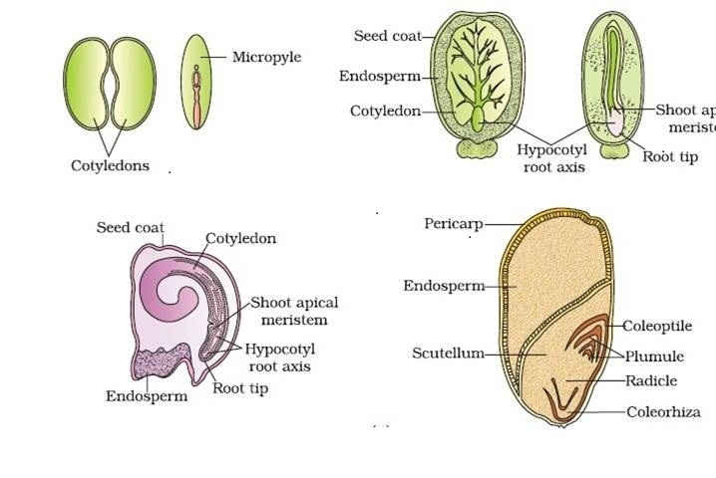
STRUCTURES OF SOME SEEDS
CASTOR SEED
BEAN SEED
MAIZE SEED

Slide 10
SEED DORMANCY
            As the seed matures, its water content is reduced and seeds become relatively dry (10-15 per cent moisture by mass).
The general metabolic activity of the embryo slows down. The embryo may enter a state of inactivity called dormancy.
When favorable conditions are available (adequate moisture, oxygen and suitable temperature), they germinate .
The micropyle (small pore) facilitates entry of oxygen and water into the seed during germination.

Slide 11
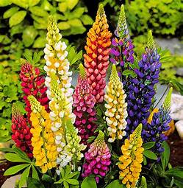
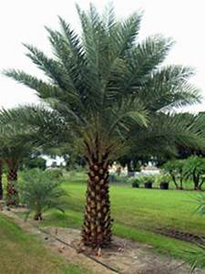
SEED VIABILITY
The ability of seeds to retain the power of germination over a period of time is called viability of seeds.
RECORDS OF VERY OLD VIAVLE SEEDS
The oldest is that of a lupine (Lupinus arcticus) excavated from Arctic tundra.
The seed germinated and flowered after an estimated period of I0,000 years of dormancy.
2000 years old viable seed is of the date palm( Phoenix dactlifera ).
Lupinus arcticus
Phoenix dactlifera
This was discovered during the archeological excavation at King Herod's palace near the Dead Sea.

Slide 12
ADVANTAGES OF SEEDS
Seed production is more dependable because reproductive processes in flowering plants are independent of water.
They have better adaptive strategies for dispersal Seeds have enough food reserves which helps young seedlings to get nourishment.
Dehydration and dormancy of mature seeds are crucial for storage of seeds. Thus, seeds can be used as food throughout the year.

Slide 13
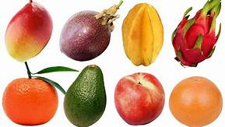
ADVANTAGES OF FRUITS
Fruits are juicy, pulpy, colored, aromatic structure that encloses seeds.
It develops from a ripend ovary.
They are a rich source of vitamin, minerals and fibers. They are the main source of a balanced diet.

Slide 14
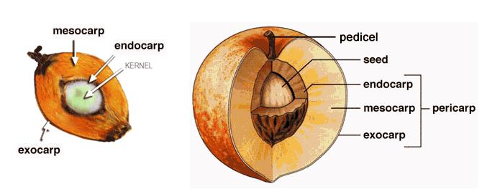
PARTS OF FRUIT
A fruit comprises the following parts:
Pericarp Seeds

Slide 15
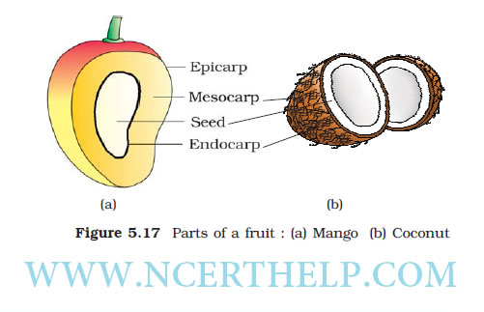
PERICARP
The pericarp : the fruit wall.
Epicarp: Outermost layer, forms the peel.
Mesocarp: Middle layer, fleshy, edible portion of the fruits.
Endocarp: Innermost layer where the seed is
accommodated.

Slide 16
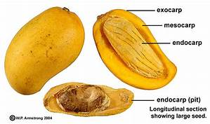
TRUE FRUIT
In some plants, the fruit may be formed from the ovary and the other floral parts persist only as withered remains.
This when happens, the fruits are described as true fruits.
Examples include the tomato, orange, melon,banana,mango.

Slide 17
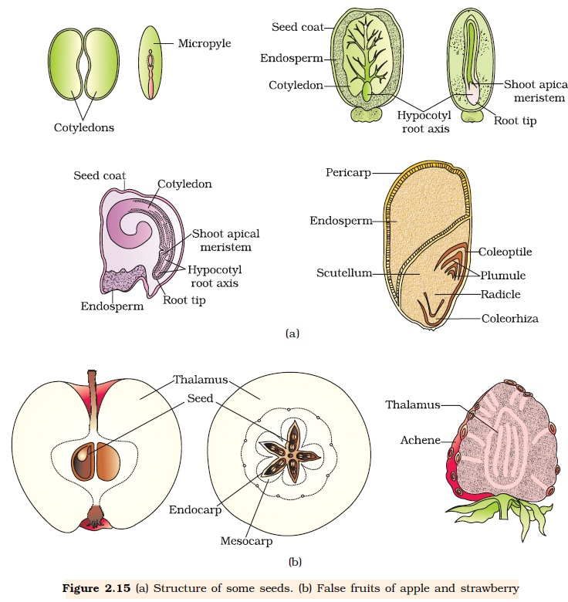
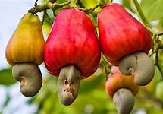
FALSE FRUIT
An example is the apple, in which the top of the flower stalk becomes fleshy, surrounds the ovary wall and fuses with it. Such fruits are often referred to as false fruits .
Examples of false fruits are apples, pineapples, strawberries, and cashews.
Cashew nut

Slide 18
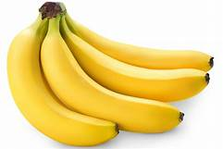
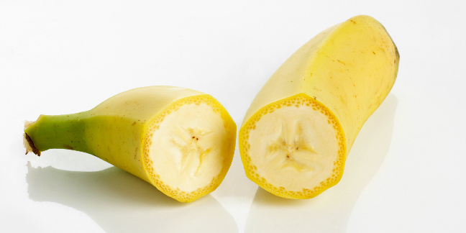
PARTHENOGENESIS
In some species, fruits develop without fertilization. Such fruits are called parthenocarpic fruit.
This phenomenon is called parthenocarpy.
Example: Banana.

Slide 19
APOMIXIS / AGAMOSPERMY
It plays an important role in hybrid seed production.
Seeds are formed without fertilization.
E.g.- Few flowering plants such as some species of Asteraceae and grasses show apomixis
It may develop if a diploid egg cell or megaspore mother cell develops into embryo without fertilization.
Sometimes cells of nucellus may develop into embryo .

Slide 20
SIGNIFICANCE OF APOMIXIS
The phenomenon can be used to maintain hybrid varieties indefinitely.
The method of producing hybrid seeds by cultivation is very expensive for farmers.
Also, by sowing hybrid seeds, it is difficult to maintain hybrid characters as characters segregate during meiosis. Since the embryo in apomictic seeds often develops from diploid cells ,so apomixis prevents the loss of specific characters in the hybrid.

Slide 21
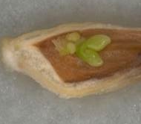
POLYEMBRYONY
It is the phenomenon of formation of more than one embryo during the development of seed.
Polyembryony occurs due to fertilization of more than one egg cell in an ovule.
Sometime presence of more than one embryo sac gives rise to polyembryony.
It also occurs when different parts like synergids, antipodal cells, nucellus differentiate into embryo.
E.g.- lemon, orange, onion etc.
Polyembryo

Slide 22
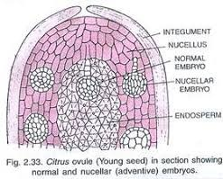
POLYEMBRYONY
Citrus ovule showing normal and nucellar embryos

Slide 23
THANKING YOU
ODM EDUCATIONAL GROUP

