Slide 1


SEXUAL REPRODUCTION IN FLOWERING PLANTS
OUT BREEDING DEVICES,POLLEN PISTIL INTERACTION,ARTIFICIAL HYBRIDISATION
SUBJECT : BIOLOGY
CHAPTER NUMBER:02
CHAPTER NAME :SEXUAL REPRODUCTION IN FLOWERING PLANTS

Slide 2
OUTBREEDING DEVICES
Outbreeding devices are mechanisms which are followed and adapted by the plants in order to prevent self pollination.
Majority of flowering plants produce hermaphrodite flowers and pollen grains are likely to come in contact with the stigma of the same flower.
Continued self-pollination result in inbreeding depression.
Flowering plants have developed many devices to discourage self pollination and to encourage cross-pollination.
The devices are:Dichogamy,Heterostyle,Self sterility,Unisexuality,Dioecy,Pollen prepotency.

Slide 3
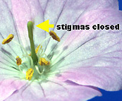
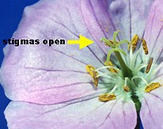
DICHOGAMY
In this mechanism the male reproductive part the anther and the female reproductive part the stigma matures at different times.
PROTOANDRY
Anther shedding pollen
Pollen release and stigma receptivity are not synchronised.
Protoandry: the pollen is released before the stigma becomes receptive.
Protogyny: the stigma becomes receptive much before the release of pollen.
It prevents autogamy.
Example: Salvia, sunflower
Stigma Opens
PROTOGYNY

Slide 4
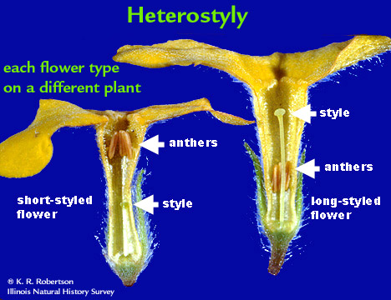
HETEROSTYLY
The anther and stigma are placed at different positions so that the pollen can not come in contact with the stigma of the same flower.

Slide 5
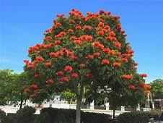
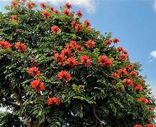
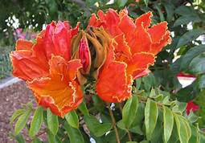
SELF INCOMPATIBILITY
This is a genetic mechanism and prevents self-pollen (from the same flower or other flowers of the same plant) from fertilising the ovules by inhibiting pollen germination or pollen tube growth in the pistil.
The gene in the female reproductive part of the flower which recognizes the gene present in the pollen grain of the same plant, prevents the fertilization results in self sterility.
Example:
Spathodea campanulata
THE FOUNTAIN TREE
Spathodea campanulata

Slide 6
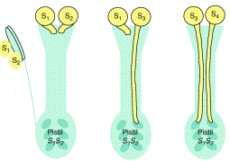
SELF INCOMPATIBILITY
INCOMPATIBLE
COMPATIBLE

Slide 7
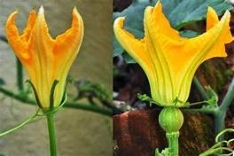
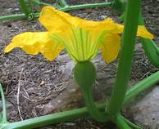
UNI SEXUALITY
This device prevents self-pollination by producing uni sexual flowers; either staminate or pistillate flowers.
It prevents autogamy but not geitonogamy.
PUMPKIN
Ovary
Male flower
Female flower

Slide 8
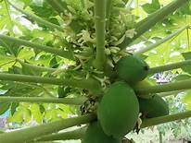
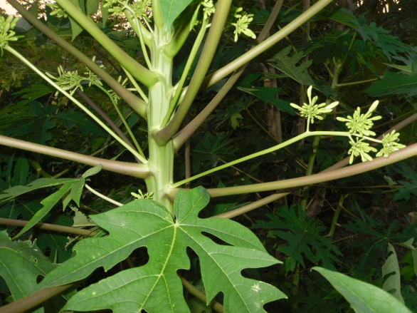
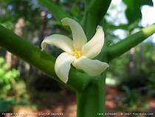
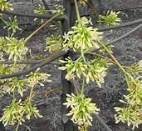
DIOECY
In several species such as papaya, male and female flowers are present on different plants, that is each plant is either male or female (dioecy).
This condition prevents both autogamy and geitonogamy.
Female plant
Male plant
Papaya
Female flower
Male flower

Slide 9
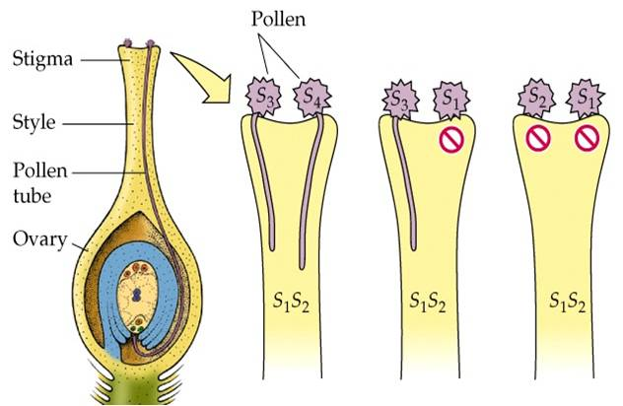
POLLEN PREPOTENCYY
The pollen of the different flower germinate faster than the pollen of the same flower thus preventing self pollination.
e.g: Apple and Grape
POLLEN–PISTIL INTERACTION
All pollinations do not lead to successful fertilization.
For successful fertilization, the pistil of a flower has to recognize the pollen of the same species.
Once compatible pollen is accepted by pistil, events for fertilization proceed, whereas incompatible pollens are rejected.
This interaction where a pistil is capable of recognizing its pollen is the result of long term pollen-pistil interaction and chemicals released by pollen.
Recognition of compatible pollen
It is the interaction between chemical components of pollen
and those of stigma.

Slide 10
Events of pollen-pistil interaction process
The landing of true pollen on the compatible pistil.
Germination of pollen and formation of pollen tube where pollen grains release its contents.
Pollen tube growth through the style of the pistil towards the ovary.
The entry of male gametes into the ovule and then to synergid.

Slide 11
Germination of pollen
Compatible pollen starts its germination, stimulated by certain secretion of stigma.
Intine grows out through one of germ pore to form pollen tube. Vegetative and generative 2 male gametes move into the tube.
Pollen tube grows through the tissues of stigma and style by secreting enzymes to digest them and enters ovule through micropyle.
It enters the embryo sac through filliform apparatus of one synergids to liberate male gametes.

Slide 12
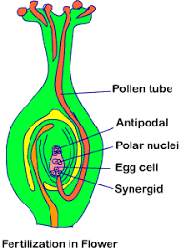
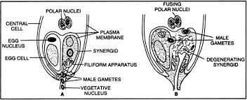
ENTRY OF POLLEN TUBE INTO EMBRYO-SAC

Slide 13
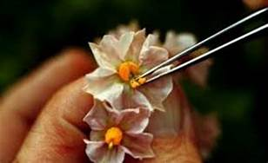
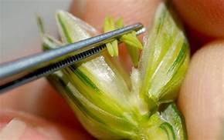
ARTIFICIAL HYBRIDISATION
Is one of the major approaches of crop improvement programme. In such crossing experiments it is important to make sure that only the desired pollen grains are used for pollination and the stigma is protected from contamination (from unwanted pollen).
This is achieved by emasculation and bagging techniques.
If the female parent bears bisexual flowers, removal of anthers from the flower bud before the anther dehisces using a pair of forceps is necessary.
This step is referred to as emasculation.
EMASCULATION
Removal of anther

Slide 14
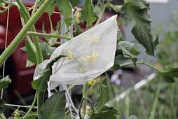
ARTIFICIAL HYBRIDISATION
BAGGING
Emasculated flowers have to be covered with a bag of suitable size, generally made up of butter paper, to prevent contamination of its stigma with unwanted pollen.
This process is called bagging.

Slide 15
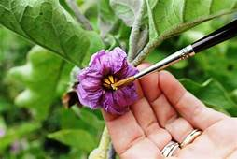
ARTIFICIAL POLLINATION (DUSTING)AND REBAGGING
When the stigma of bagged flower attains receptivity, matured pollen grains collected from anthers of the desired male parent are dusted on the stigma, and the flowers are rebagged, and the fruits allowed to develop.

Slide 16
THANKING YOU
ODM EDUCATIONAL GROUP

