Slide 1


REPRODUCTION IN FLOWERING PLANTS
SUBJECT : BIOLOGY
CHAPTER NUMBER:02
CHAPTER NAME :SEXUAL REPRODUCTION IN FLOWERING PLANTS

Slide 2
LEARNING OUTCOME
Students will learn about the importance of outbreeding devices.
Students will be able to know the various types of outbreeding devices and the importance as well.
They will have clear idea about pollen pistil interaction.
Students can acquire a generalised idea about artificial hybridisation.

Slide 3
LECTURE- 4
https://www.youtube.com/watch?v=v2aLagk8GrM

Slide 4
OUTBREEDING DEVICES
Outbreeding devices are mechanisms which are followed and adapted by the plants in order to prevent self pollination.
Why outbreeding?
To avoid the pollen grains to come in contact with the stigma of the same flower.
Continued self-pollination result in inbreeding depression..
Devices to discourage self pollination and to encourage cross-pollination.
The devices are:
Dichogamy, Heterostyle
Self sterility, Unisexuality,
Dioecy, Pollen prepotency

Slide 5
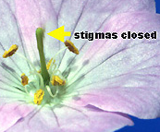
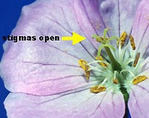
DICHOGAMY
Pollen release and stigma receptivity are not synchronised.
Protoandry: the pollen is released before the stigma becomes receptive.
Protogyny: the stigma becomes receptive much before the release of pollen.
Anther shedding pollen
PROTOANDRY
Why dichogamy?
It prevents autogamy.
Example: Salvia, sunflower etc.
Stigma Opens
PROTOGYNY

Slide 6
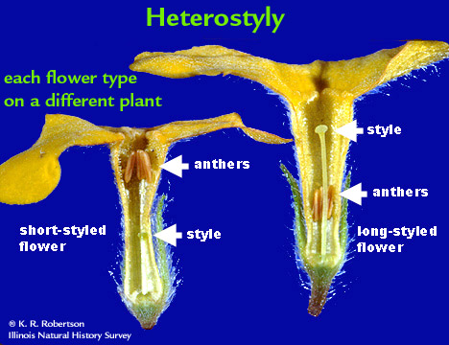
HETEROSTYLY
The anther and stigma are placed at different positions so that the pollen can not come in contact with the stigma of the same flower.

Slide 7
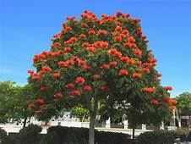
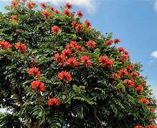
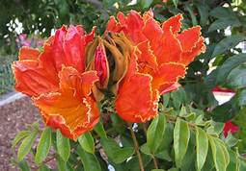
SELF INCOMPATIBILITY
Genetic mechanism and prevents self-pollen.
The gene in the female reproductive part of the flower which recognizes the gene present in the pollen grain of the same plant, prevents the fertilization results in self sterility.
Example: Spathodea campanulata
THE FOUNTAIN TREE
Spathodea campanulata

Slide 8
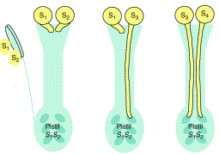
SELF INCOMPATIBILITY
POLLINATION
INCOMPATIBLE
COMPATIBLE

Slide 9
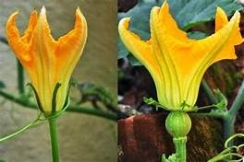
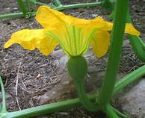
UNI SEXUALITY
This device prevents self-pollination by producing uni-sexual flowers; either staminate or pistillate flowers.
It prevents autogamy but not geitonogamy.
PUMPKIN
Ovary
Male flower
Female flower

Slide 10
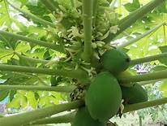
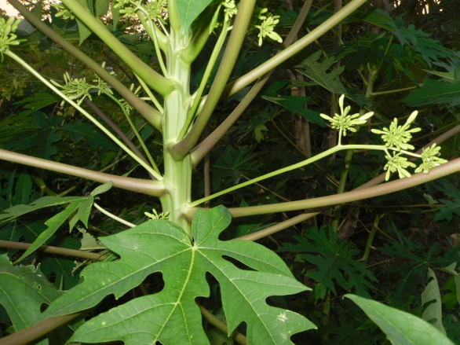
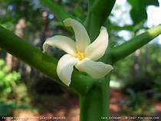
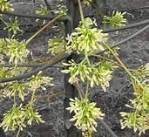
DIOECY
Male and female flowers are present on different plants, that is each plant is either male or female (dioecy).
This condition prevents both autogamy and geitonogamy.
Female plant
Male plant
Papaya
Female flower
Male flower

Slide 11
POLLEN PREPOTENCYY
The pollen of the different flower germinate faster than the pollen of the same flower thus preventing self pollination.
Example: Apple and Grape.

Slide 12
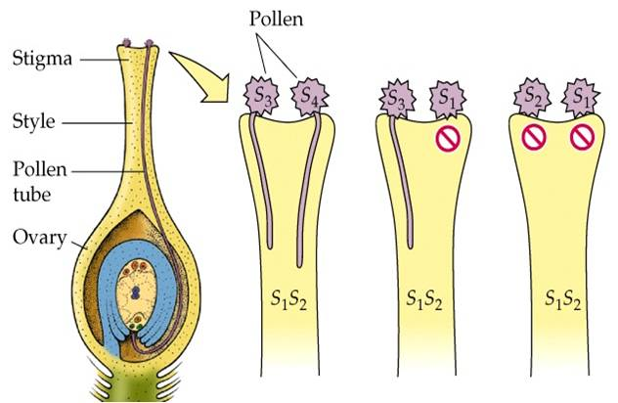
POLLEN–PISTIL INTERACTION
All pollinations do not lead to successful fertilization.
For successful fertilization, the pistil of a flower has to recognize the pollen of the same species.
compatible pollen is accepted by pistil, whereas incompatible pollens are rejected.
The interaction of a pollen with that of where a pistil is long term chemical dialogue between the two.

Slide 13
POLLEN–PISTIL INTERACTION
Recognition of compatible pollen
It is the interaction between chemical components of pollen and those of stigma.
The landing of true pollen on the compatible pistil.
Germination of pollen and formation of pollen tube.
Pollen tube growth through the style of the pistil towards the ovary.
The entry of male gametes into the ovule and then to synergids.

Slide 14
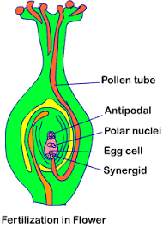
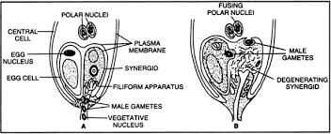
ENTRY OF POLLEN TUBE INTO EMBRYO-SAC

Slide 15
ARTIFICIAL HYBRIDISATION
The major approach of crop improvement programme.
Desired pollen grains are used for pollination and the stigma is protected from contamination (from unwanted pollen).
This is achieved by emasculation and bagging techniques.

Slide 16
ARTIFICIAL HYBRIDISATION
STEPS OF ARTIFICIAL HYBRIDISATION
Emasculation
Bagging
Artificial pollination
Rebagging

Slide 17
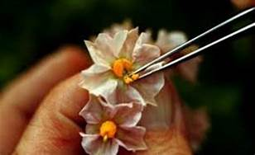
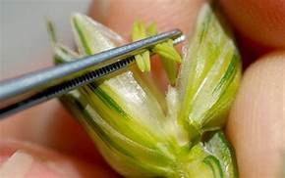
ARTIFICIAL HYBRIDISATION
EMASCULATION
Removal of anther

Slide 18
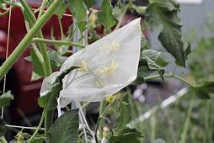
ARTIFICIAL HYBRIDISATION
BAGGING
Emasculated flowers have to be covered with a bag (butter paper), to prevent contamination with unwanted pollen.

Slide 19
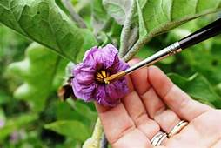
ARTIFICIAL POLLINATION (DUSTING) AND REBAGGING
When the stigma of bagged flower attains receptivity, matured pollen grains collected from anthers of the desired male parent are dusted on the stigma, and the flowers are rebagged, and the fruits allowed to develop.

Slide 20
THANKING YOU
ODM EDUCATIONAL GROUP

