Slide 1


SEXUAL REPRODUCTION IN FLOWERING PLANTS
ANTHECOLOGY THE POLLINATION BIOLOGY
SUBJECT : BIOLOGY
CHAPTER NUMBER:02
CHAPTER NAME :SEXUAL REPRODUCTION
IN FLOWERING PLANTS

Slide 2
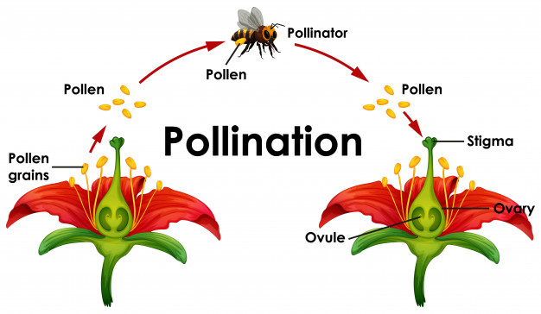
POLLINATION
DEFINATION
The transfer of pollen grains from anther to the stigma of a flower.
Pollen grains are immobile.They can not reach the stigma by themselves.An external agent is required for this.It can be wind,water,animals,gravity or growth contact.

Slide 3
TYPES OF POLLINATION
SELF POLLINATION
CROSS POLLINATION OR XENOGAMY
AUTOGAMY
GEITONOGAMY
ABIOTIC FACTORS
BIOTIC FACTORS
ANEMOPHILY
HYDROPHILY
ENTOMOPHILY
ORNITHOPHILY
CHIROPTEROPHILY
MALACPPHILY

Slide 4
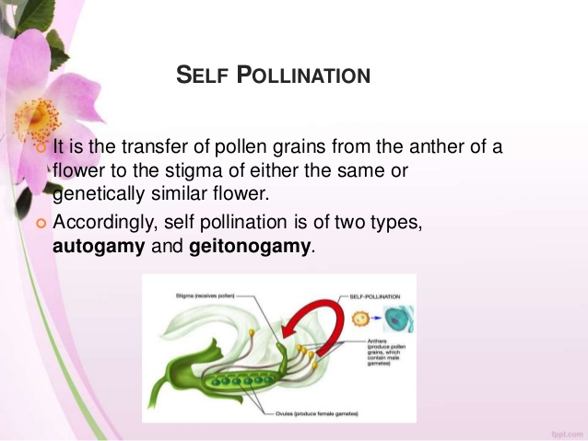

Slide 5
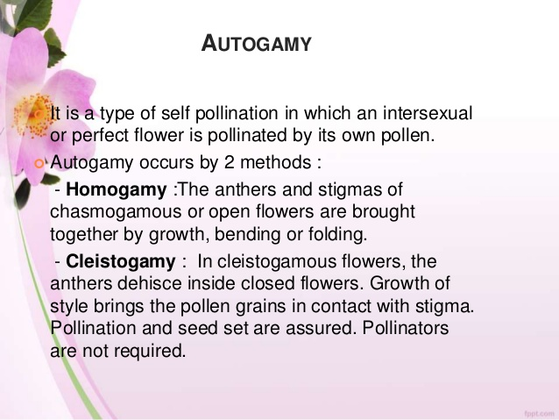

Slide 6
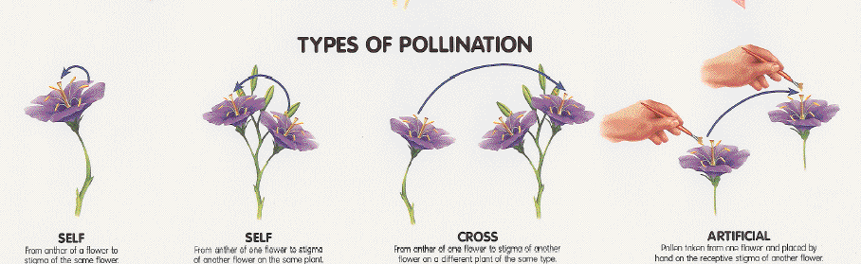
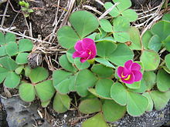
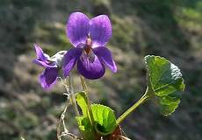
AUTOGAMY
CLEISTOGAMY
GEITONOGAMY
Oxalis purpurea
Viola odorata
Transfer of pollen grains from anther to stigma of the same flower.
The sexual reproduction in Viola occurs via the chasmogamous flowers in early spring and via cleistogamous flowers in the summer.
Flower is pollinated by the pollen grains of another flower of the same plant.

Slide 7
COMPARISION BETWEEN CHASMOGAMOUS
AND CLEISTOGAMOUS FLOWER
CHASMOGAMOUS | CLEISTOGAMOUS
Flowers open to expose their stigma and stamen | Bisexual flowers which never open
May be self pollinated or crospollinated | Self pollinated only

Slide 8
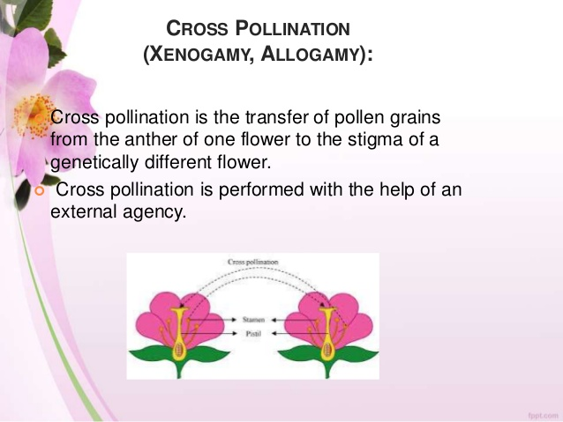

Slide 9
AGENTS OF POLLINATION
ANTIBIOTIC AGENTS
BIOTIC AGENTS
WIND POLLINATION
WATER POLLINATION
ANIMALS
INSECTS
MAMMALS
REPTILES
BIRDS

Slide 10
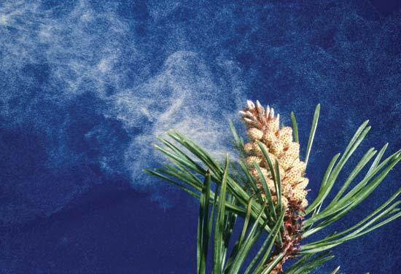
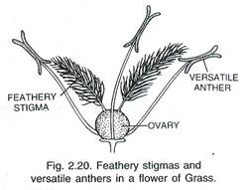
Adaptation of Wind Pollinated Flowers (Anemophily)
Pollen grains are light, non-sticky/dry, sometimes winged.Well exposed anther.
Large feathery stigma.
Flowers arranged as inflorescence.
Single ovules.
Clouds of Pollen Grains
Female flower

Slide 11
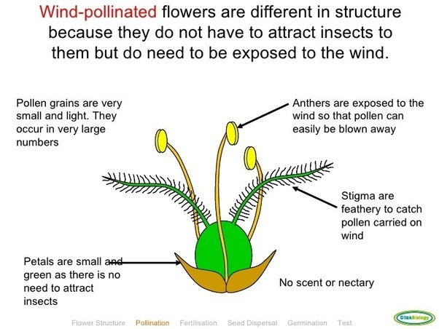

Slide 12
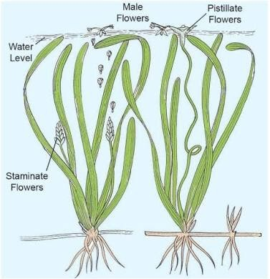
Adaptation of Water Pollinated Flowers (hydrophily)
Seen in submerged flowers like Vallisneria and Hydrilla and
Zostera.
In Vallisneria male flowers released on water surface and
female flowers reaches the surface for pollination.
In sea grasses, pollen grains are long ribbon like and
carried passively to submerged female flowers.
Mucilage coated pollen grains.
VALLISNERIA

Slide 13
Adaptation of insect pollinated flowers (ENTOMOPHILY)
It is transfer of pollen grains from anther of one flower to the stigma of another flower with the help of insects like moths, bees, wasps, butterflies, beetles, ants etc.
Bees are the most pollinating insects. Insects visit flowers for containing food,(pollen,nectar) or shelter.
Even larger animals such as some primates (lemurs), arboreal (tree dwelling) rodents, or even reptiles (gecko lizard and garden lizard) have been reported as pollinators in some species

Slide 14
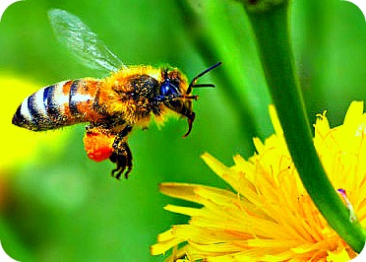
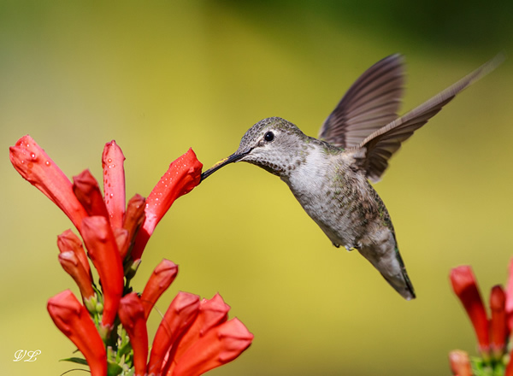
Adaptation in insects (entomophily) & birds Pollinated (ornithophily) Flowers
Large
Brightly coloured and showy.
If flowers are small, grouped into inflorescence.
Highly fragrant
Produce nectar
Sticky pollen and stigmatic surface
Provide floral rewards to animal pollinator such as nectar,
food (pollen) or provide safe place for laying eggs.

Slide 15
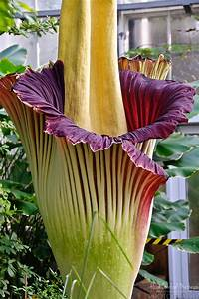
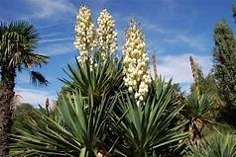
Some insects also use flowers for laying eggs eg. Amorphophallus.
It has the largest inflorescence and the tallest flowers with a flower reaching about 1.8 m (6 ft).
Flowers are bright coloured, large and showy.
They produce nectar and fragrance.
Amorphophallus
A similar relationship exist between species of moth and plant Yucca where both species-moth and the plant cannot complete their life cycles without each other.
The moth deposits the eggs in the locule of the ovary and the flower, in turn, gets pollinated by the moth.
The larva of the moth come out of the eggs as the seeds start developing.
Yucca

Slide 16
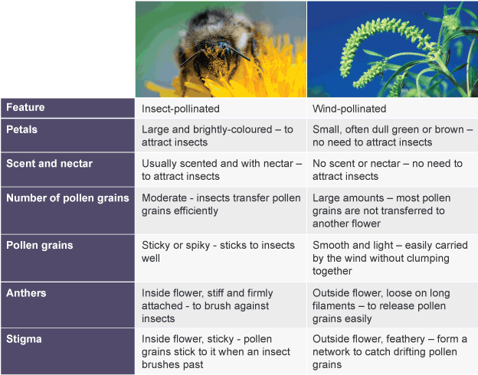

Slide 17
THANKING YOU
ODM EDUCATIONAL GROUP

