Slide 1


REPRODUCTION IN FLOWERING PLANTS
SUBJECT : BIOLOGY
CHAPTER NUMBER:02
CHAPTER NAME :SEXUAL REPRODUCTION IN FLOWERING PLANTS

Slide 2
LEARNING OUTCOME
Students will learn about pollination.
They will have basic ideas about the different types of pollination.
Students will be able to differentiate between autogamy, geitonogamy and xenogamy.
They will be familiar with the chasmogamous and clestogamous flowers.
Students will learn about the characteristics of wind, water and insect pollinated flowers.

Slide 3
LECTURE-3

Slide 4
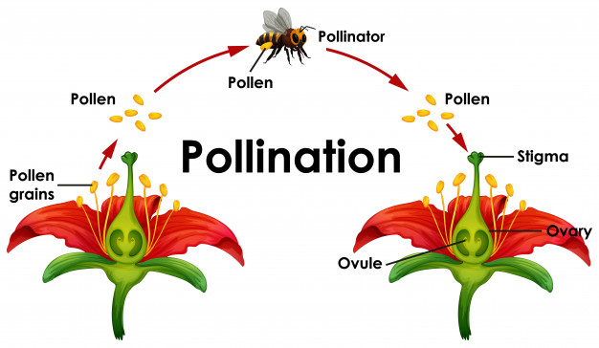
POLLINATION
Pollen grains are immobile.
An external agent is required for transfer of the pollen grains:
It can be wind
water
animals
gravity
growth contact

Slide 5
TYPES OF POLLINATION
SELF POLLINATION
CROSS POLLINATION OR XENOGAMY
AUTOGAMY
GEITONOGAMY
ABIOTIC FACTORS
BIOTIC FACTORS
ANEMOPHILY
HYDROPHILY
ENTOMOPHILY
ORNITHOPHILY
CHIROPTEROPHILY
MALACPPHILY

Slide 6
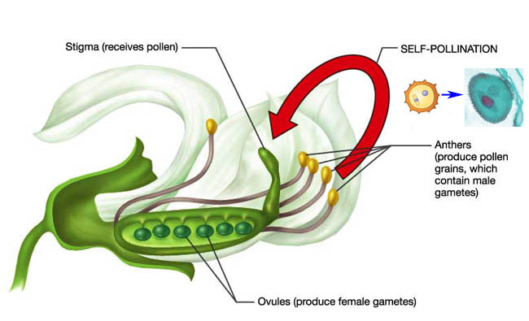
SELF POLLINATION

Slide 7
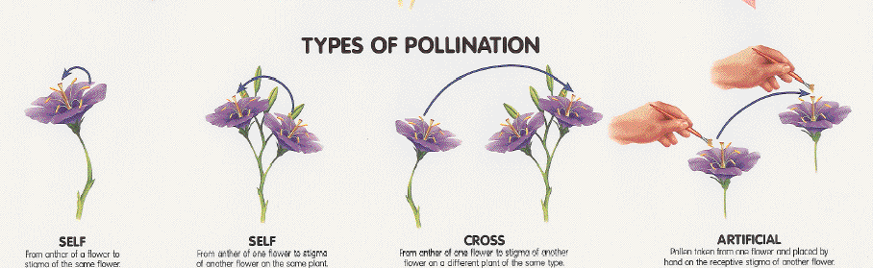
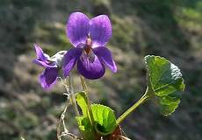
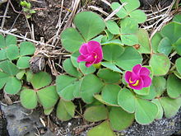
SELF POLLINATION
AUTOGAMY
GEITONOGAMY
CLEISTOGAMY
Viola odorata
Oxalis purpurea

Slide 8
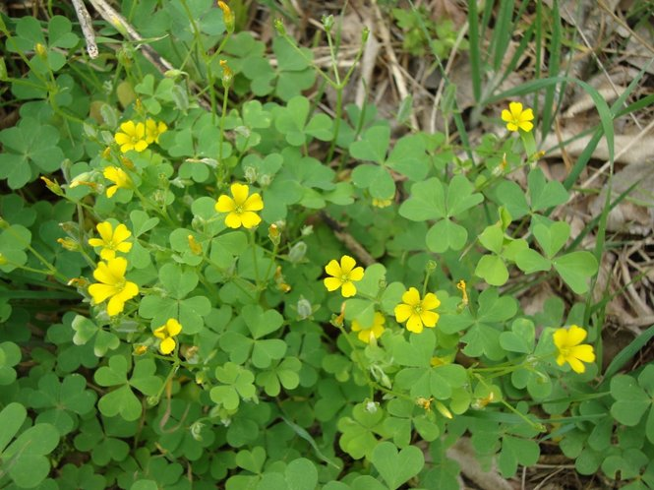
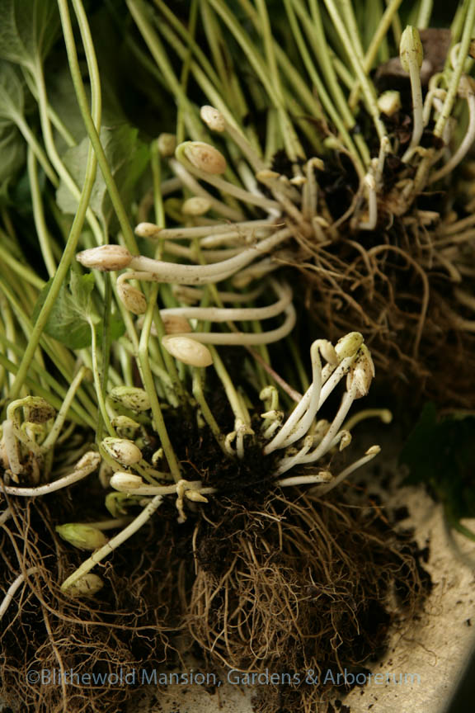
CHASMOGAMY AND CLESTOGAMY
Oxalis
Clestogamous flowers

Slide 9
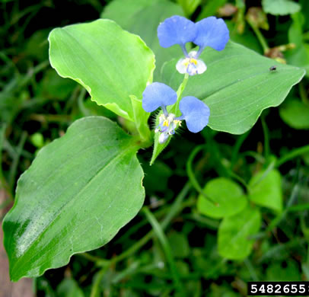
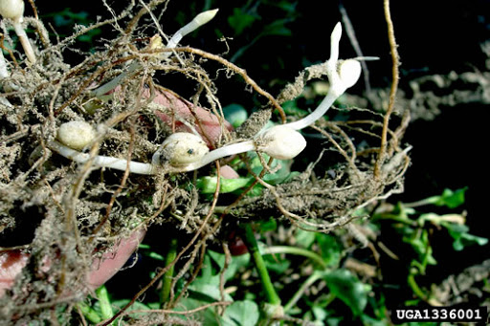
CHASMOGAMY AND CLESTOGAMY
Commelina benghalensis
Clestogamous flower

Slide 10
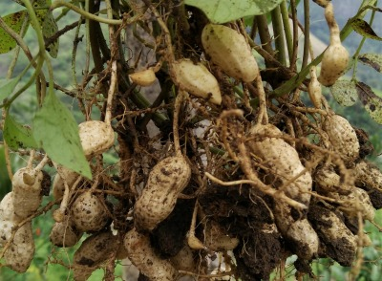
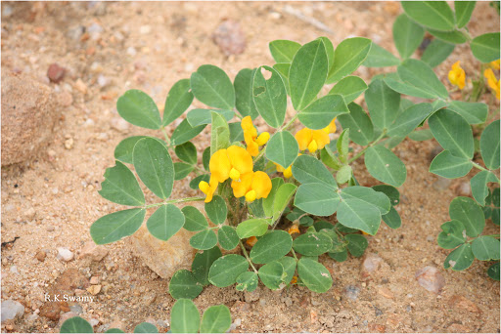
CHASMOGAMY AND CLESTOGAMY
Significance of clestogamy:
ensure pollination
ensure seed formation
?
Arachis hypogea
?

Slide 11
COMPARISION BETWEEN CHASMOGAMOUS
AND CLEISTOGAMOUS FLOWER
CHASMOGAMOUS | CLEISTOGAMOUS
Flowers open to expose their stigma and stamen | Bisexual flowers which never open
May be self pollinated or crospollinated | Self pollinated only

Slide 12
CROSS POLLINATION

Slide 13
AGENTS OF POLLINATION
ANTIBIOTIC AGENTS
BIOTIC AGENTS
WIND POLLINATION
WATER POLLINATION
ANIMALS
INSECTS
MAMMALS
REPTILES
BIRDS

Slide 14
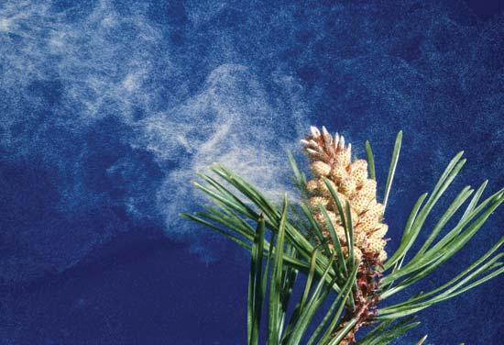
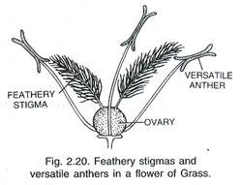
Adaptation of Wind Pollinated Flowers (Anemophily)
Pollen grains are light, non-sticky/dry, sometimes winged.
Well exposed anther.
Large feathery stigma.
Flowers arranged as inflorescence.
Single ovules.
Clouds of Pollen Grains
Female flower

Slide 15
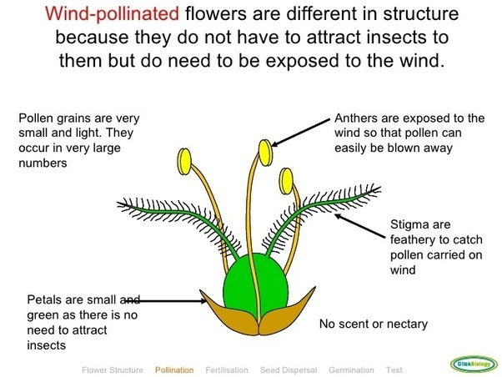
Adaptation of Wind Pollinated Flowers

Slide 16
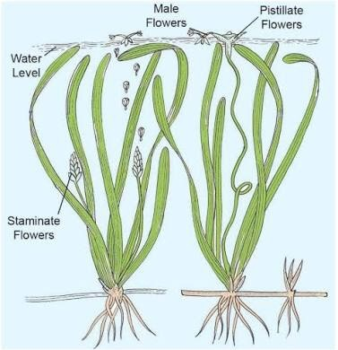
Adaptation of Water Pollinated Flowers (hydrophily)
Seen in submerged flowers like Vallisneria and Hydrilla and
Zostera.
In Vallisneria male flowers released on water surface and
female flowers reaches the surface for pollination.
In sea grasses, pollen grains are long ribbon like and
carried passively to submerged female flowers.
Mucilage coated pollen grains.
VALLISNERIA

Slide 17
Agents of insect pollinated flowers (ENTOMOPHILY)
Transfer of pollen grains with the help of:
bees
wasps
butterflies
beetles
ants etc.
Bees are the most pollinating insects.
Insects visit flowers for:
food
pollen
nectar
shelter
Even larger animals such as some primates (lemurs), arboreal rodents, or even reptiles (gecko lizard and garden lizard) have been reported as pollinators.

Slide 18
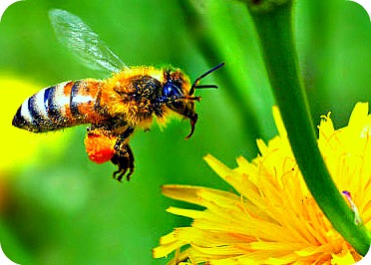
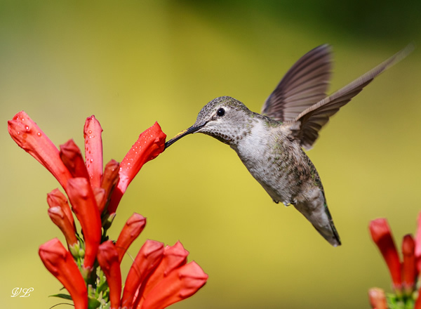
Adaptation in insects (entomophily) & birds Pollinated (ornithophily) Flowers
Large flowers
Brightly coloured and showy.
If flowers are small, grouped into inflorescence.
Highly fragrant
Produce nectar
Sticky pollen and stigmatic surface
Provide floral rewards to animal pollinator such as nectar,
food (pollen) or provide safe place for laying eggs.

Slide 19
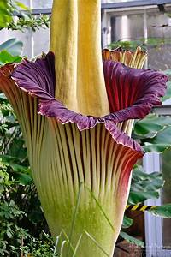
Adaptation of Amorphophallus Flowers
Some insects also use flowers for laying eggs eg. Amorphophallus.
It has the largest inflorescence and the tallest flowers with a flower reaching about 1.8 m (6 ft).
Flowers are bright coloured, large and showy.
They produce nectar and fragrance.
Amorphophallus

Slide 20
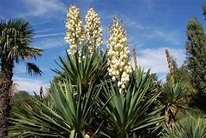
Adaptation of Yucca Flowers
Coevolution between species of moth and plant Yucca where both species-moth and the plant cannot complete their life cycles without each other.
The moth deposits the eggs in the locule of the ovary and the flower, in turn, gets pollinated by the moth.
The larva of the moth come out of the eggs as the seeds start developing.
Yucca

Slide 21
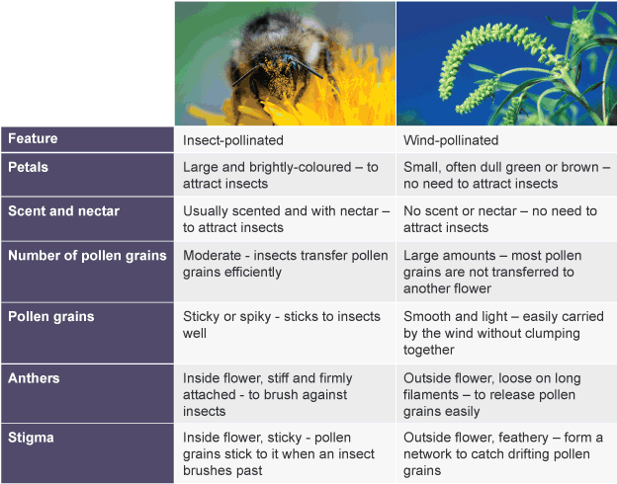
Differences between insect and wind pollinated flowers

Slide 22
THANKING YOU
ODM EDUCATIONAL GROUP

