Slide 1


SEXUAL REPRODUCTION IN FLOWERING PLANTS
PRE FERTILISATION EVENTS, STRUCTURE OF PISTIL, developmeNt of a female gametophyte
SUBJECT : BIOLOGY
CHAPTER NUMBER:02
CHAPTER NAME :SEXUAL REPRODUCTION IN FLOWERING PLANTS

Slide 2
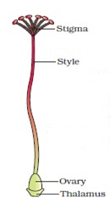
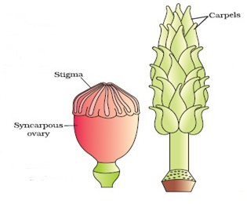
GYNOECIUM THE FEMALE REPRODUCTIVE SYSTEM
The gynoecium represents the female reproductive part of the flower.
The gynoecium consist of:
A single pistil (monocarpellary) Or may have more than one pistil (multicarpellary)
Carpel of Hibiscus
When there are more than one, the pistils:
may be fused together (syncarpous)
or may be free (apocarpous) .
APOCARPOUS OVARY- MICHELIA
SYNCARPOUS OVARY- PAPAVER

Slide 3


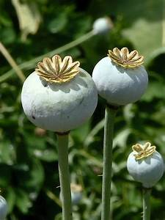
Apocarpous and syncarpous ovary
Papaver (Opium)
Michelia champaca (Champa
SUNCARPOUS OVARY- Papaver

Slide 4
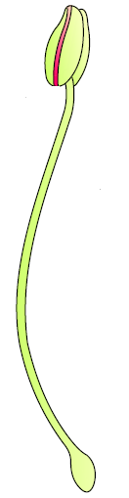

FEMALE REPRODUCTIVE SYSTEM
Each pistil has three parts ,the stigmastyle and ovary.
The stigma serves as a landing platform for pollen grains.
The style is the elongated slender part beneath the stigma.
The basal bulged part of the pistil is the ovary.
Inside the ovary is the ovarian cavity (locule).
The placenta is located inside the ovarian cavity.
A PISTIL
A PISTIL

Slide 5
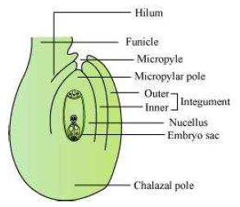
STRUCTURE OF OVULE
Arising from the placenta are the m e g a s p o r a n g i a, commonly called o v u l e s. The number of ovules in an ovary may be one (wheat, paddy, mango) to many (papaya, water melon, orchids).
The Megasporangium (Ovule) : Let us familiarise ourselves with the structure of a typical angiosperm ovule. The ovule is a small structure
Attached to the placenta by means of a stalk called funicle.
The body of the ovule fuses with funicle in the region called hilum.
Thus, hilum represents the junction between ovule and funicle.
Each ovule has one or two protective envelpoes called
Integuments.
Integuments encircle the nucellus except at the tip where a small opening called the micropyles is organised.
Opposite the micropylar end, is the chalaza, representing the basal part of the ovule.
Enclosed within the integuments is a mass of cells called the nucellus. Cells of the necullus have abundant reserve food materials.
Located in the nucellus is the embryosac or female gametophyte.
ANATROPUS OVULE

Slide 6
megasporogenesis
An ovule generally has a single embryo sac formed from a megaspore.
Megasporogenesis : The process of formation of megaspores from the
megaspore mother cell is called megasporogenesis.
Ovules generally differentiate a single megaspore mother cell(MMC) in the micropylar region of the nucellus. It is a large cell containing dense cytoplasm and a prominent nucleus.
The M M C undergoes meiotic division. Meiosis results in the production of four me gasopers.

Slide 7
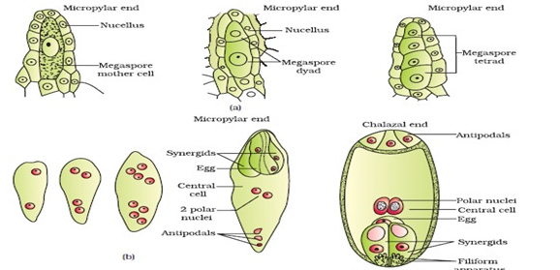
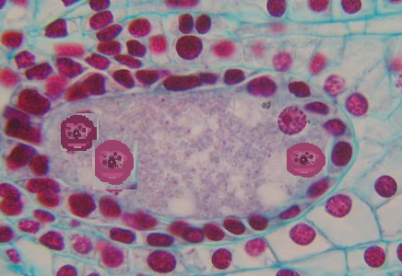
Development of female gametophyte
Formation of the embryo sac
The nucleus of the functional megaspore divides mitotically to form two nuclei which move to the opposite poles, forming the 2-nucleate embryo sac.
Two more sequential mitotic nuclear divisions result in the formation of the 4-nucleate and later the 8-nucleate stages of the embryo sac. These mitotic divisions are strictly free nuclear, that is, nuclear divisions are not followed immediately by cell wall formation.
After the 8-nucleate stage, cell walls are laid down leading to the organisation of the typical female gametophyte or embryo sac. Observe the distribution of cells inside the embryo sac.
4- NUCLEI

Slide 8
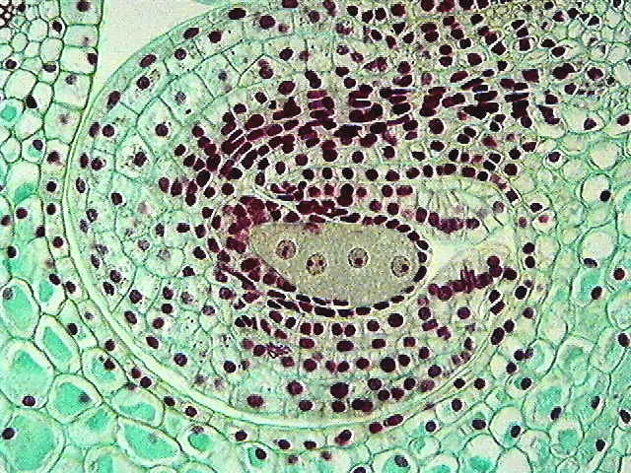
Development of female gametophyte
Mega spore tetrad
4- NUCLEI
Six of the eight nuclei are surrounded by cell walls and organised into cells;
the remaining two nuclei, called polar nuclei are situated below the
e g g apparutus in the large central cell.
There is a characteristic distribution of the cells within the embryo sac.
Three cells are grouped together at the micropylar end and constitute the egg apparatus.

Slide 9

THE EGG APPARATUS
The egg apparatus, in turn, consists of two synergids and one egg cell. The synergids have special cellular thickenings at the micropylar tip called filiform apparatus, which play an important role in guiding the pollen tubes into the synergid.
EGG APPRATUS

Slide 10
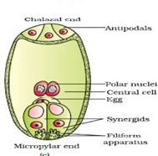
THE 7-CELLED MATURED EMBRYO SAC
The egg apparatus, consists of two synergids and one egg cell. Thus total of 3 cells.
Three cells are at the chalazal end and are called the antipodals. The large central cell, has two polar nuclei.
Thus, a typical angiosperm embryo sac, at maturity though 8-nucleties 7-celled.
MATURED EMBRYO SAC

Slide 11
THANKING YOU
ODM EDUCATIONAL GROUP

