Slide 1


REPRODUCTION IN FLOWERING PLANTS
CLASS-XII
SUBJECT : BIOLOGY
CHAPTER NUMBER:02
CHAPTER NAME :SEXUAL REPRODUCTION IN FLOWERING PLANTS

Slide 2
LEARNING OUTCOME
Students will have the generalised idea about the pistil.
Students will be familiar with the terms like apocarpous and syncarpous ovary.
They will have basic ideas about the morphology of the female reproductive system.
Students will get a fundamental idea about the structure of anatropus ovule.
They will learn about the development of the female gametophyte.

Slide 3
LECTURE-2

Slide 4
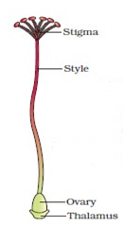
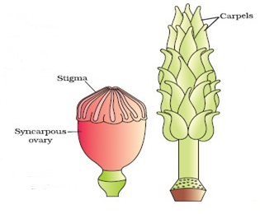
GYNOECIUM THE FEMALE REPRODUCTIVE SYSTEM
The female reproductive: the gynoecium.
The structure of a pistil.
Monocarpellary and multicarpellary
Carpel of Hibiscus
SYNCARPOUS OVARY- PAPAVER
APOCARPOUS OVARY- MICHELIA

Slide 5


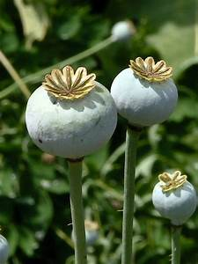
Apocarpous and syncarpous ovary
Papaver (Opium)
Michelia champaca (Champa
SUNCARPOUS OVARY- Papaver

Slide 6

FEMALE REPRODUCTIVE SYSTEM
Parts of the pistil:
the stigma, style and ovary.
The landing platform for pollen grains: the stigma.
The style structure and the function.
The basal bulged part of the pistil: the ovary.
ovarian cavity the locule.
A PISTIL

Slide 7
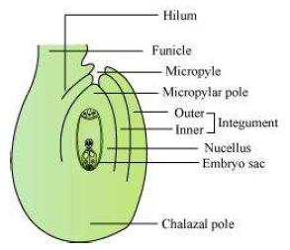
STRUCTURE OF OVULE
The structure of the megasporangium (Ovule) :
the funicle
the hilum
micropylar end and the chalaza pole
the Integuments
the necullus
embryosac or female gametophyte
ANATROPUS OVULE

Slide 8
megasporogenesis
Megasporogenesis : formation of the megaspores from the megaspore mother cell (MMC):
formation of the megaspore tetrad
functional megaspore tetrad cell
the free nuclear division of the functional megaspore tetrad cell
formation of the 8 haploid nuclei
cell wall formation to form 7 cells
A typical matured embryo sac though 7 cell is 8 nucleated.

Slide 9
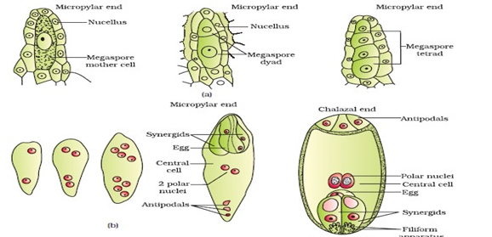
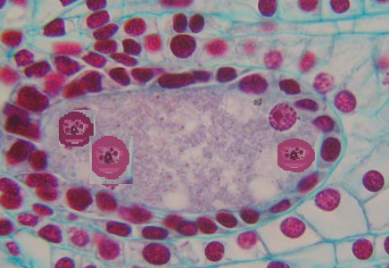
Development of female gametophyte
Formation of the embryo sac
MEGASPORE TETRAD

Slide 10
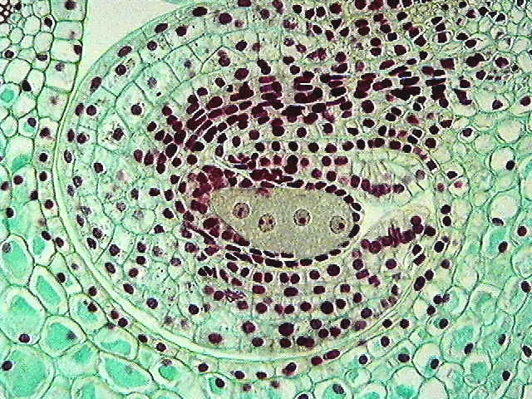
Development of female gametophyte
Mega spore tetrad
4- NUCLEI

Slide 11

THE EGG APPARATUS
The egg apparatus:
the two synergids and one egg cell.
The function of the synergids in fertilization of the egg.
EGG APPRATUS

Slide 12
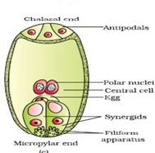
THE 7-CELLED MATURED EMBRYO SAC
The matured embryo sac;
antipodal cells
central cell
egg apparatus
Thus, a typical angiosperm embryo sac, at maturity though 8-nucleties 7-celled.
MATURED EMBRYO SAC

Slide 13
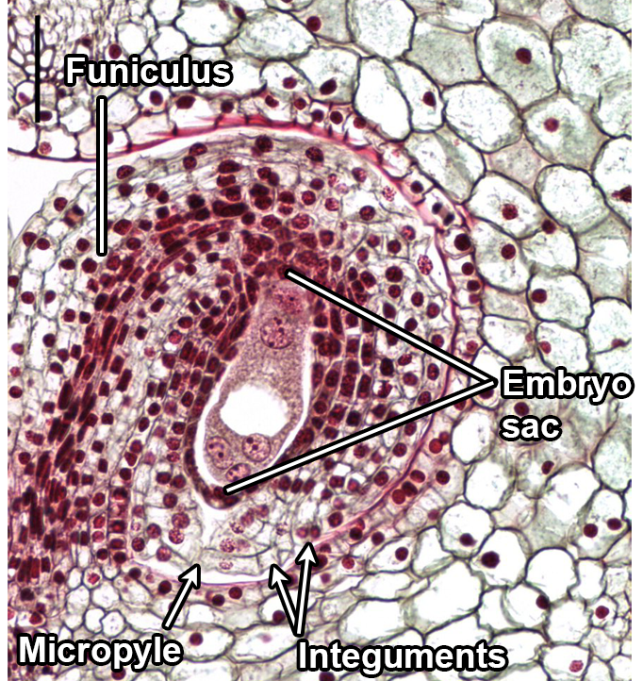
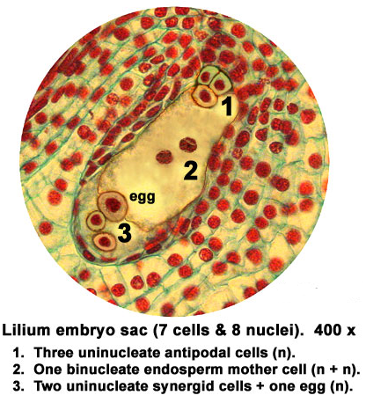
THE 7-CELLED MATURED EMBRYO SAC
MATURED EMBRYO SAC

Slide 14
THANKING YOU
ODM EDUCATIONAL GROUP

