Slide 1


SEXUAL REPRODUCTION IN FLOWERING PLANTS
PRE FERTILIZATION EVENTS,STRUCTURE OF STAMEN
SUBJECT : BIOLOGY
CHAPTER NUMBER:02
CHAPTER NAME :SEXUAL REPRODUCTION IN FLOWERING PLANTS

Slide 2
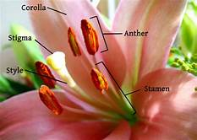
    PRE-FERTILISATION: STRUCTURE AND EVENTS
Several hormonal and structural changes are initiated which lead to the differentiation and further development of the floral primordium.
In the flower the male and female reproductive structures, the androecium and the gynoecium differentiate and develop.

Slide 3
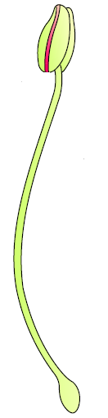
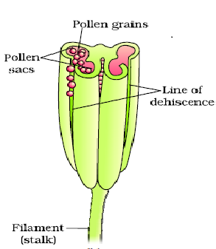
STRUCTURE OF STAMEN
ANTHER
The androecium consists of a whorl of stamens representing the male reproductive organ.
The long and slender stalk called the filament, and the terminal generally bilobed structure called the anther. The proximal end of the filament is attached to the thalamus or the petal of the flower.
The number and length of stamens are variable in flowers of different species.
FILAMENT
A typical angiosperm anther is bilobed with each lobe having two theca, i.e., they are dithecous. The longitudinal groove runs lengthwise separating the theca.
The bilobed nature of an anther is very distinct in the transverse section of the anther.
The anther is a four-sided (tetragonal) structure consisting of four microsporangia located at the corners, two in each lobe.
The microsporangia develop further and become pollen sacs. They extend longitudinally all through the length of an anther and are packed with pollen grains.

Slide 4
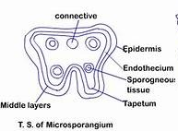
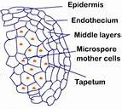
Structure of microsporangium
A transverse section, of a typical microsporangium appears near circular in outline. It surrounded by four wall layers the epidermis, endothecium, middle layers and the tapetum.
The outer three wall layers perform the function of protection and help in dehiscence of anther to release the pollen. The innermost wall layer the tapetum, nourishes the developing pollen grains.
Cells of the tapetum possess dense cytoplasm and generally have more than one nucleus.
In young anther, a group of compactly arranged homogenous cells called the sporogenous tissue occupies the centre of each microsporangium.

Slide 5
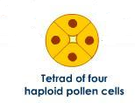
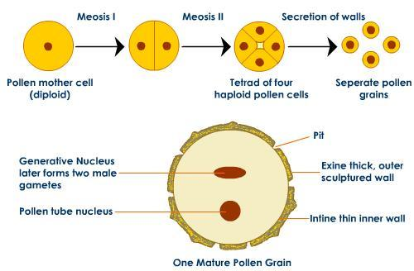

Microsporogenesis
As the anther develops, the cells of the sporogenous tissue undergo meiotic divisions to form microspore tetrads.
Each cell of the sporogenous tissue is capable of giving rise to a microspore tetrad. Each one is a potential pollen or microspore mother cell.
The process of formation of microspores from a pollen mother cell (PMC) through meiosis is called microsporogenesis.
The microspores, as they are formed, are arranged in a cluster of four cells–the microspore tetrad.
As the anthers mature and dehydrate, the microspores dissociate from each other and develop into pollen grains.
Inside each microsporangium several thousands of microspores or pollen grains are formed that are released with the dehiscence of anther.
The pollen grains represent the male gametophytes.

Slide 6
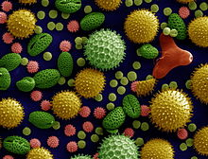
POLLEN GRAIN
Pollen grains are generally spherical measuring about 25-50 micrometers in diameter. It has a prominent two-layered wall. The hard outer layer called the exine is made up of sporopollenin which is one of the most resistant organic material known.
It can withstand high temperatures and strong acids and alkali. No enzyme that degrades sporopollenin is so far known.
Pollen grain exine has prominent apertures called germ pores where sporopollenin is absent. Pollen grains are well preserved as fossils because of the presence of sporopollenin.
The exine exhibits a fascinating array of patterns and designs. The inner wall of the pollen grain is called the intine. It is a thin and continuous layer made up of cellulose and pectin. The cytoplasm of pollen grain is surrounded by a plasma membrane.
When the pollen grain is mature it contains two cells, the vegetative cell and generative cell. The vegetative cell is bigger, has abundant food reserve and a large irregularly shaped nucleus. The generative cell is small and floats in the cytoplasm of the vegetative cell.

Slide 7


It is spindle shaped with dense cytoplasm and a nucleus. In over 60 per cent of angiosperms, pollen grains are shed at this 2-celled stage. In the remaining species, the generative cell divides mitotically to give rise to the two male gametes before pollen grains are shed (3-celled stage).
2-celled stage pollen
3-celled stage pollen
Vegetative cell
Generative cell
Generative cell

Slide 8
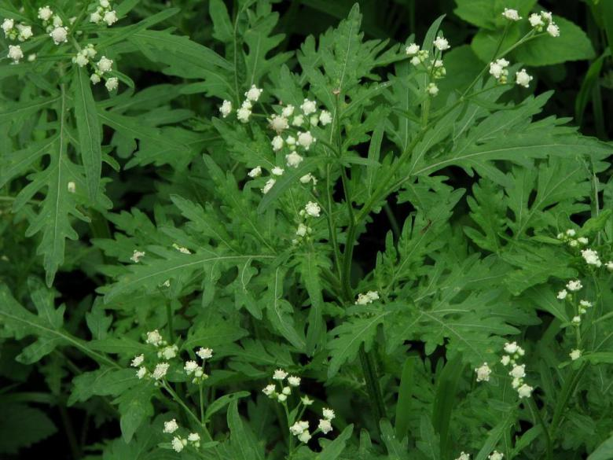
HEALTH EFFECTS OF POLLEN GRAIN
Pollen grains of many species cause severe allergies and bronchial afflictions in some people often leading to chronic respiratory disorders– asthma, bronchitis, etc.
It may be mentioned that Parthenium or carrot grass that came into India as a contaminant with imported wheat,has become ubiquitous in occurrence and causes pollen allergy.
Pollen grains are rich in nutrients. It has become a fashion in recent years to use pollen tablets as food supplements.
In western countries, a large number of pollen products in the form of tablets and syrups are available in the market.
Pollen consumption has been claimed to increase the performance of athletes and race horses.
Parthenium

Slide 9
POLLEN VIABILITY
Once the pollen grains are shed, these have to land on the stigma before they lose viability if they have to bring about fertilisation.
The period for which pollen grains remain viable is highly variable and to some extent depends on the prevailing temperature and humidity.
In some cereals such as rice and wheat, pollen grains lose viability within 30 minutes of their release, and in some members of Rosaceae, Leguminoseae and Solanaceae, they maintain viability for months.
It is possible to store pollen grains of a large number of species for years in liquid nitrogen (-1960C). Such stored pollen can be used as pollen banks, similar to seed banks, in crop breeding programmes.

Slide 10
THANKING YOU
ODM EDUCATIONAL GROUP

