Slide 1


REPRODUCTION IN FLOWERING PLANTS
SUBJECT : BIOLOGY
CHAPTER NUMBER:02
CHAPTER NAME :SEXUAL REPRODUCTION IN FLOWERING PLANTS

Slide 2
LEARNING OUTCOME
Students will have ideas about the pre-fertilization events and structures of a bisexual flowers.
Students will be familiar with the terms like bilobed, dithecous, line of dehiscence and sporogenous tissue.
They will have basic ideas about microsporogenesis.
Students will get a fundamental idea about the structure of pollen grain.
They will learn about the health effects of pollen grains on humans.
Students can acquire a generalised idea about the pollen viability.

Slide 3
LECTURE-1

Slide 4
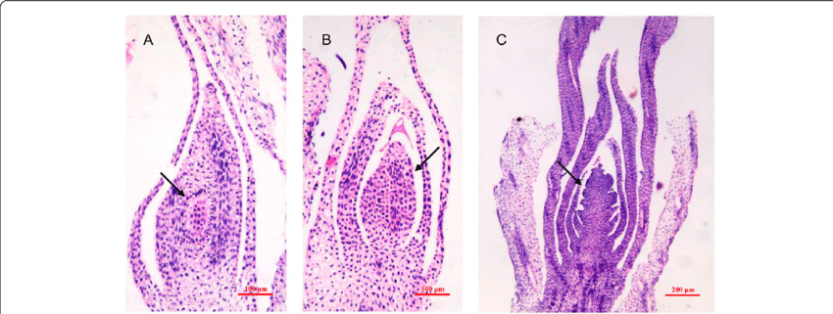
    PRE-FERTILISATION: STRUCTURE AND EVENTS
Floral initiation-floral primordium.
Differentiation of the male and female reproductive structures: the androecium and the gynoecium.
The arrows pointing the floral primordium

Slide 5
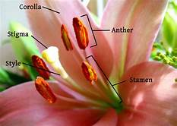
    PRE-FERTILISATION: STRUCTURE AND EVENTS
PARTS OF A TYPICAL BISEXUAL FLOWER
CALYX
COROLLA
ANDROECIUM
GYNOECIUM
A bisexual flower

Slide 6
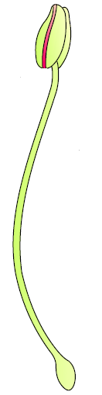
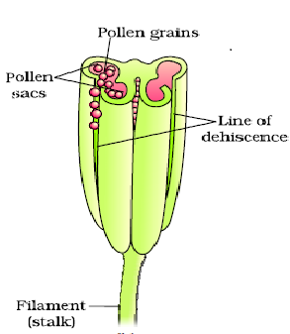
STRUCTURE OF STAMEN
The androecium consists of a whorl of stamens representing the male reproductive organ.
A typical angiosperm anther is bilobed dithecous.
The anther is a four-sided (tetragonal) structure consisting of four microsporangia located at the corners, two in each lobe.
Development of the microsporangia:
Development of the pollen sacs.
ANTHER
FILAMENT
A Stamen

Slide 7
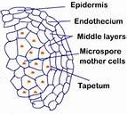
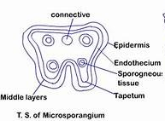
Structure of microsporangium
A transverse section, of a typical microsporangium.
The four wall layers:
the epidermis, endothecium, middle layers and the tapetum, structure and function.
TS of Microsporangium

Slide 8
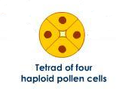
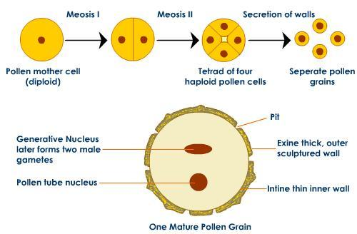

Microsporogenesis
Development of the sporogenous tissue to form microspore tetrads.
The Microsporogenesis:
the process of formation of the microspores from a pollen mother cell (PMC).
The microspore tetrad and the development of the pollen grain.
Dehiscence of the anther.
The male gametophytes- pollen grains.
The development of pollen grains

Slide 9
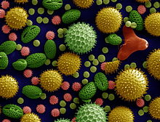
POLLEN GRAIN
The morphology of the pollen grains:
the size of the Pollen grains.
the shapes of the pollen grains.
Pollen grains of different species

Slide 10
STRUCTURE OF A POLLEN GRAIN
The structure of the outer wall of the pollen grains: exine.
Chemical composition of the exine and intine.
Why does pollen grain doesn’t get decomposed easily?
Importance of the germ pore.
Pollen as a fossil.

Slide 11
POLLEN GRAIN
The two cells:
the vegetative cell and,
the generative cell.
The vegetative cell is bigger, has abundant food reserve and a large irregularly shaped nucleus.
The generative cell is small and floats in the cytoplasm of the vegetative cell.

Slide 12


POLLEN GRAIN
2-celled stage pollen grains.
3-celled stage pollen grains.
2-celled stage pollen
3-celled stage pollen
Generative cell
Vegetative cell
Generative cell

Slide 13
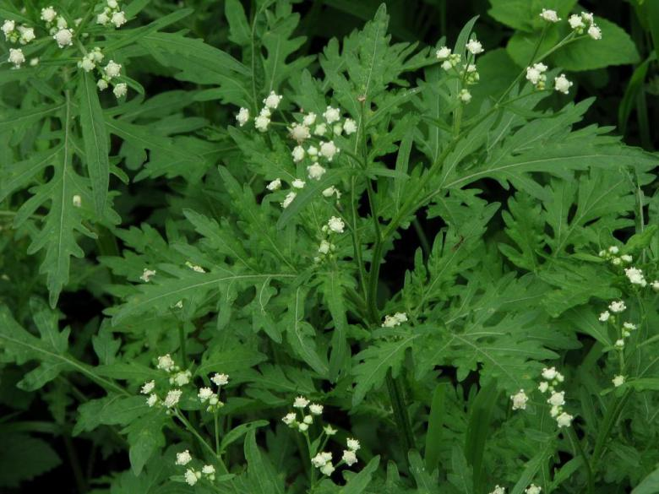
HEALTH EFFECTS OF POLLEN GRAIN
Allergies and bronchial afflictions:
chronic respiratory disorders.
Parthenium or carrot grass as a contaminant .
How Parthenium came to India?
Pollen as food supplements.
Parthenium

Slide 14
POLLEN VIABILITY
Viability of the pollen grains in:
In cereals like rice and wheat.
In Rosaceae, Leguminoseae and Solanaceae.
Factors affecting the pollen viability:
the temperature and humidity
Cryopreservation of pollen grains.

Slide 15
THANKING YOU
ODM EDUCATIONAL GROUP

