Slide 1


REPRODUCTION IN ORGANISMS
SUBJECT : BIOLOGY
CHAPTER NUMBER:01
CHAPTER NAME :REPRODUCTION IN ORGANISMS

Slide 2
LEARNING OUTCOME
Students will be able to know about sexual reproduction.
Students will be able to know about different phases of life and their significance.
Students will be familiar with monocarpic and polycarpic plants.
They will easily classify types of breeding like seasonal and continuous breeders.
Students will be able to know types of reproductive cycle.
Students will be able to know pre fertilization, fertilization and post fertilization events in organisms.

Slide 3
LECTURE -2
Sexual reproduction.
Phases of life.
Monocarpic plants and Polycarpic plants.
Animal breeding.
Continuous and seasonal breeders.
Oestrous and menstrual cycle
Pre-fertilization Events.
Gametogenesis
Gamete transfer
Pollination
Fertilization.
External and internal
Post fertilization events & embryogenesis.

Slide 4
SEXUAL REPRODUCTION
The entire life of an individual includes following phases:
juvenile phase/ vegetative phase
(B) reproductive phase/maturity phase
(C) ageing/senescent/death phase

Slide 5
SEXUAL REPRODUCTION
In flowering plants the onset of reproductive phase can be easily seen when they come to flower.
Sexually flowering plants are of two categories:
Monocarpic plants.
(2) Polycarpic plants.

Slide 6
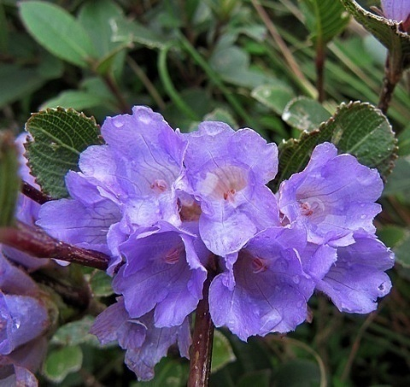
PLANTS
Monocarpic plants
Polycarpic plants
It includes all the annual (wheat, rice) biennial (carrot) plants, few perennial plants like Bamboo and Strobithanthus .
Inter flowering period.
It includes perennial plants like Mango, Apple, Jackfruit
Commonly known as Neelakuranji which has life span of 12 years. In the twelfth year it flowers, fruits and dies.
Strobithanthus kunthiana

Slide 7
ANIMAL BREEDING
Breeders
Types of breeders
Placental mammals exhibit reproductive cycles like:
Oestrous cycle in non primates
Menstrual cycle in primates
Seasonal breeders
Continuous breeders

Slide 8
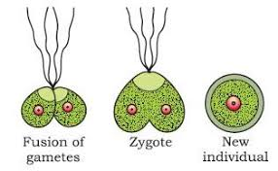
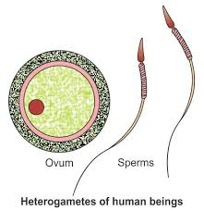
Pre-fertilization
What is gametogenesis?
Meiocytes
Types of gametes:
homogametic (isogametes)
heterogametes antherozooids or sperm and
female gametes are called ovum or egg.

Slide 9
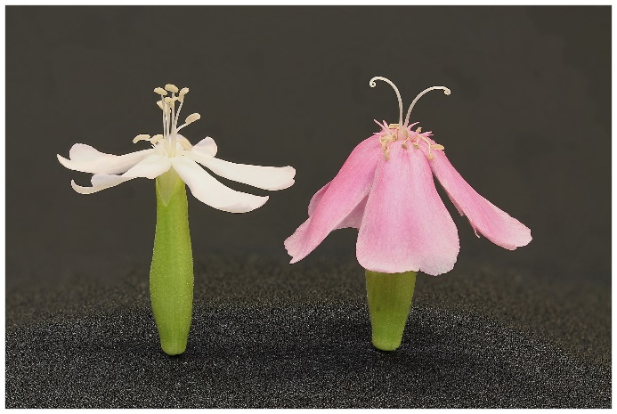
Pre-fertilization
In plants
Homothallic/ monoecious- staminate
Heterothallic/ dioecious.
In animals
Bisexual / hermaphrodites.
Unisexual
pistillate

Slide 10
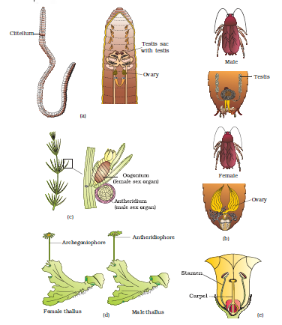
Figure showing sexuality in organisms

Slide 11
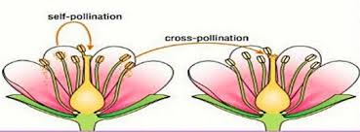
Gamete Transfer
Gamete Transfer in simple plants like algae, fungi, bryophytes and pteridophytes.
Pollination in higher plants like angiosperms.
Self pollination
cross pollination

Slide 12
FERTILIZATION
FERTILIZATION-
Syngamy
Parthenogenesis
TYPES OF FERTILIZATION
EXTERNAL FERTILIZATION
Ex. Bony fishes and Amphibians.
INTERNAL FERTILIZATION
Ex. Birds and Mammals.

Slide 13
POST FERTILIZATION EVENTS
Post Fertilization Events-
Formation of single celled zygote.
Embryogenesis.
Development of zygote
Post fertilization changes in plants.
Oviparous
Ex – Reptiles and birds
Viviparous
Ex- Human, dog, horse

Slide 14
ASSINGNMENTS
Differentiate external and internal fertilization.
(B) Differentiate between ovipary and vivipary.
(C)Define embryogenesis.
Hots questions:
Define homothallic and heterothallic condition.
(B) Mention the role of meiocyte and give its ploidy number.
(C)Why more number of gametes are produced by bryophytes and pteridophytes?
(D)What do you understand by inter flowering period?

Slide 15
https://youtu.be/5SuvKvGI4-4

Slide 16
THANKING YOU
ODM EDUCATIONAL GROUP

