Slide 1


REPRODUCTION IN ORGANISMS
LIFE SPAN, REPRODUCTION: BINARY FISSION , BUDDING, FRAGMENTATION, SPORULATION, ENCYSTATION, VEGETATIVE PROPAGATION
SUBJECT :BIOLOGY
CHAPTER NUMBER:01
CHAPTER NAME :REPRODUCTION IN ORGANISMS

Slide 2
LEARNING OUTCOME
Students will be able to know the meaning of reproduction and different phases of life.
Students will be familiar with the types of reproduction in organisms .
They will easily classify the different types of asexual reproduction in lower , and higher organisms .
This basic idea will create interest among the students to know the asexual reproductive structures in different organisms.

Slide 3
LECTURE-1
INTRODUCTION
LIFE SPAN
REPRODUCTION AND IT’S TYPE
ASEXUAL REPRODUCTION IN LOWER ORGANISMS
BINARY FISSION
BUDDING
ASEXUAL REPRODUCTION IN ALGAE AND FUNGI & HIGHER PLANTS.
FRAGMENTATION
SPORULATION
ENCYSTATION
VEGETATIVE PROPAGATION AND VEGETATIVE PROPAGULES

Slide 4
LIFE SPAN
The period from birth to the natural death of an organism represents its life span.
Sl. No. | ORGANISMS | LIFE SPAN
1 | Actinobacteria | Half a million years old
2 | Populus tremuloides (Quaking aspen) | 80,000 years old
3 | Banyan tree | 500- 1000 years
4 | Mayflies | 24 hours
5 | Glass sponges | 10,000 years old
6 | Aldabra giant tortoise | 255 years

Slide 5
TYPES OF REPRODUCTION
Based on whether there is one or two organisms taking part in the process of reproduction
ASEXUAL REPRODUCTON
When the offspring is produced by single parents with or without the involvement of gamete formation, the reproduction is called asexual reproduction.
SEXUAL REPRODUCTION
When two parents (opposite sex) participates in reproduction process and also involves the
fusion of male and female gametes, it is called sexual reproduction.

Slide 6
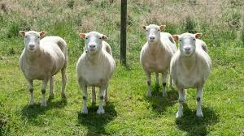
ASEXUAL REPRODUCTION
Organisms with relatively simpler organizations.
Uniparental.
With/without involvement of gamete formation.
Genetically and morphologically similar organisms.
No variation.
clones

Slide 7
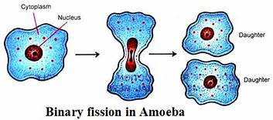
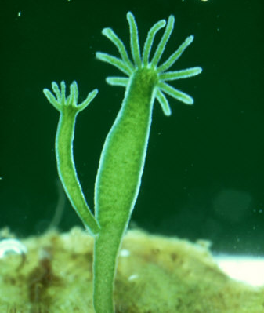
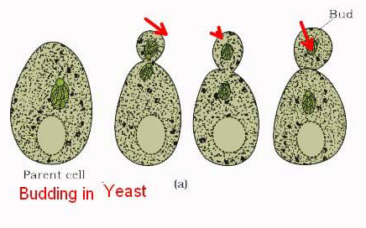
TYPES OF ASEXUAL REPRODUCTION
Binary fission
Budding
Developing Buds
Budding in Hydra
Budding In Yeast

Slide 8
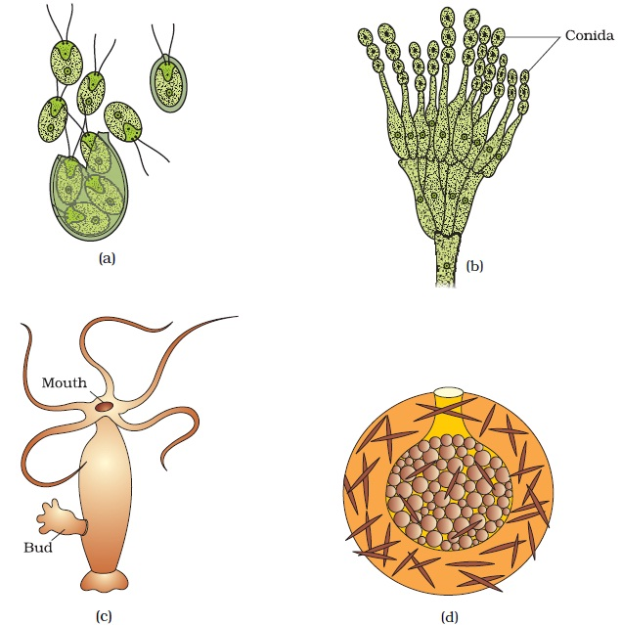
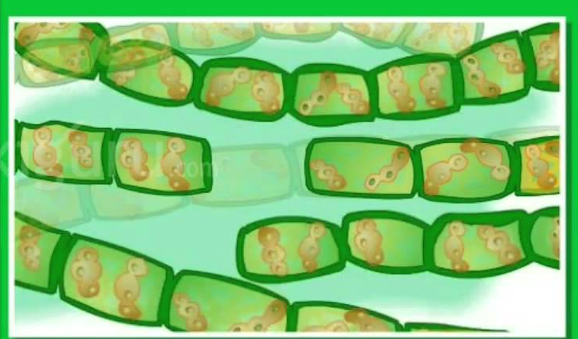
ASEXUAL REPRODUCTION IN ALGAE AND FUNGI
SPORULATION
conidia
Motile Zoospores
Penicillium
Chlamydomonas
GEMMULATION
FRAGMENTATION
Gemmules
Fragments
SPIROGYRA
Sponge

Slide 9
VEGETATIVE PROPAGATION IN PLANTS
Vegetative reproduction occurs by vegetative propagules.
Vegetative propagules: the structures which are capable of giving rise to a new plant.
Sl. No. | PLANTS | VEGETATIVE PROPAGULES
1 | Potato | Tuber
2 | Onion | Bulb
3 | Ginger | Rhizome
4 | Bryophylum | Leaf Buds
5 | Agave | Bulbil
6 | Eichornia | Offsets

Slide 10
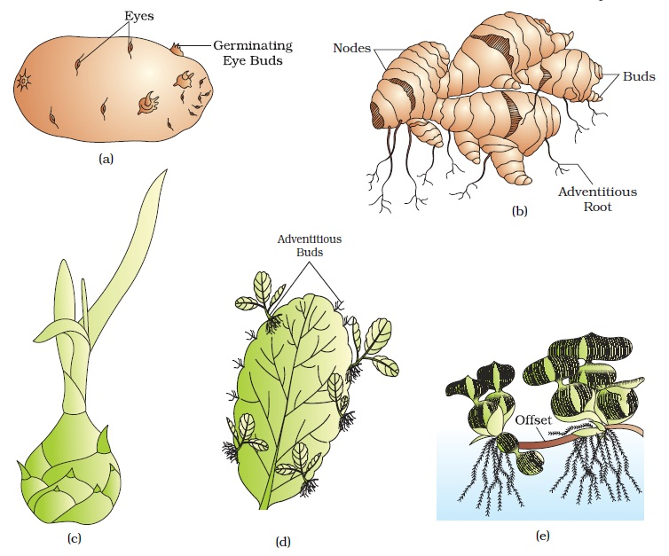
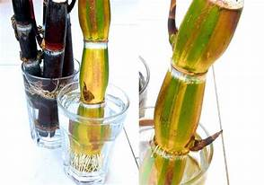
VEGETATIVE PROPAGATION IN PLANTS
Nodes
Buds
Rhizome of Ginger
Buds
Node
Sugar cane

Slide 11
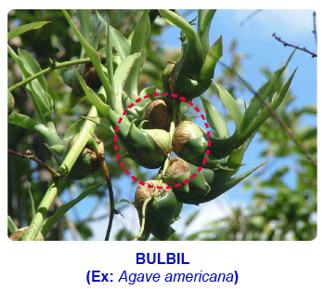
VEGETATIVE PROPAGATION IN PLANTS
Bulbil
Bulbil
Agave

Slide 12
VEGETATIVE PROPAGATION IN PLANTS
Adventitious Buds
Germinating Buds
Bryophyllum
Tuber of Potato

Slide 13
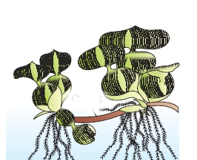
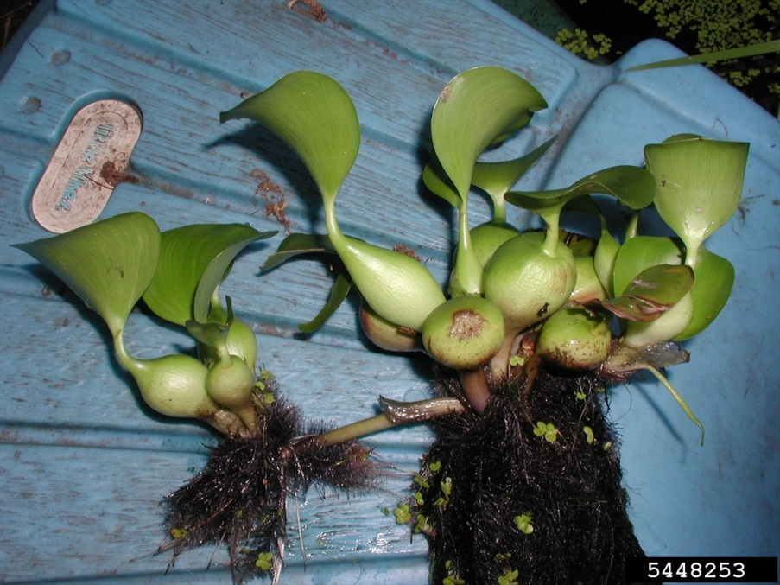
VEGETATIVE PROPAGATION IN PLANTS
Eichhornia
Offset
Offset

Slide 14
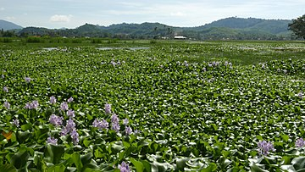
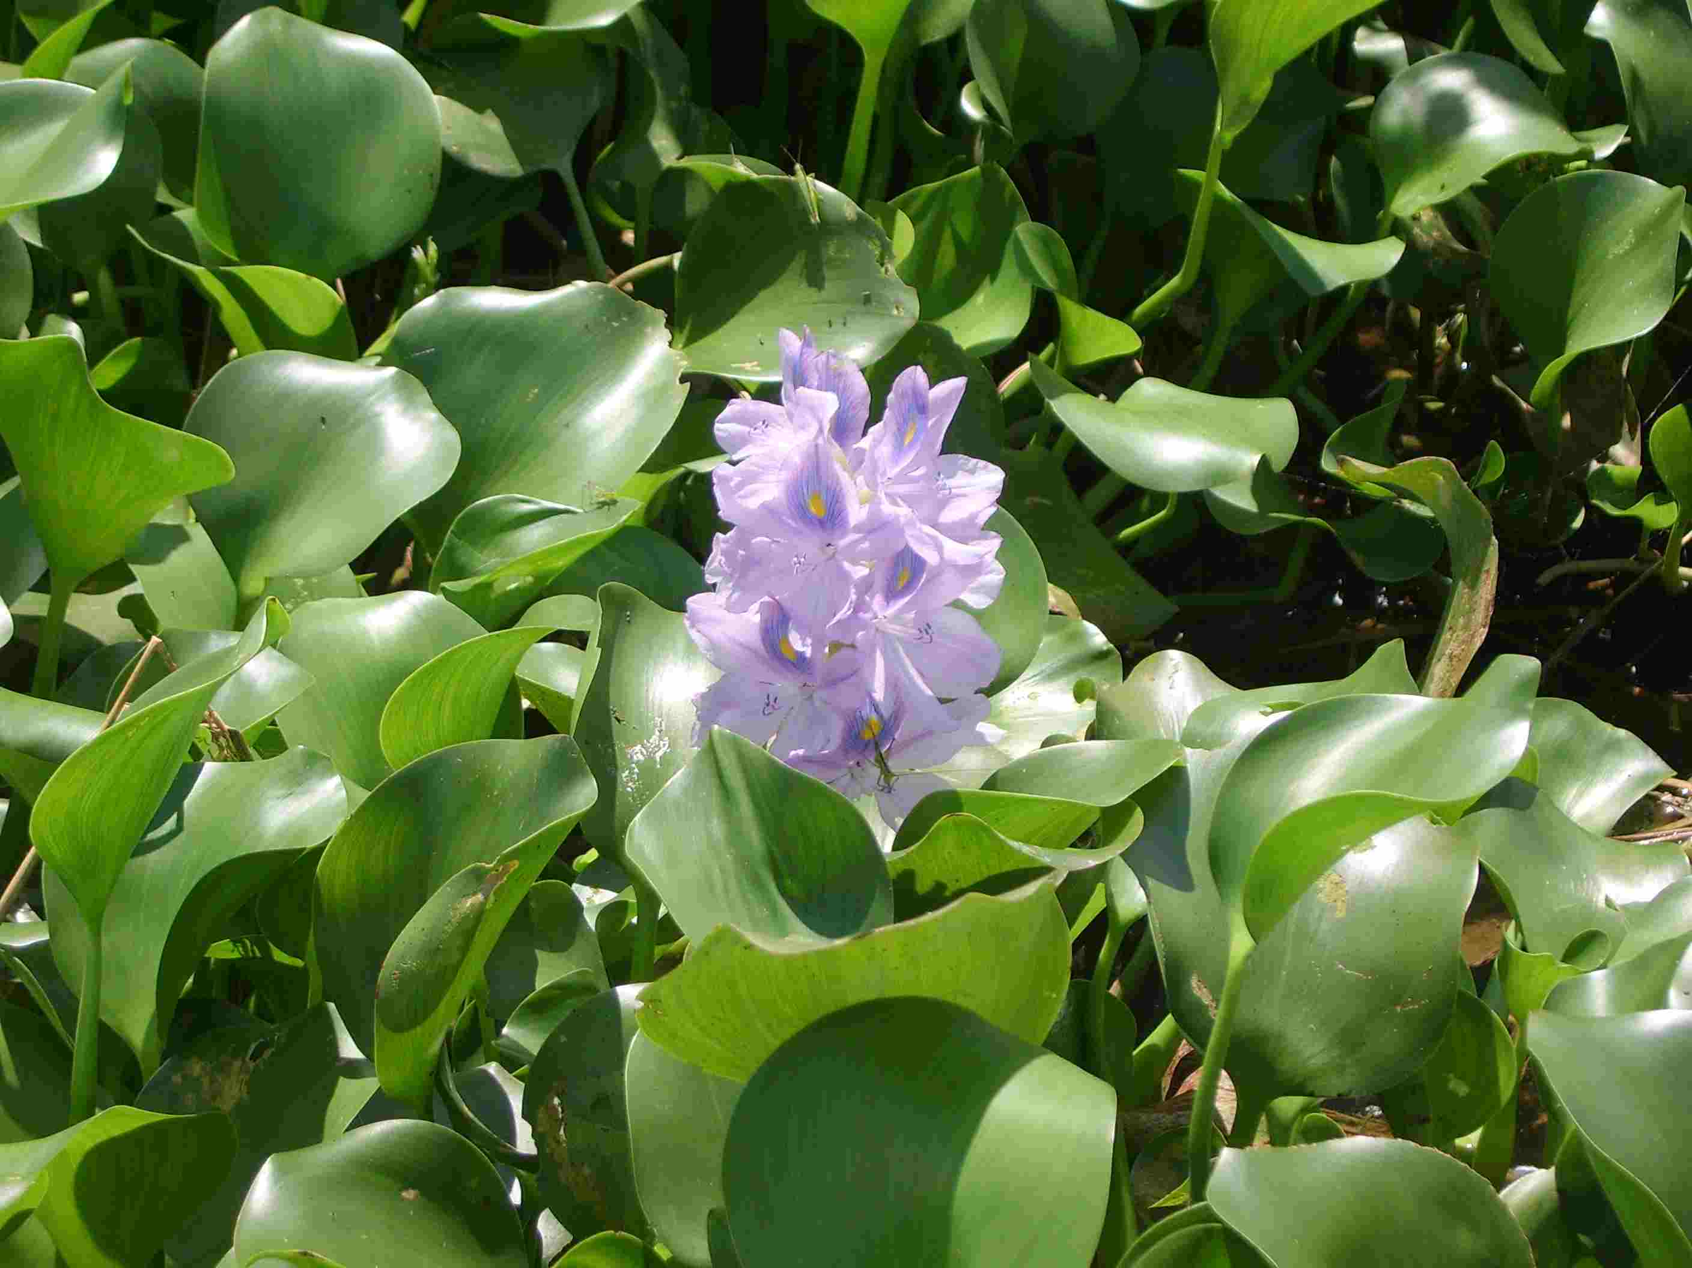
EICHHORNIA
Why known as TERROR OF BENGAL?.
Eichhornia azurea Eichhornia heterosperma
Eichhornia natans Eichhornia diversifolia

Slide 15
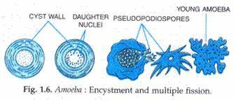
ENCYSTATION AND MULTIPLE FISSION
Under unfavourable condition the Amoeba -encystation.
Under favourable condition- (multiple fission ) pseudopodiospores.

Slide 16
ASSINGNMENTS
(A) Define clones.
(B) What is budding and how it is different in sporulation?
(C) Name vegetative propagation of potato, onion, ginger, Byrophyllum.
(D) Mention the characteristics of zoospores.
(E) Name the asexual buds of penicillium and sponges.

Slide 17
THANKING YOU
ODM EDUCATIONAL GROUP

