Slide 1

WELCOME TO ONLINE CLASS
SUBJECT : ENGLISH
CHAPTER : 3
TOPIC : use of This and That

Slide 2
LET’S LEARN ONCE AGAIN USES OF THIS AND THAT

Slide 3
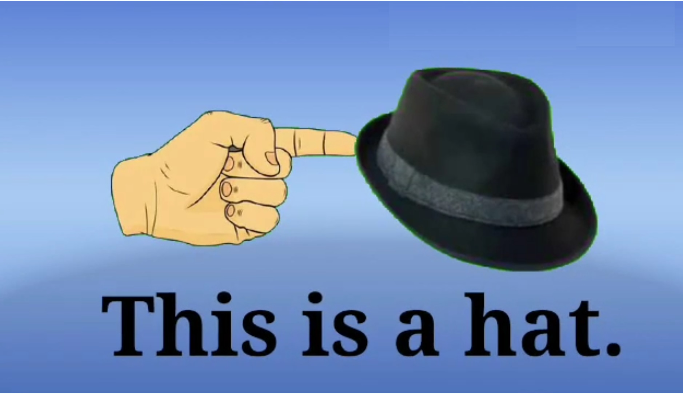

Slide 4
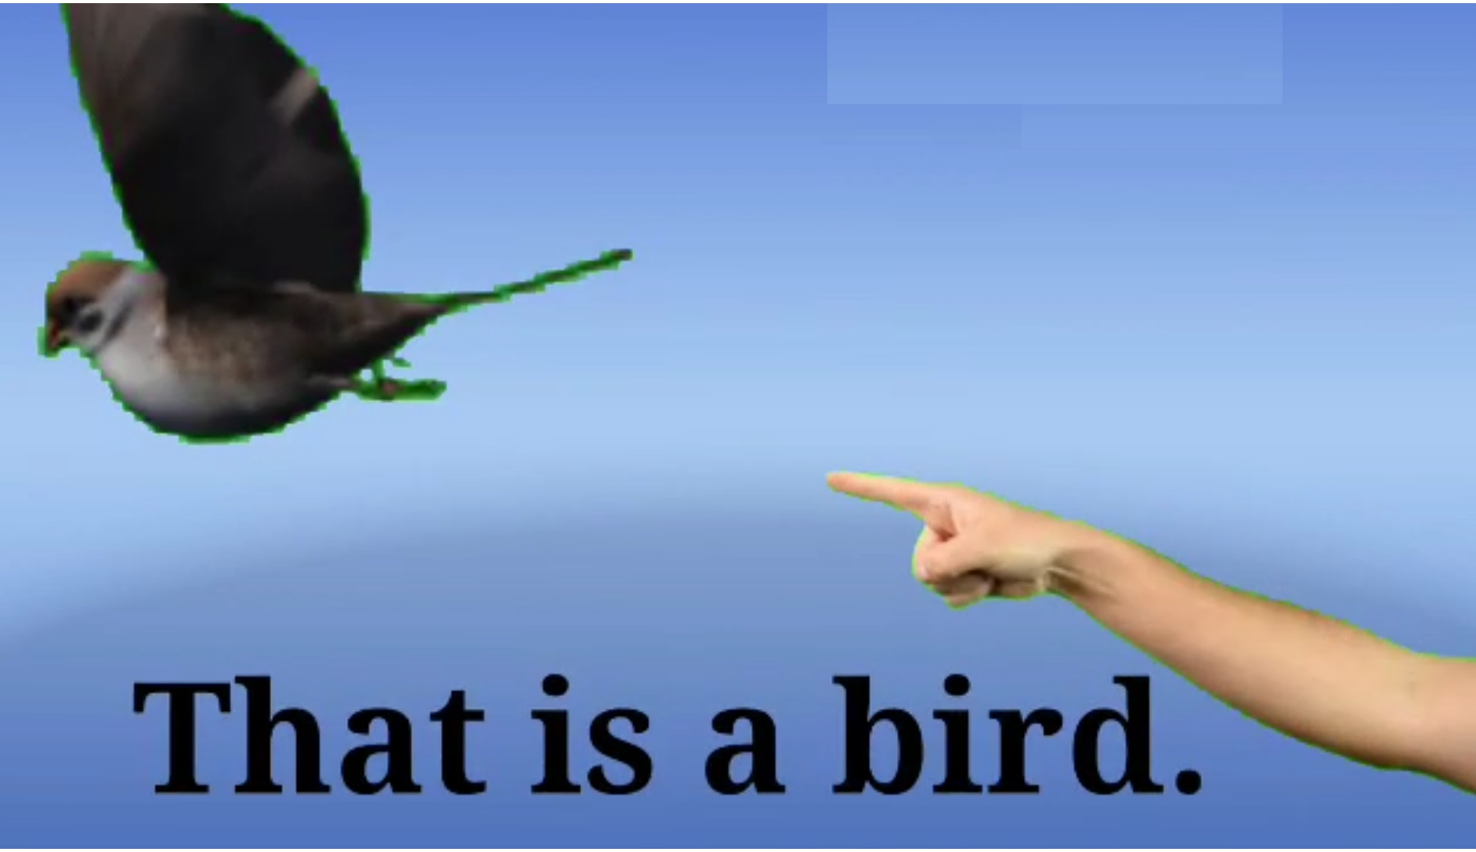

Slide 5
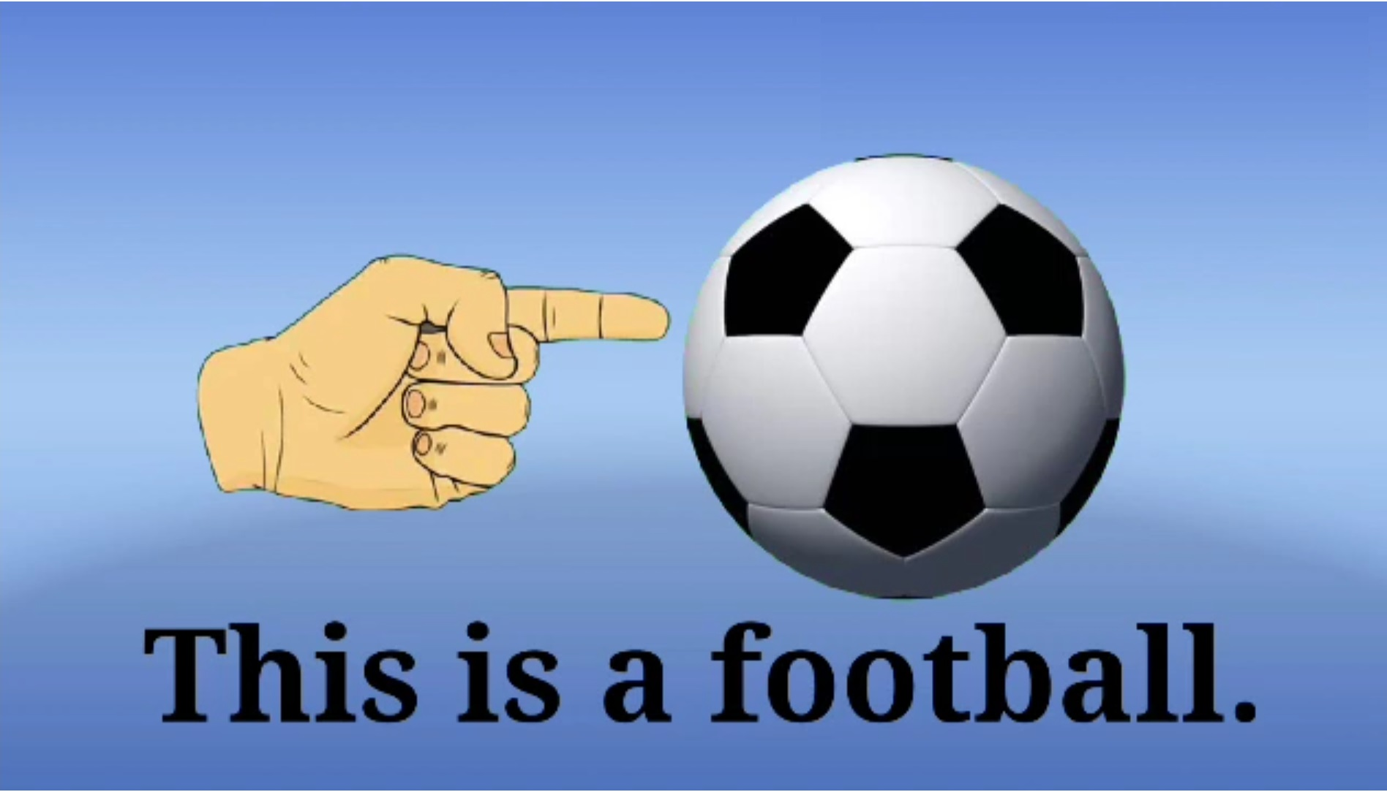

Slide 6
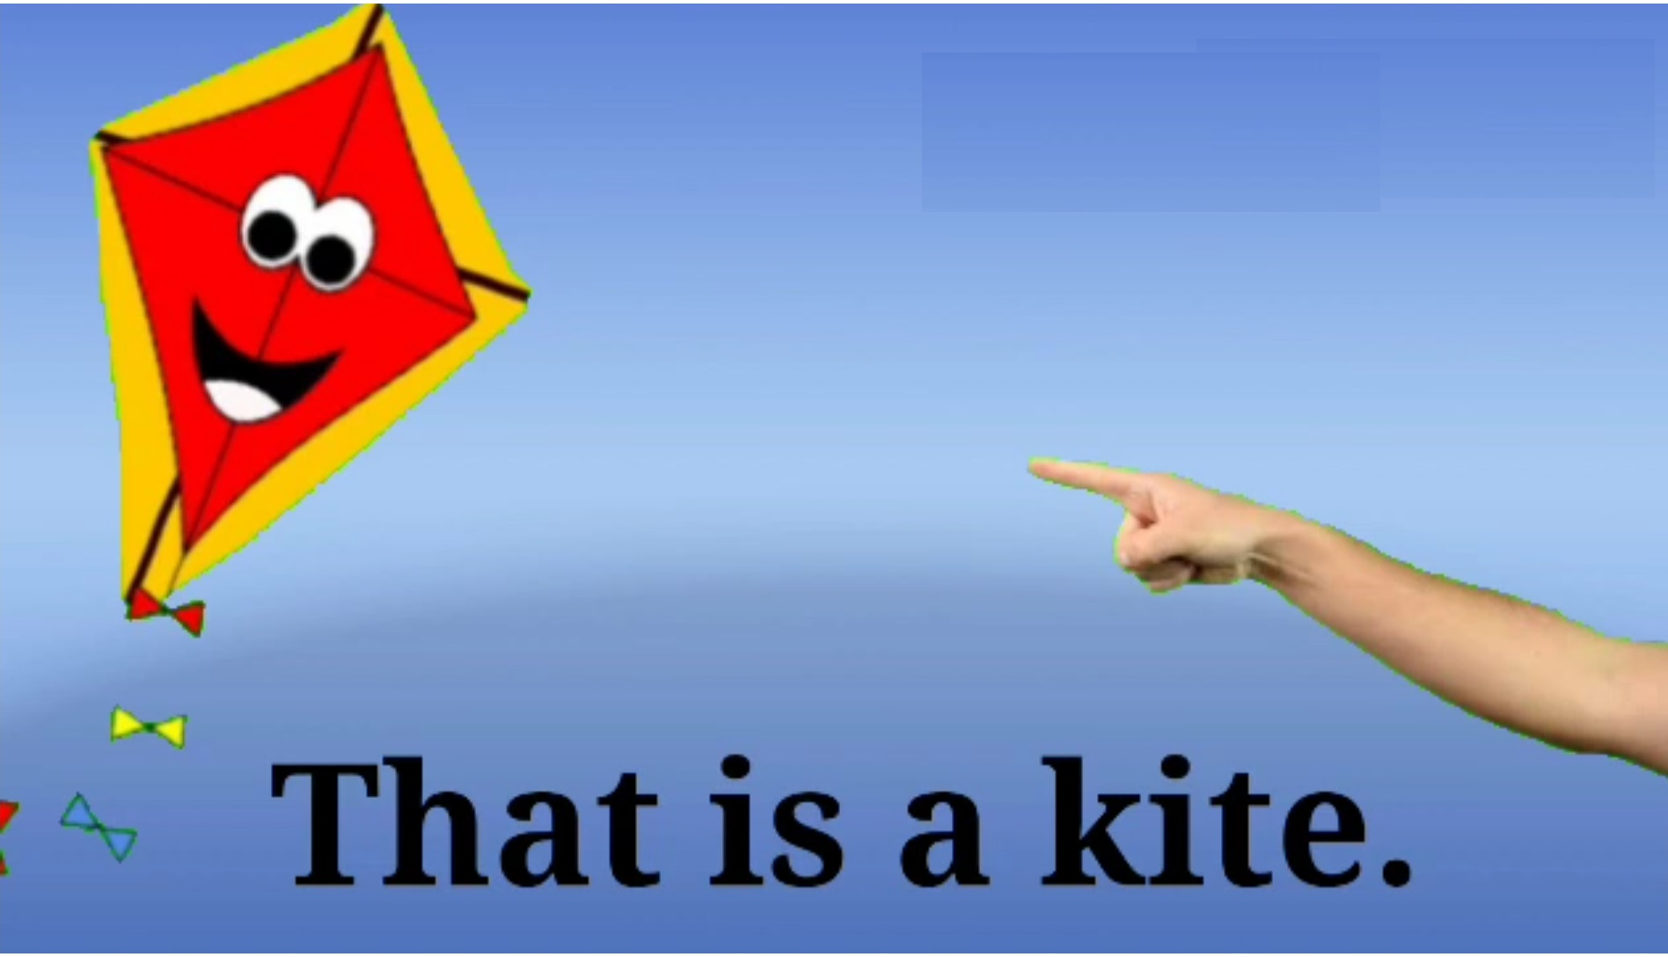

Slide 7
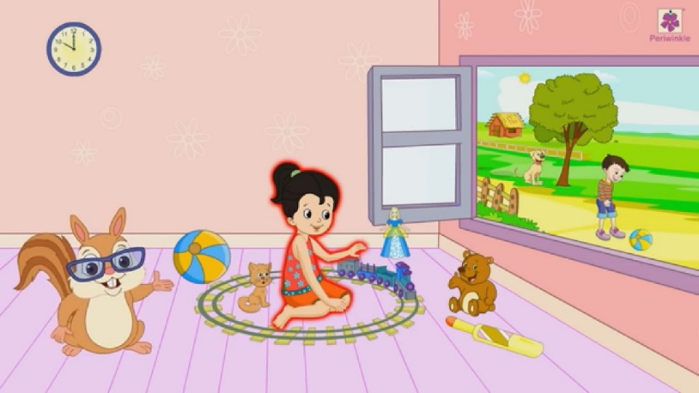
See the picture & complete the sentences using ‘This’ or ‘That’
__________ is a ball
__________ is a tree
__________ is a girl
__________ is a hut
__________ is a dog
__________ is a watch
__________ is a toy train
__________ is a doll
CLASS ASSIGNMENT

Slide 8
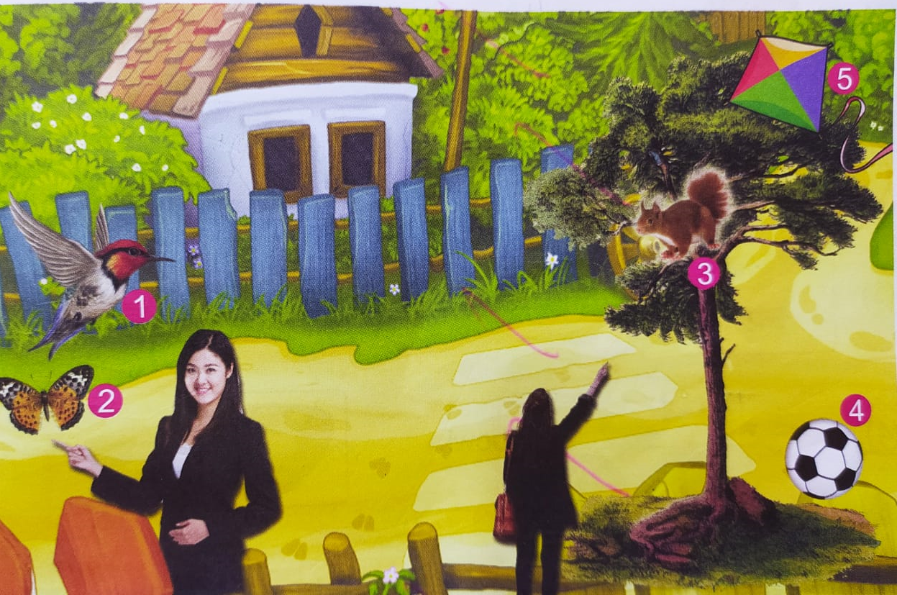
See the picture & complete the sentences using ‘This’ or ‘That’
HOME ASSIGNMENT
__________ is a bird
__________ is a butterfly
__________ is a squirrel
__________ is a ball
__________ is a kite

