Slide 1

WELCOME TO ONLINE CLASS
CLASS-UKG
SUBJECT-STORY
TOPIC-THE SELFISH DOG
(English)

Slide 2

An ox and a dog

Slide 3

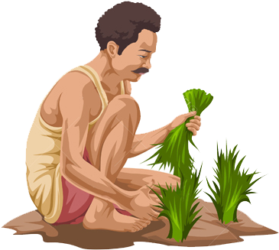
A farmer

Slide 4
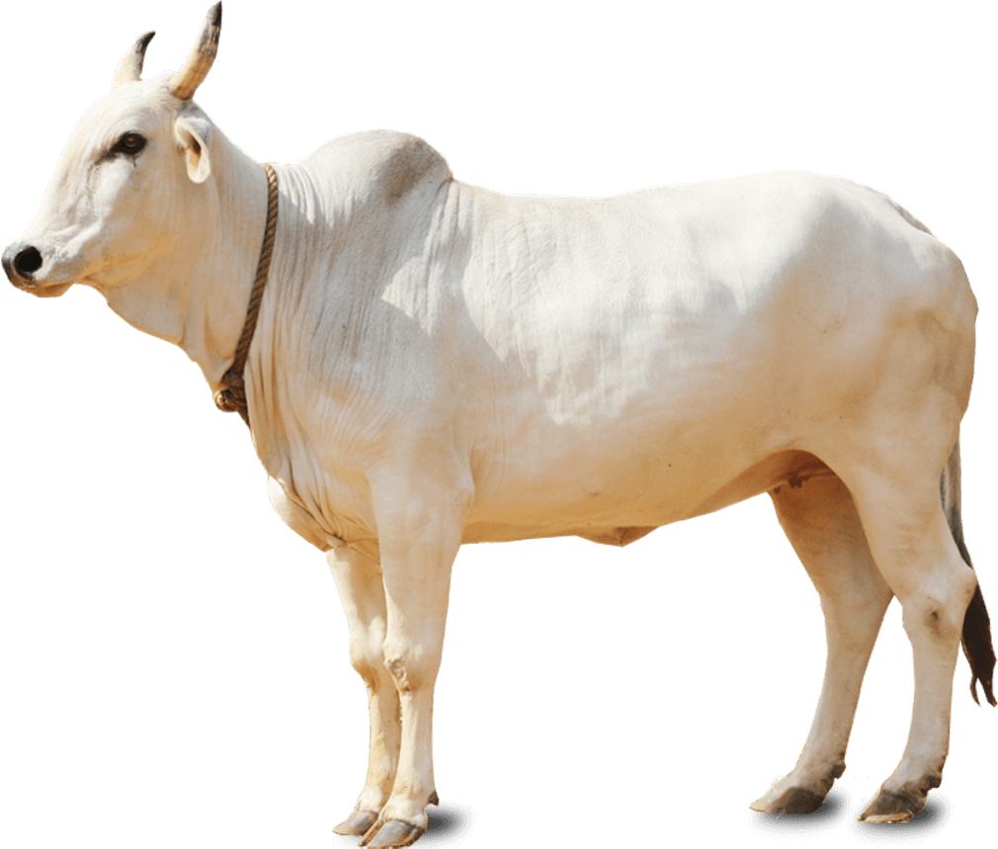
An ox

Slide 5

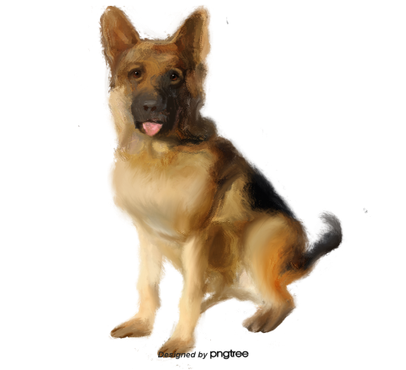
A dog

Slide 6
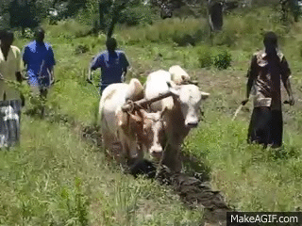

Slide 7
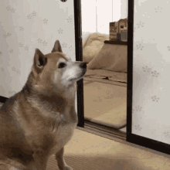

Slide 8

THANKING YOU
ODM EDUCATIONAL GROUP

