Slide 1

WELCOME TO ONLINE CLASS
CLASS : UKG
SUBJECT : ENGLISH
CHAPTER : 3 ( ‘oa’ sound words)
TOPIC : Name the pictures and sight word

Slide 2
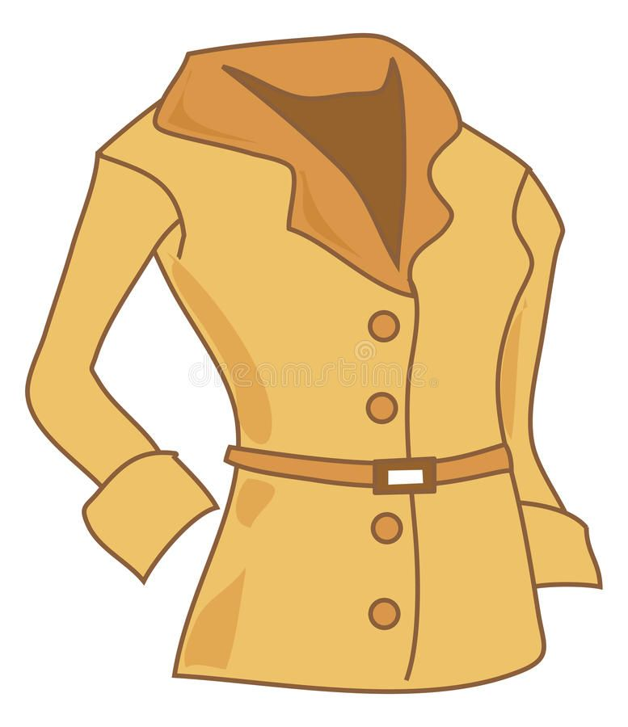
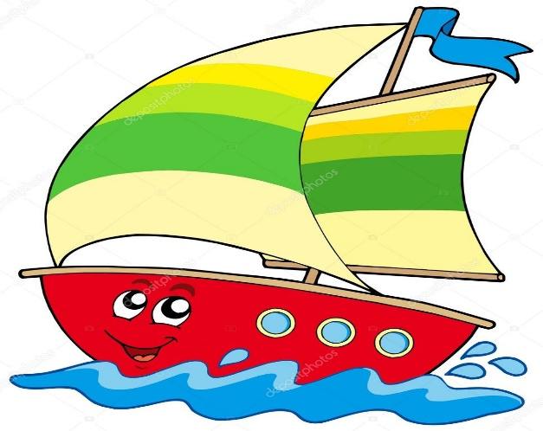

Name the pictures (REVISION) Class Assignment
COAT
BOAT
SOAP

Slide 3

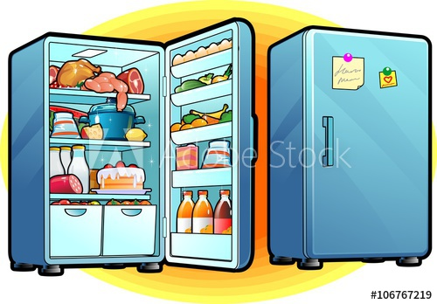
FRIDGE
SHELF

Slide 4
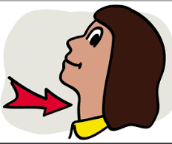
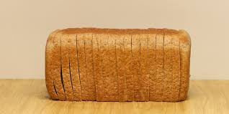
throat
loaf

Slide 5
SIGHT WORDS
the
has
them
this
here
for
has
of
is
for
wears
that

Slide 6
HOME ASSIGNMEN T
Make sentences using the sight words given below –
    wears
    For
    Here
    This
    That

Slide 7

THANKING YOU
ODM EDUCATIONAL GROUP

