Slide 1

SUBJECT-ENGLISH
CHAPTER- UNIT-4
Topic-'ing' sound words.
( seen passage)

Slide 2
Lets revise all the 'ing'sound words
ring
sing
king
swing
wings
string

Slide 3
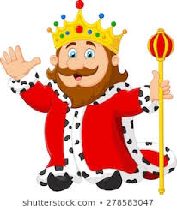
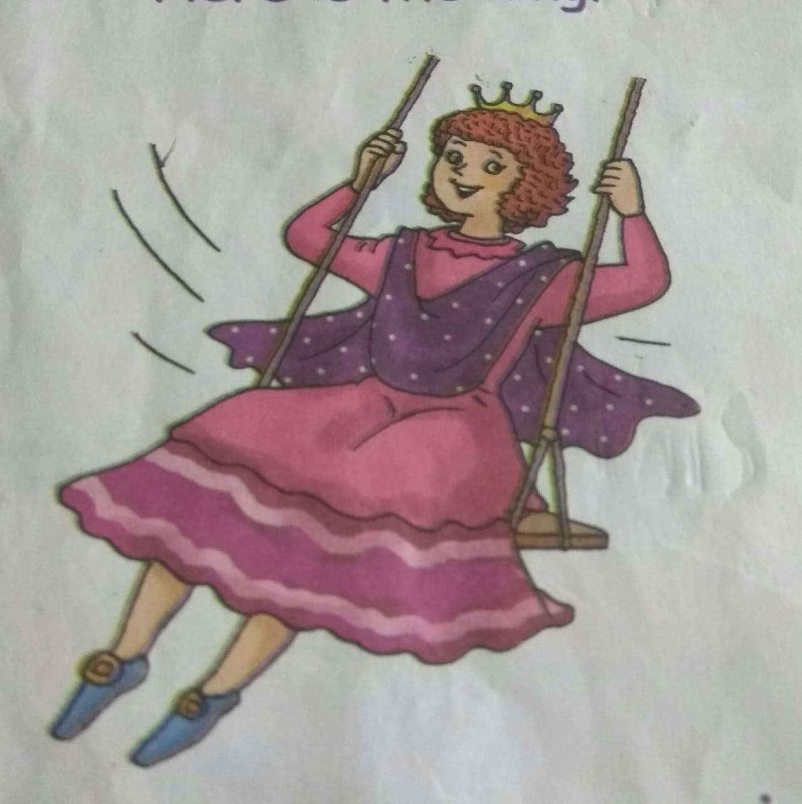
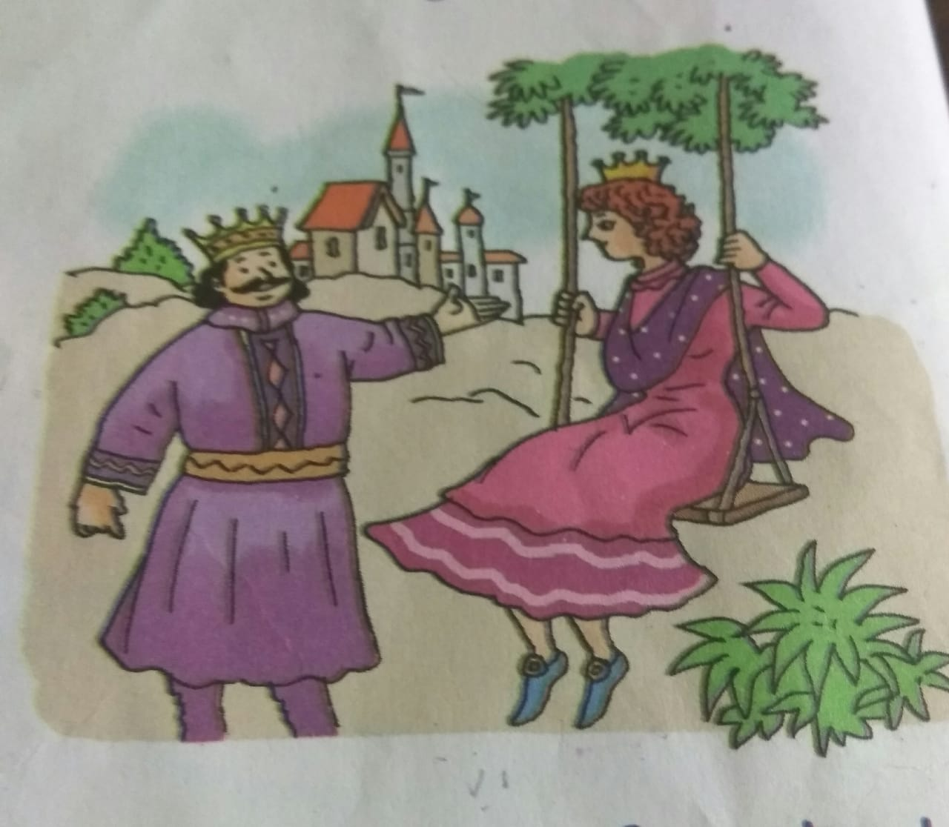
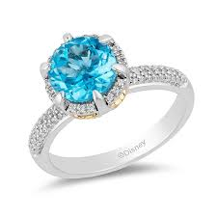
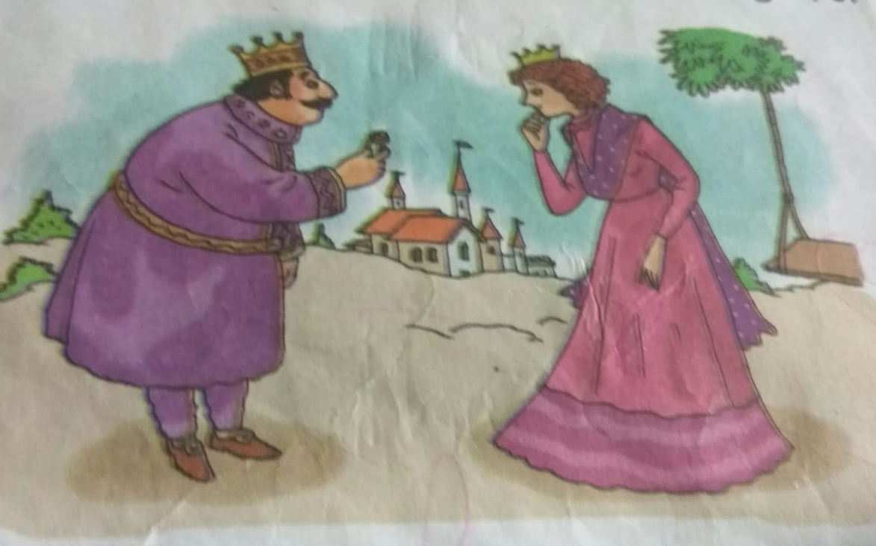

Read the passage and circle the ing sound words
Class Assignment
Here is the king. The king has a ring. The queen sits on the swings. The queen sings for the king. The king gives the queen his ring.

Slide 4
Complete the sentences
HOME Assignment
Here is the ____.
The ____ has a ring.
The queen sits on a _____ .
The queen _____ for the king.
The ____ gives the queen his ring.

Slide 5

THANKING YOU
ODM EDUCATIONAL GROUP

