Slide 1

WELCOME TO THE ON LINE CLASS
CLASS- UKG
SUBJECT-RHYME
TOPIC- COLOUR RHYME
SL.NO - 06 (BK PG-12)

Slide 2

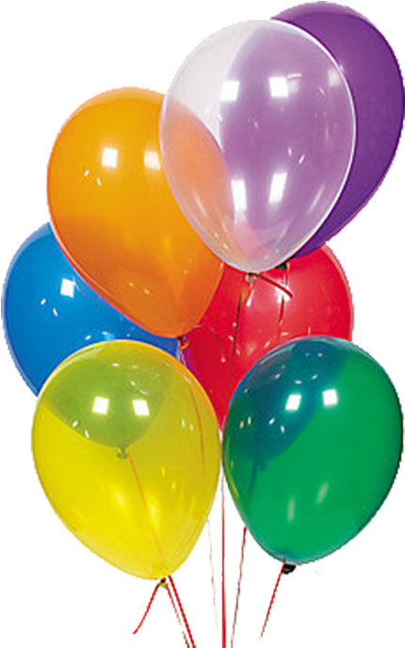





COLOUR RHYME

Slide 3


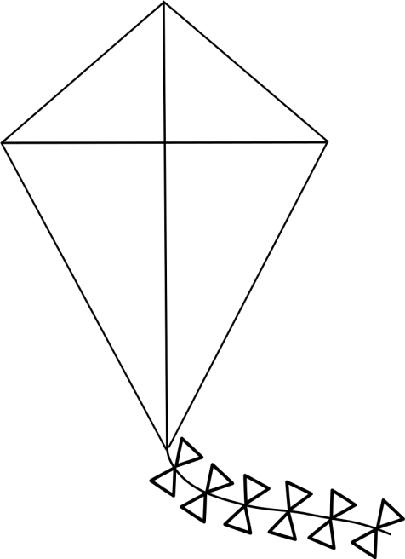
TWO KITES RED AND WHITE ,IN THE SKY SO BLUE
BIG AND SMALL ,ON AND ON THEY FLEW

Slide 4
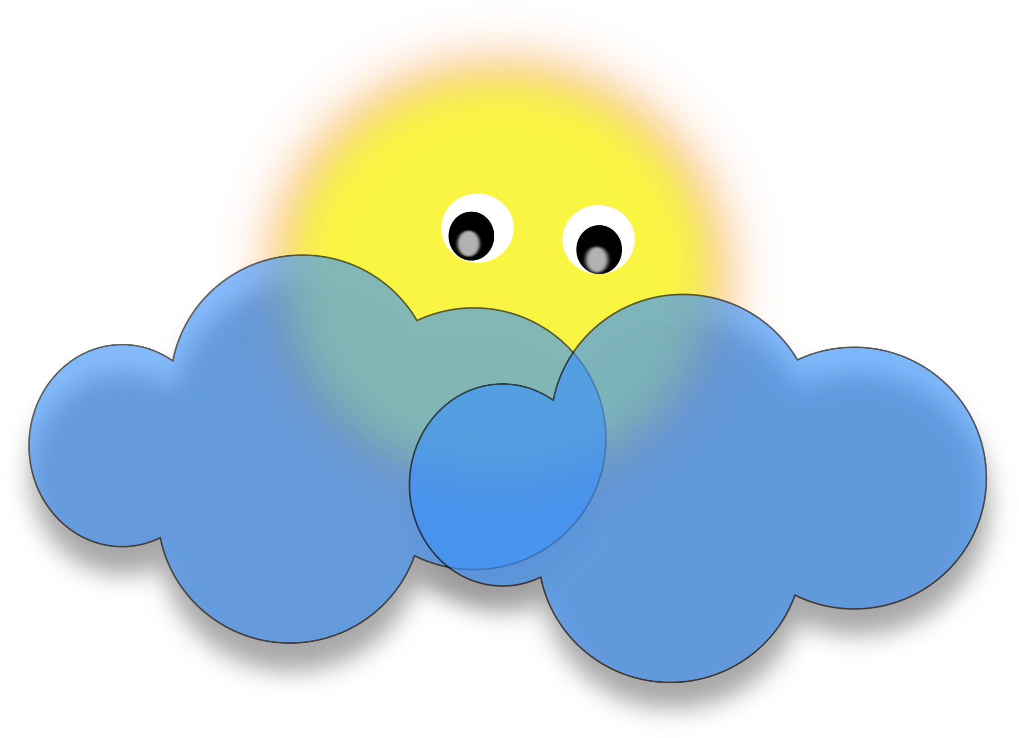

THE YELLOW SUN WATCHED THE FUN ,
CLOUDS WATCHED IT TOO.

Slide 5


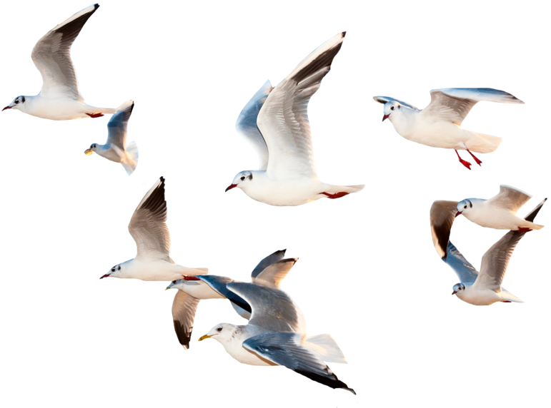

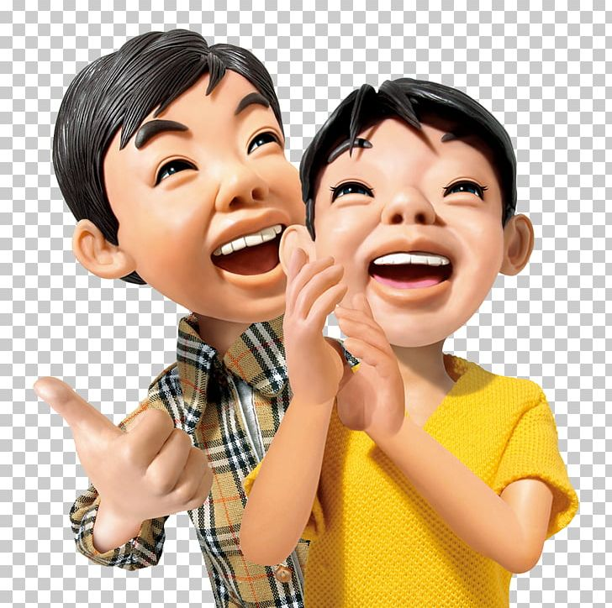
THE BOYS CLAPPED, BIRDS FLAPPED,
THE BREEZE BLEW AND BLEW.

Slide 6
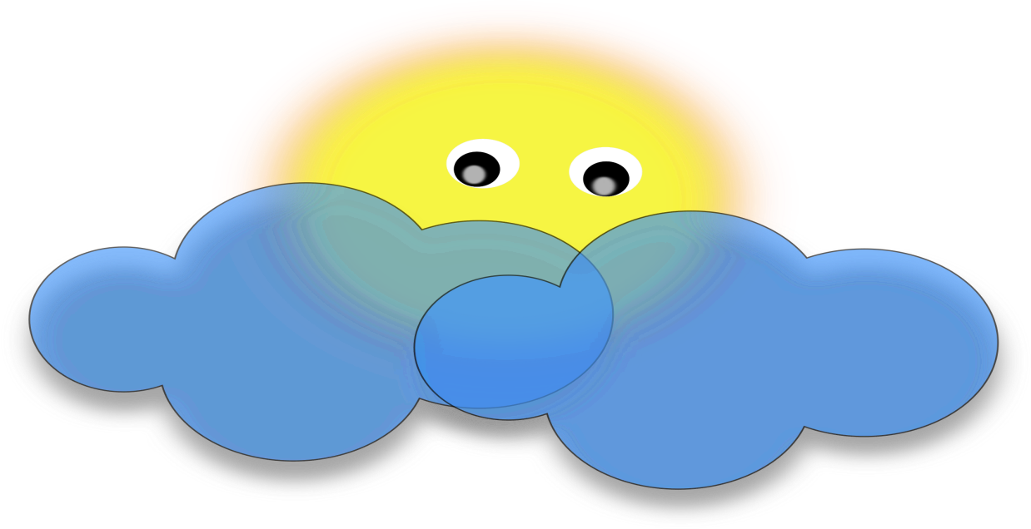
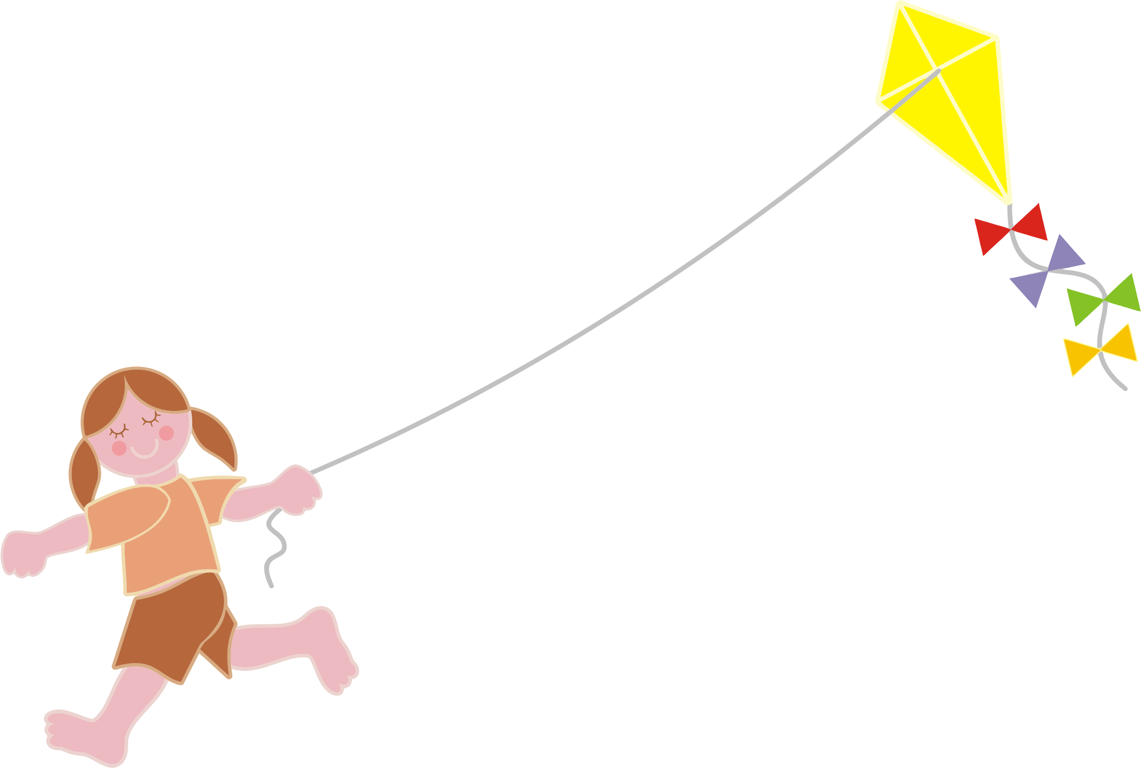
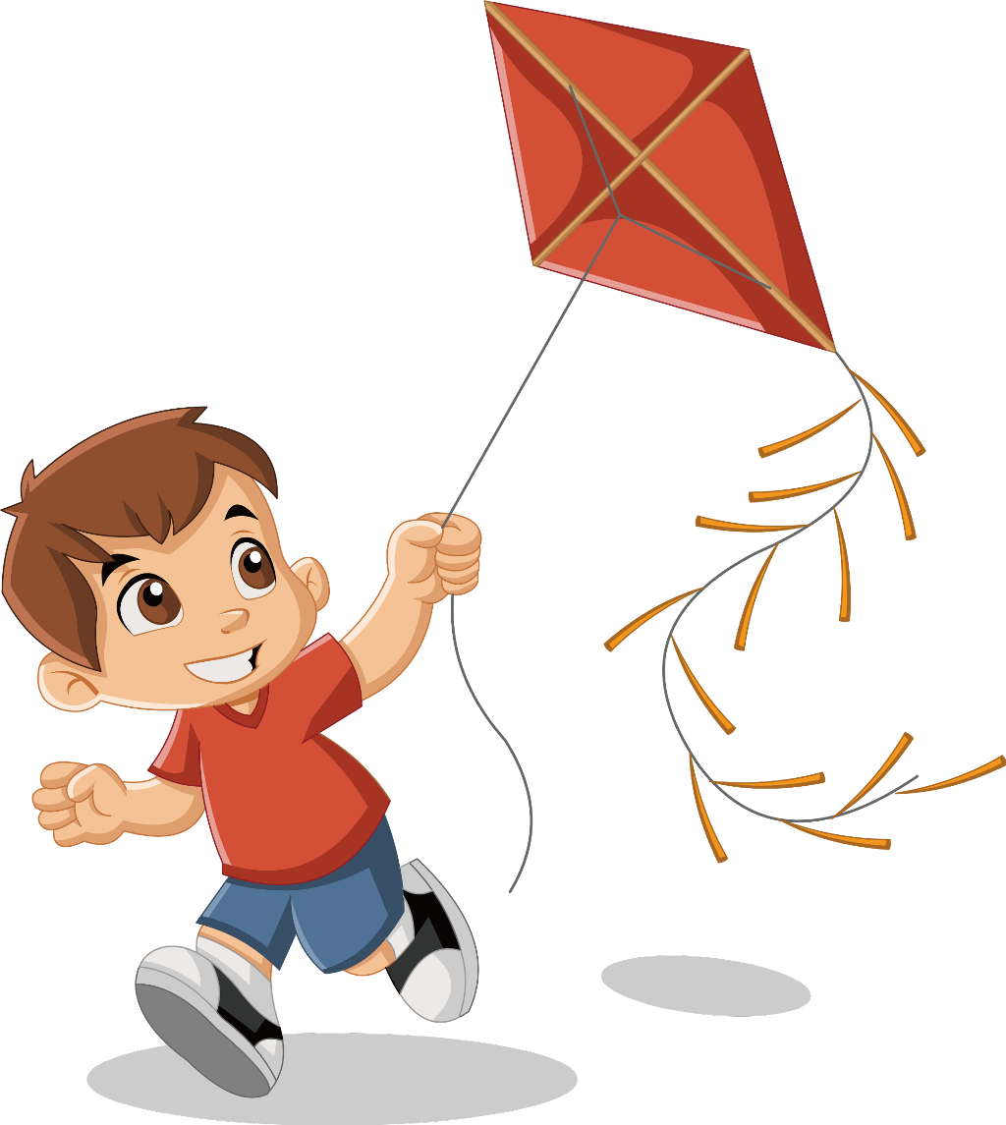
TWO KITES RED AND WHITE,IN THE SKY SO BLUE
BIG AND SMALL,ON AND ON THEY FLEW

Slide 7
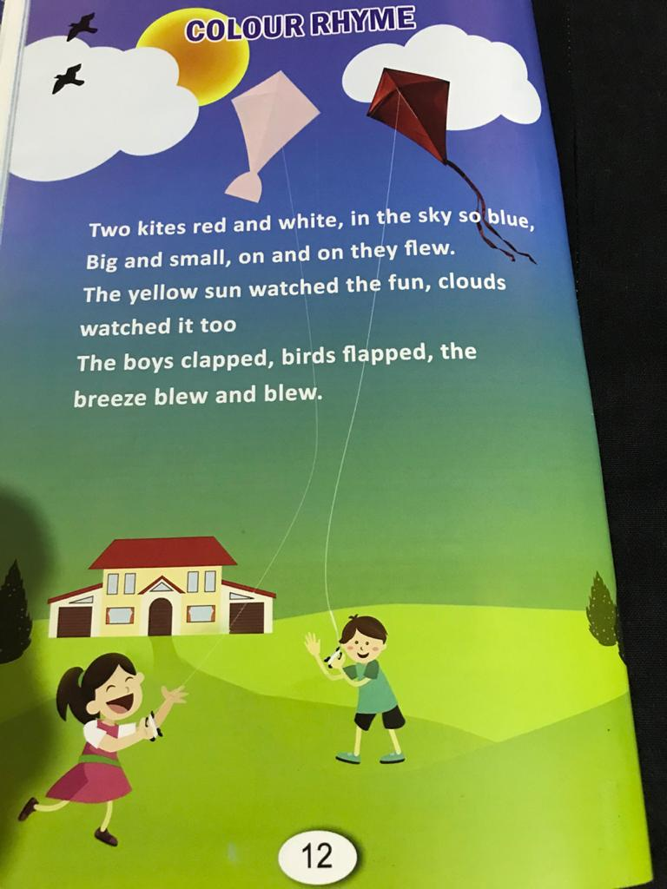

Slide 8

THANKING YOU
ODM EDUCATIONAL GROUP

