Slide 1

WELCOME TO ON LINE CLASS
CLASS-UKG
SUBJECT-MATHS
TOPIC- NUMBER AND NUMBER
NAMES 21-50(ONCE AGAIN)
(DATE-28.7.21)

Slide 2





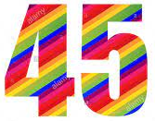

Memory game:

Slide 4
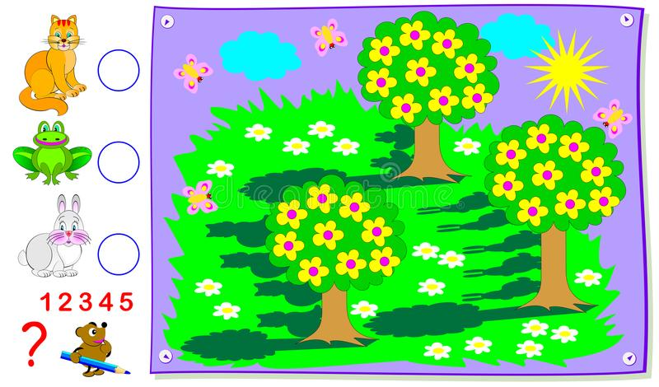
ORAL QUESTIONS:
1- What is the number name of 37?
2- What is the number name of 43?
3- What is the number name of 50?
4- Count how many yellow flowers are there?
5- Count how many white flowers are there?
6 - Count how many butterflies are there?
7 - Count how many trees and its shadows are there?

Slide 5
Count forward and say the numbers:
45
46
26
27
33
34

Slide 6
c/w 28.7.21
Write the number names
21
38
24
43
29
47
35
50

Slide 7

THANKING YOU
ODM EDUCATIONAL GROUP

