Slide 1

WELCOME TO ONLINE CLASS
CLASS : UKG
SUBJECT : ENGLISH
CHAPTER : 2 ( ‘n’ sound words)
TOPIC : Passage reading.

Slide 2

LET’S READ THE FOLLOWING SENTENCES
This is a net

Slide 3
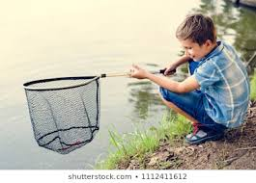
This is a new net

Slide 4

I sit near the
river.

Slide 5

I want to catch
nine fish.

Slide 6
LISTEN AND REPEAT
This is a net. This is a new net. I sit near the river. I want to catch nine fish.

Slide 7
Fill in the missing letter’s ( Class Assignment )
n __ t
n __ w
ne __
ne__ r

Slide 8
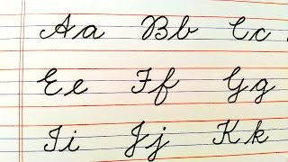
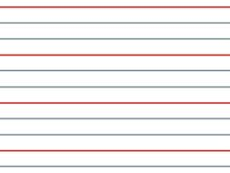
cw
11.05.21
Let’s write cursive (in nbk)

Slide 9
HOME ASSIGNMENT
READ BOOK PAGE – 9 (TWICE)

Slide 10

THANKING YOU
ODM EDUCATIONAL GROUP

