Slide 1

WELCOME TO ONLINE CLASS
CLASS : UKG
SUBJECT : ENGLISH
CHAPTER : 2 ( ‘n’ sound words)
TOPIC : Passage reading.

Slide 2

LET’S READ THE FOLLOWING SENTENCES
This is a net

Slide 3
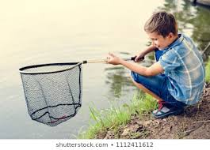
This is a new net

Slide 4

I sit near the
river.

Slide 5

I want to catch
nine fish.

Slide 6
LISTEN AND REPEAT
This is a net . This is a new net . I sit near the river . I want to catch nine fish.

Slide 7
Fill in the missing letter’s ( Class Assignment )
n _ t
n _ w
ne _
ne_ r

Slide 8
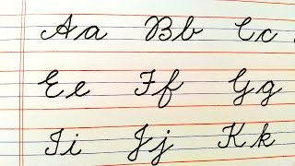
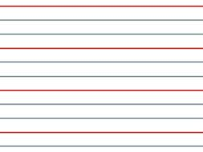
cw
11.05.21
Let’s write cursive (in nbk)

Slide 9
HOME ASSIGNMENT
READ BOOK PAGE – 9 (TWICE)

Slide 10

THANKING YOU
ODM EDUCATIONAL GROUP

