Slide 1



CLASS : NURSERY
DATE :26/07/21
SUBJECT-STORY
CHAPTER NUMBER-2
SUB-TOPIC : THE LION
AND
THE MOUSE
(sequencing)

Slide 2

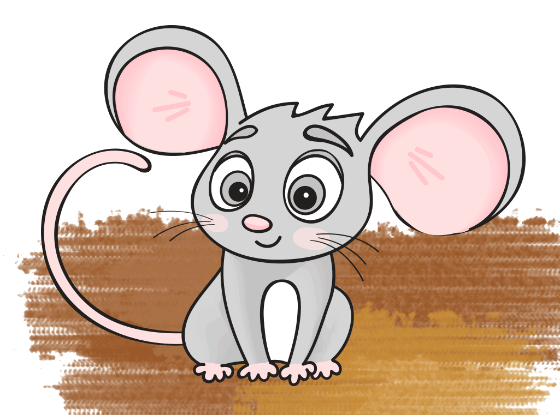

LION
MOUSE

Slide 3
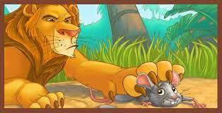
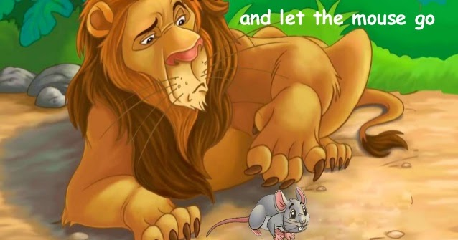
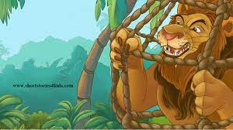
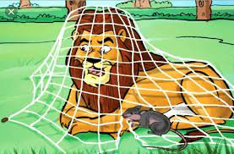
1
2
4
3

Slide 4

5

Slide 5
THANKING YOU
ODM EDUCATIONAL GROUP
THANKING YOU
ODM EDUCATIONAL GROUP

