Slide 1



CLASS : NURSERY
DATE :19/07/21
SUBJECT-STORY
CHAPTER NUMBER-2
SUB-TOPIC : THE LION
AND
THE MOUSE

Slide 2
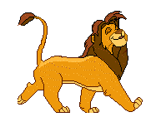

LION

Slide 3
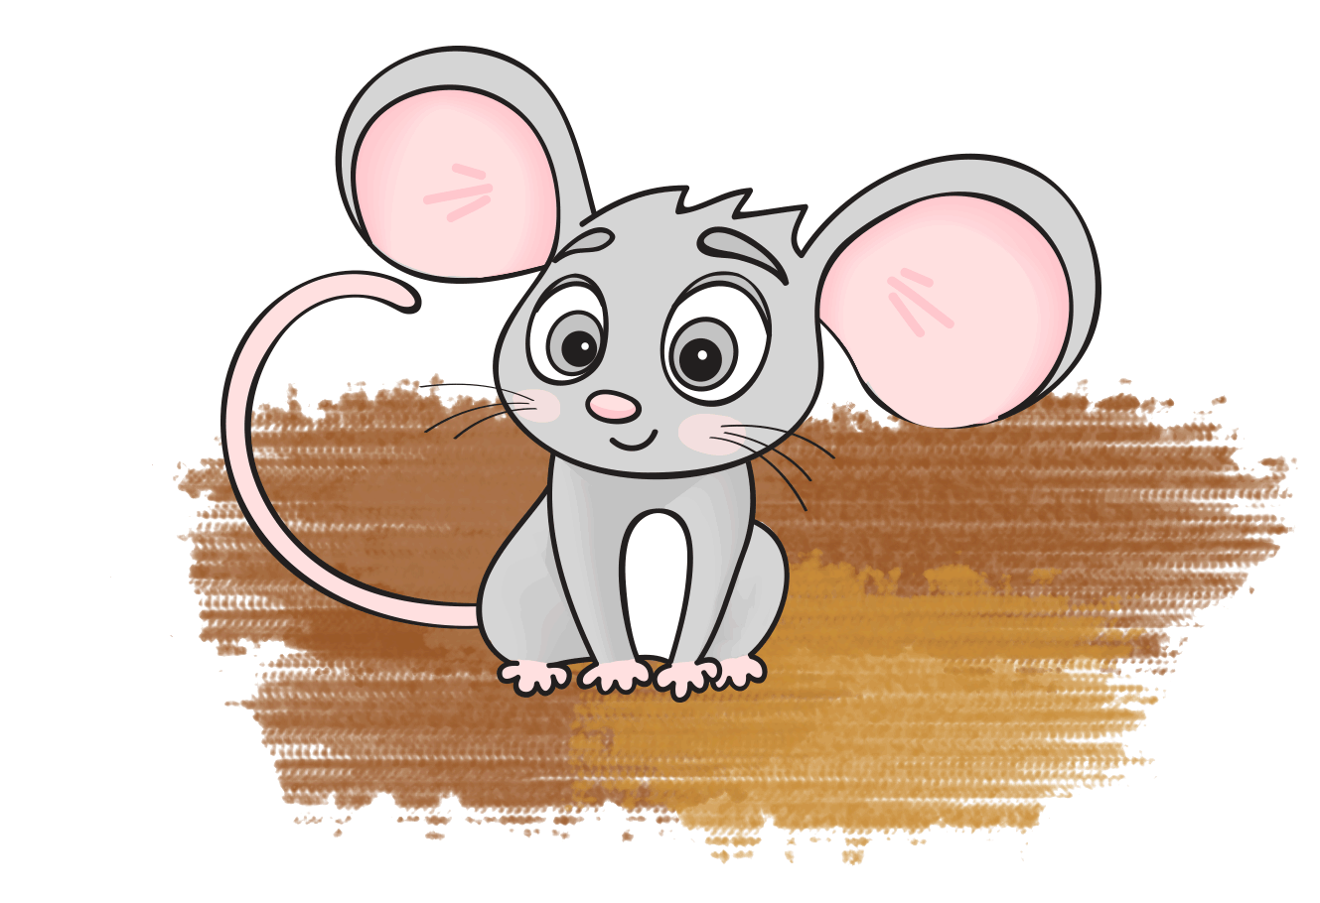
MOUSE

Slide 4
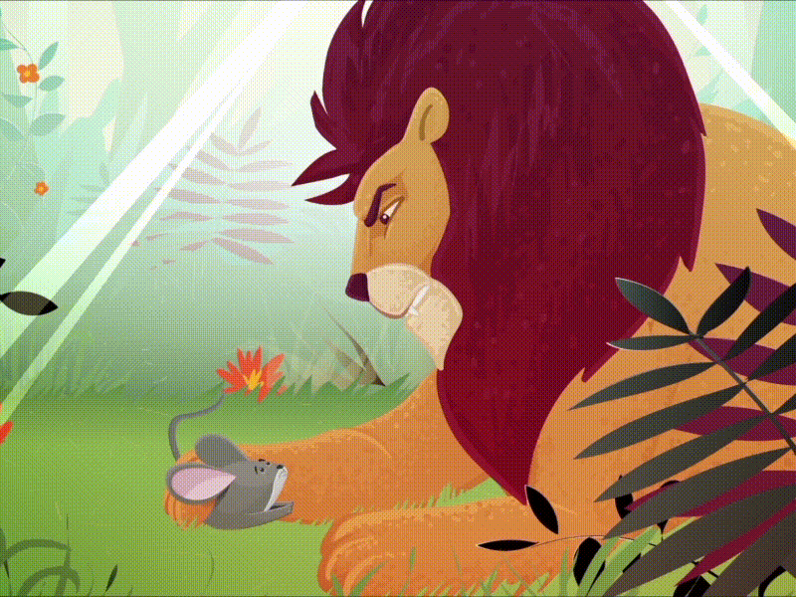
Story :The Lion and The Mouse

Slide 5
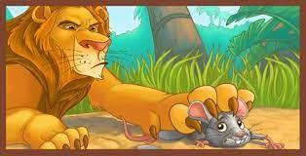
Once a lion caught a mouse.

Slide 6
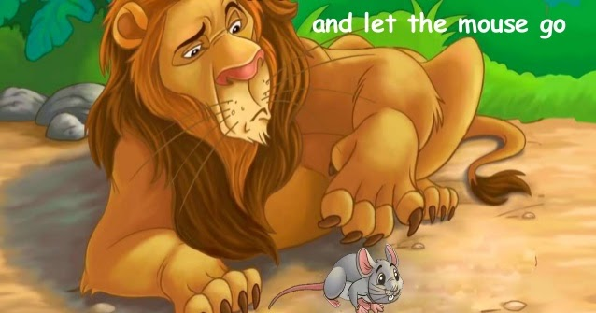
The mouse said "please don’t eat me. I will do you a favor”
So the lion let him go.

Slide 7
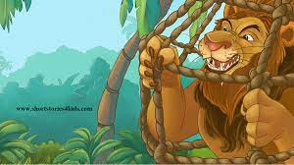
One day the lion got caught in a hunter’s net.
The mouse saw it.

Slide 8
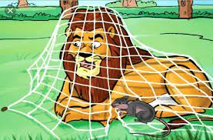
It came along the net and chewed the ropes.
And let the lion loose.
and the lion was free

Slide 9


Slide 10
THANKING YOU
ODM EDUCATIONAL GROUP
THANKING YOU
ODM EDUCATIONAL GROUP

