Slide 1

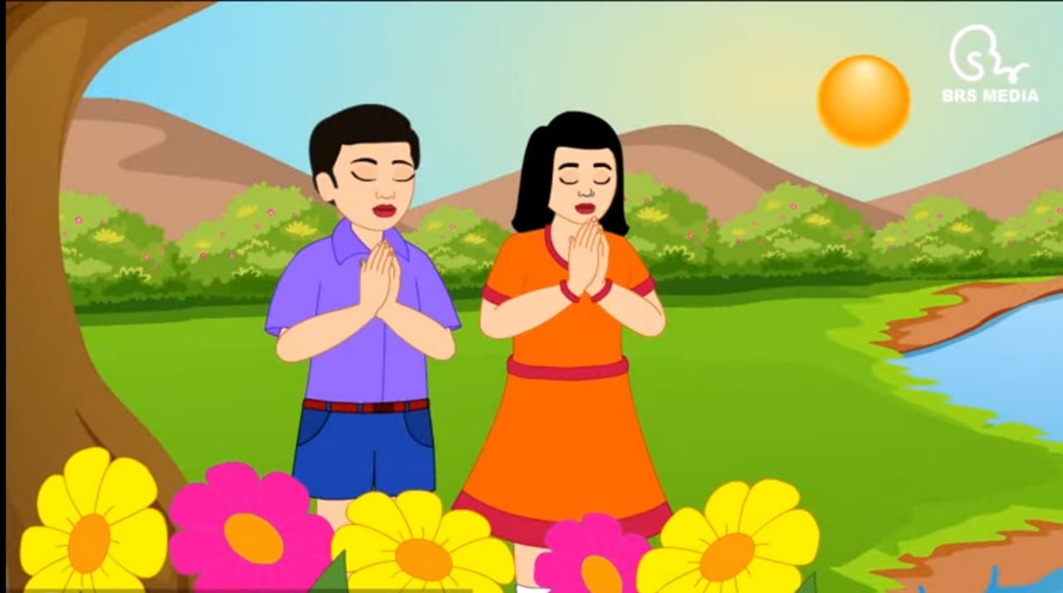
WELCOME TO ONLINE CLASS
CLASS - NURSERY
SUBJECT - RHYMES (HINDI)
TOPIC - VINITI SUNLO……….

Slide 2



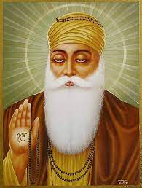
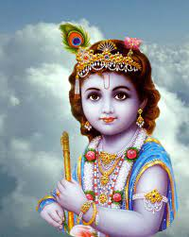

Slide 3

VINITI SUNLO HE BHAGWAN ,
HUM SAB BALAK HE NADAAN …

Slide 4
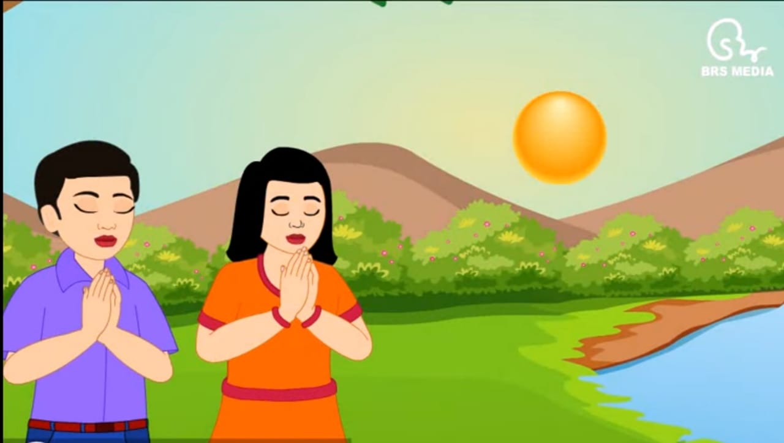
DO HUMKO TUM YAHA BARDAAN ,
PADH LIKH KAR HUM BANE MAAHAN….

Slide 5
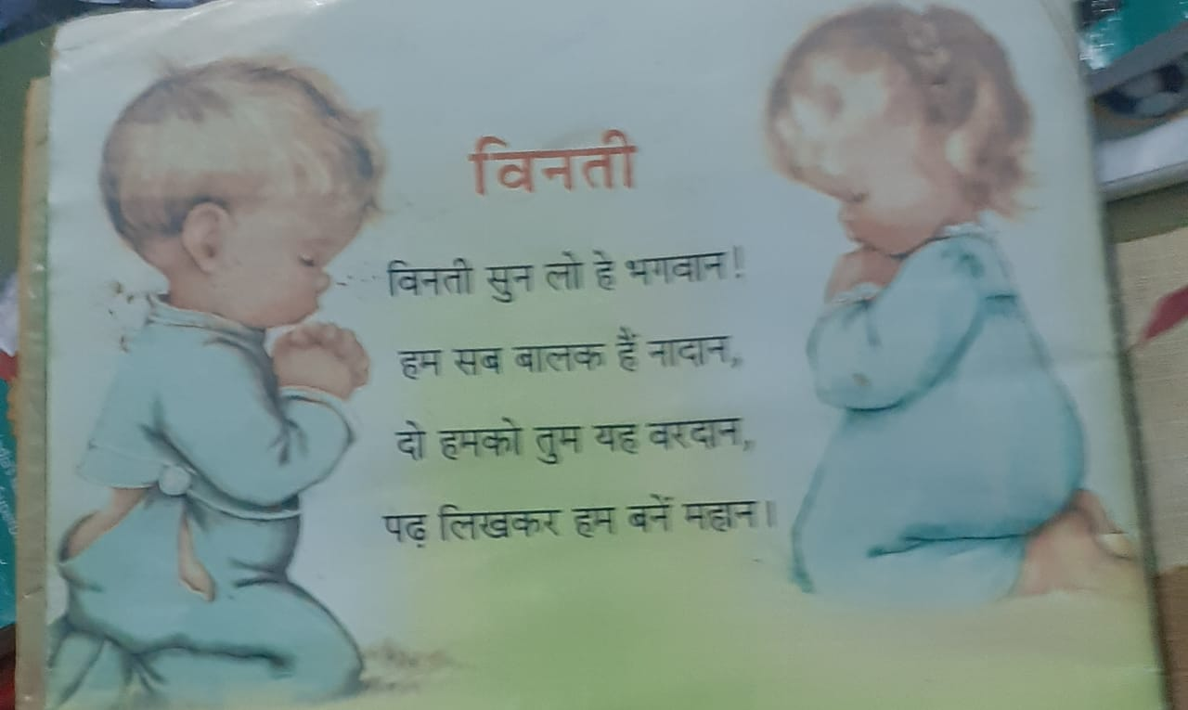

Slide 6


