Slide 1

WELCOME TO ONLINE CLASS
CLASS : UKG
SUBJECT : ENGLISH
CHAPTER : 2 ( ‘n’ sound words)
TOPIC : Jumbled words and word train

Slide 2


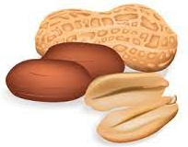
RE- ARRANGE THE JUMBLED WORDS
inne
nine
etn
net
utn
nut

Slide 3



CLASS ASSIGNMENT
sernu
nurse
osen
nose
tens
nest

Slide 4
ACTIVITY (ORAL)
WORD TRAIN
River
Rat
Table
Engine
Elephant

Slide 5
HOME ASSIGNMENT
MAKE A WORD TRAIN
Nurse

Slide 6

THANKING YOU
ODM EDUCATIONAL GROUP

