Slide 1

WELCOME TO ONLINE CLASS
CLASS : UKG
SUBJECT : ENGLISH
Chapter : 5 (“oo”) sound words

Slide 2
LET’S READ THE WORDS
BOOK
COOK
TOOK
FOOT
LOOKL
STOOD
FOOT
HOOK
GOOD

Slide 3
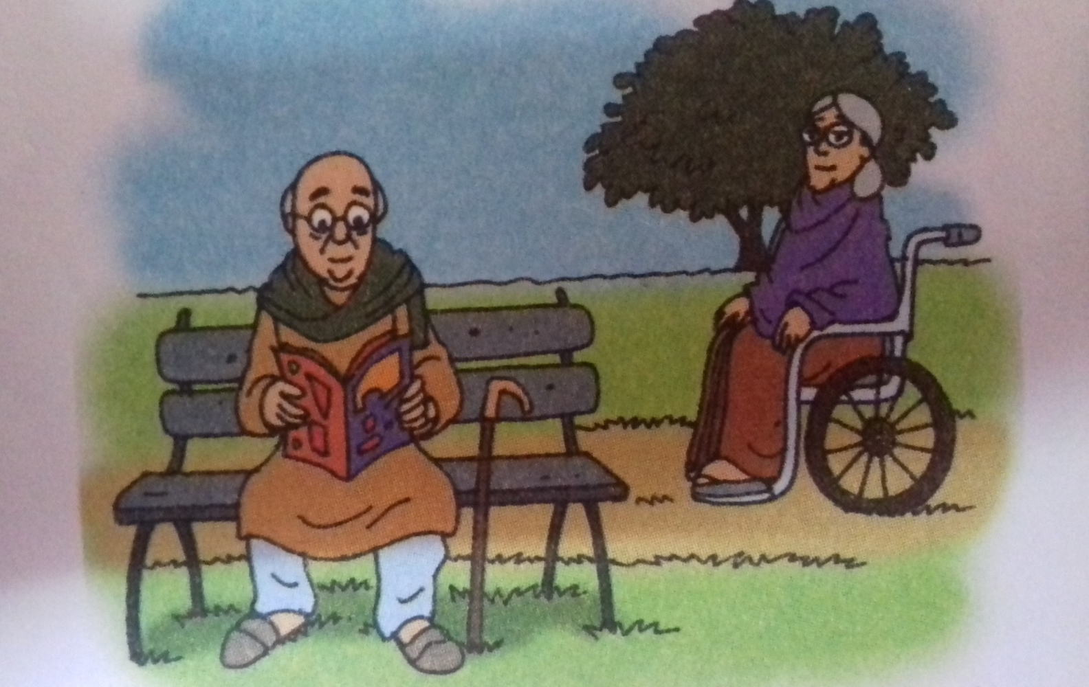
LET’S READ THE PASSAGE
Everyday Grandfather and Grand mother come to the park with Vineet.

Slide 4
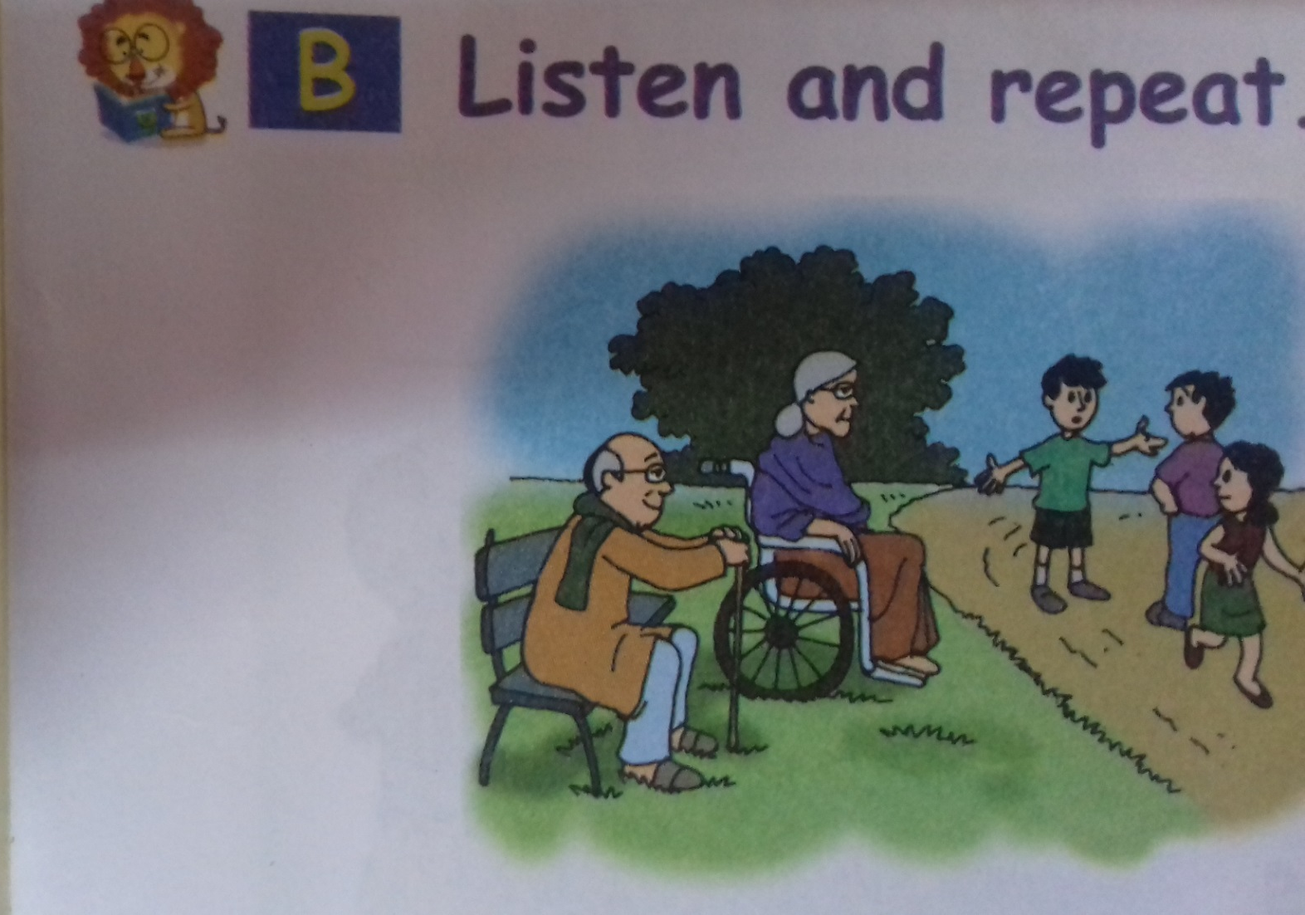
They looks at the children play.
.

Slide 5


Vineet plays with his friends, Varun and Nisha
.

Slide 6
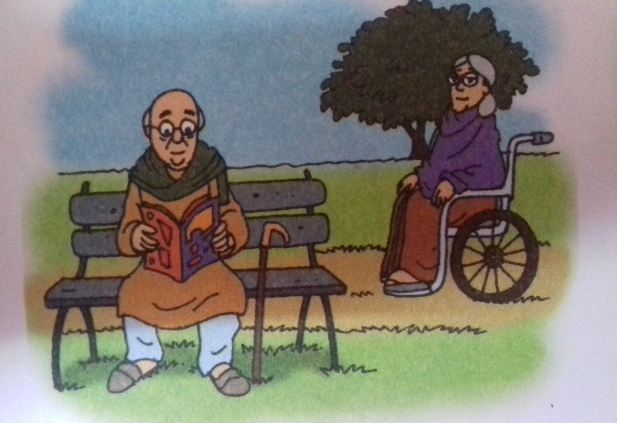
Then, Grandfather reads a book.

Slide 7
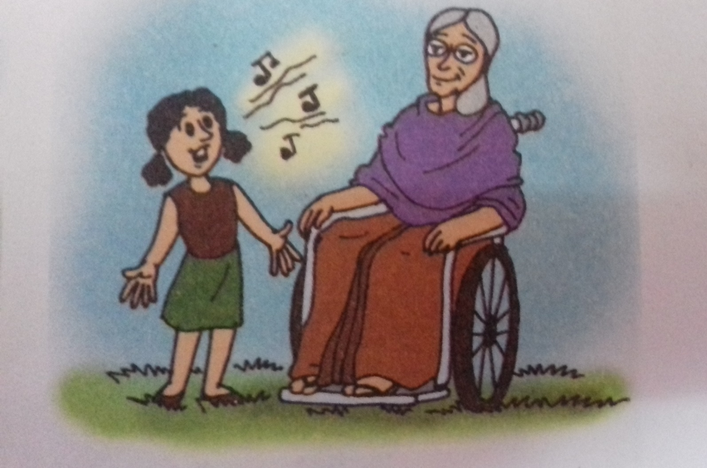
Nisha sings for Grandmother “Good” says the grandmother

Slide 8
ACTIVITY
CLASS ASSIGNMENTS : LET’S READ THE PASSAGE
Everyday ,Grandfather and Grand mother come to the park with Vineet.
They look at the children play. Vineet plays with his friends Varun and Nisha.
Then, Grand father reads a Book. Nisha sings for Grand mother “Good” says Grandmother
.

Slide 9
Home Assignment : Learn new words
Grand Father
Grand Mother
Park
Friends
Sing
Varun
Nisha
Vineet

Slide 10

THANKING YOU
ODM EDUCATIONAL GROUP

