Slide 1

WELCOME TO ONLINE CLASS
SUBJECT-ENGLISH
CHAPTER- 1
TOPIC – “f” sound words (Revision - 1)

Slide 2





C.W 16.9.21
“ f “ sound words ( Revision)
Identify the pictures and write the correct spellings.

Slide 3

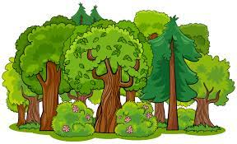
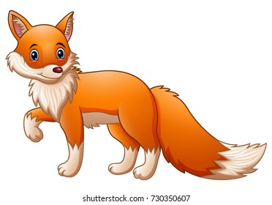
Circle the correct spelling .
Flour , floor , flower
Forest , fourst , foerest
Box , fox , fux

Slide 4

Home Assignment : Write the correct ‘f’ sound word.
1. IFLL - …………..
2. OODF - ………..
3. IGF - …………..
4. TOFO - ………..
5. INFGRE - …………

Slide 5

THANKING YOU
ODM EDUCATIONAL GROUP

