Slide 1

WELCOME TO ONLINE CLASS
SUBJECT-ENGLISH
CHAPTER- 6
TOPIC – PASSAGE READING (‘ch’ sound words)

Slide 2
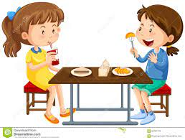

CLASS ASSIGNMENT : PASSAGE READING
Chinky is a girl. She likes to eat chips, cheese, chocolate, chicken, cherries . One day I was at lunch when I saw my friend, Chinky. She sat next to me on the bench . We had our lunch . It was fun !

Slide 3

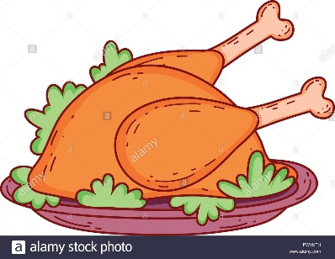



Write in your notebook .
Identify the pictures and write the correct spellings.

Slide 4
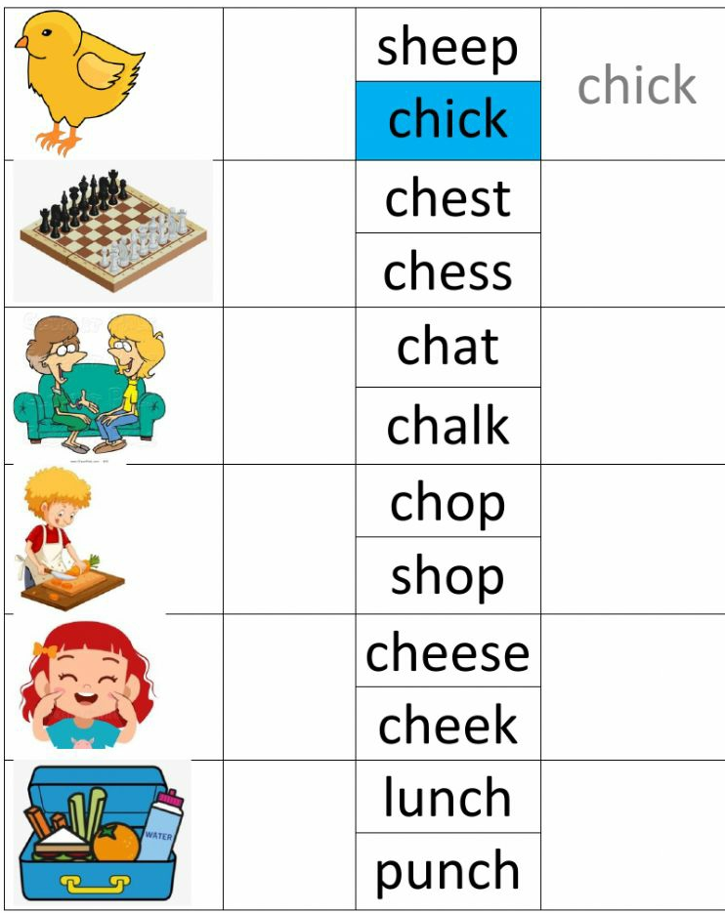
Identify the pictures and choose the correct option. Then write it .

Slide 5





Home Assignment : From the centre match the words ending with ‘ch’ sound.
-ch

Slide 6

THANKING YOU
ODM EDUCATIONAL GROUP

