Slide 1

WELCOME TO ONLINE CLASS
CLASS : UKG
SUBJECT : ENGLISH
CHAPTER : 2 ( ‘n’ sound words)
TOPIC : Use of in, on, under, near (BOOK WORK)

Slide 2
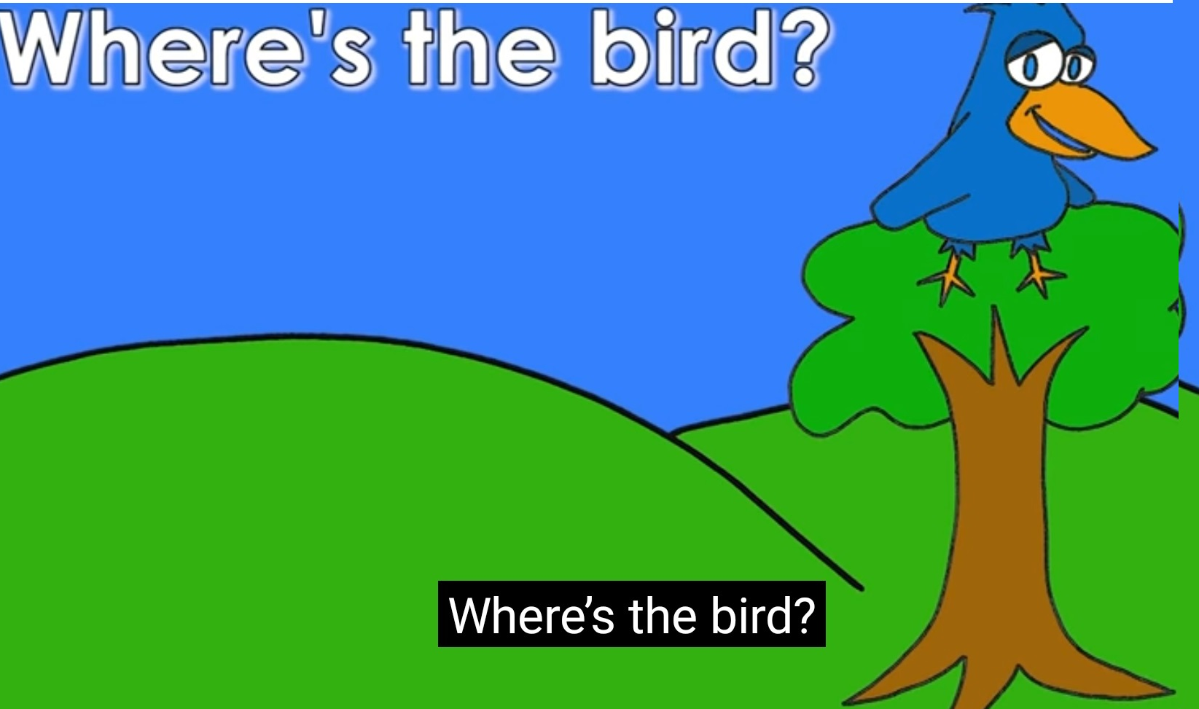
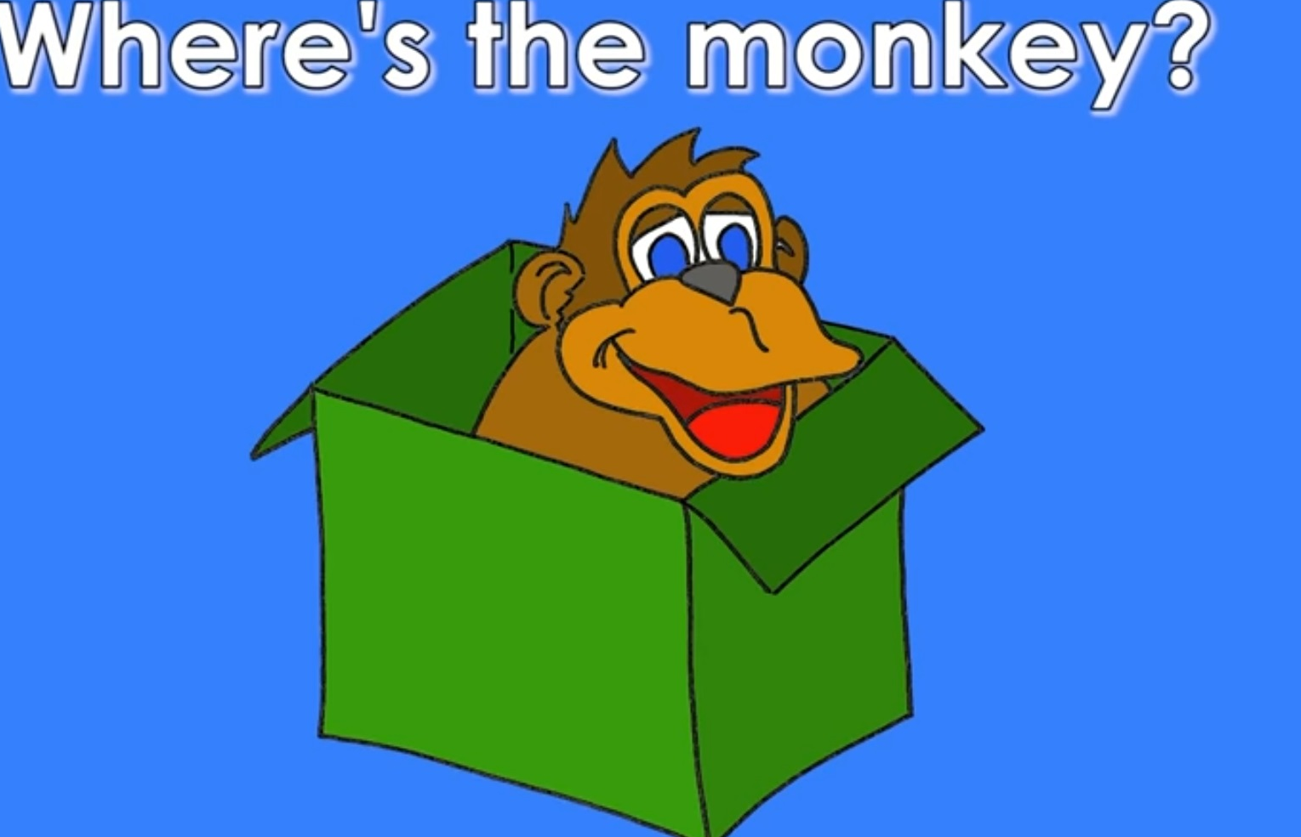
LET’ LEARN ONCE AGAIN
on
The bird is _____ the tree .
in
The monkey is _____ the box .

Slide 3
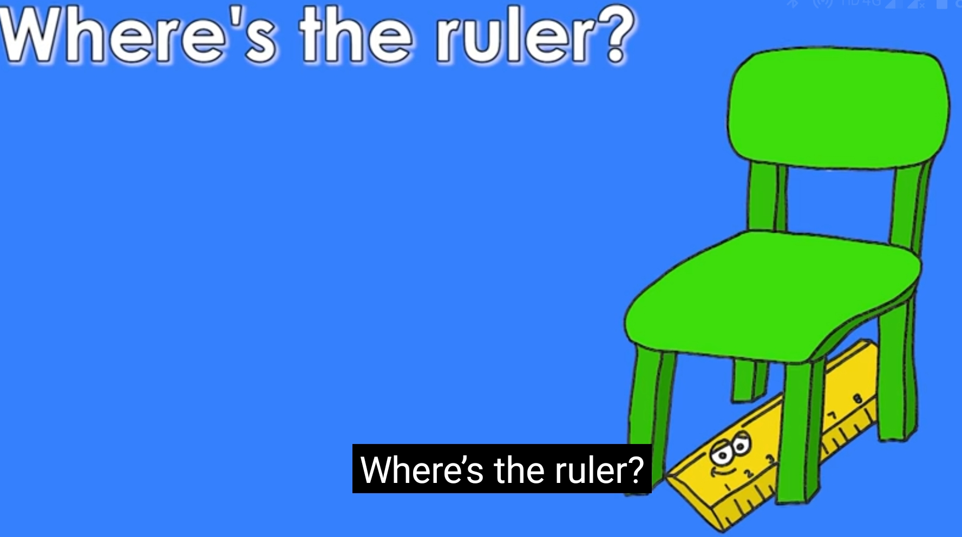
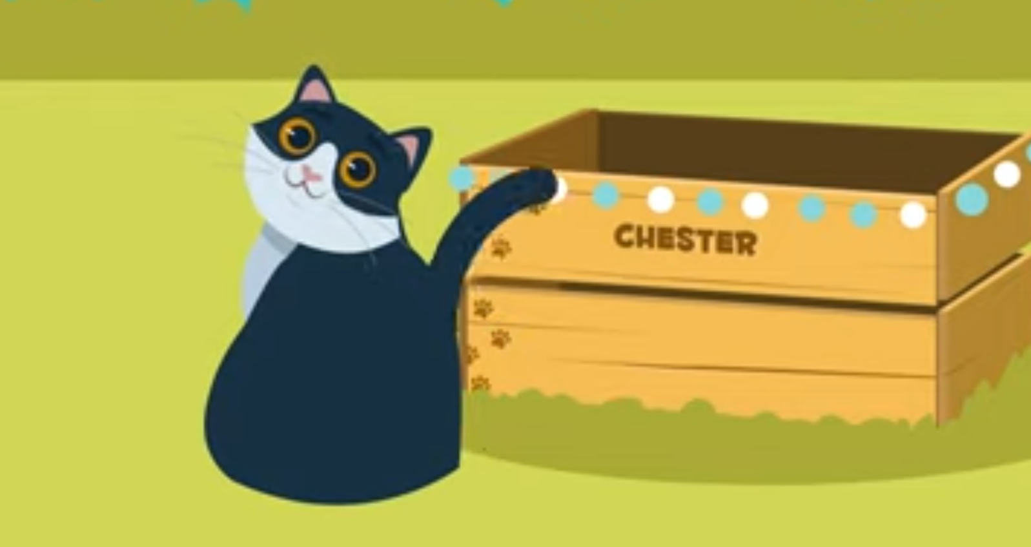
under
The ruler is ________ the chair.
Where is the cat?
near
The cat is ________ the box.

Slide 4
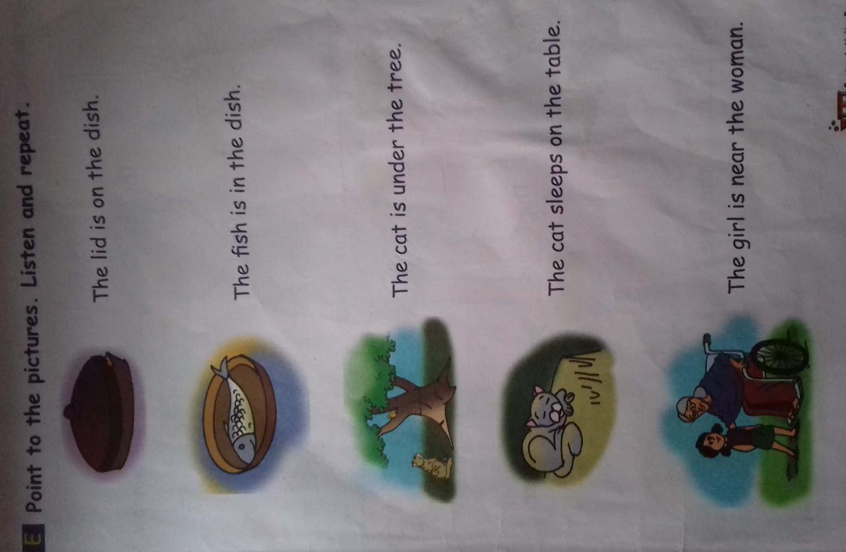
Point to the pictures. Listen and repeat ( book page 11) Class assignment

Slide 5
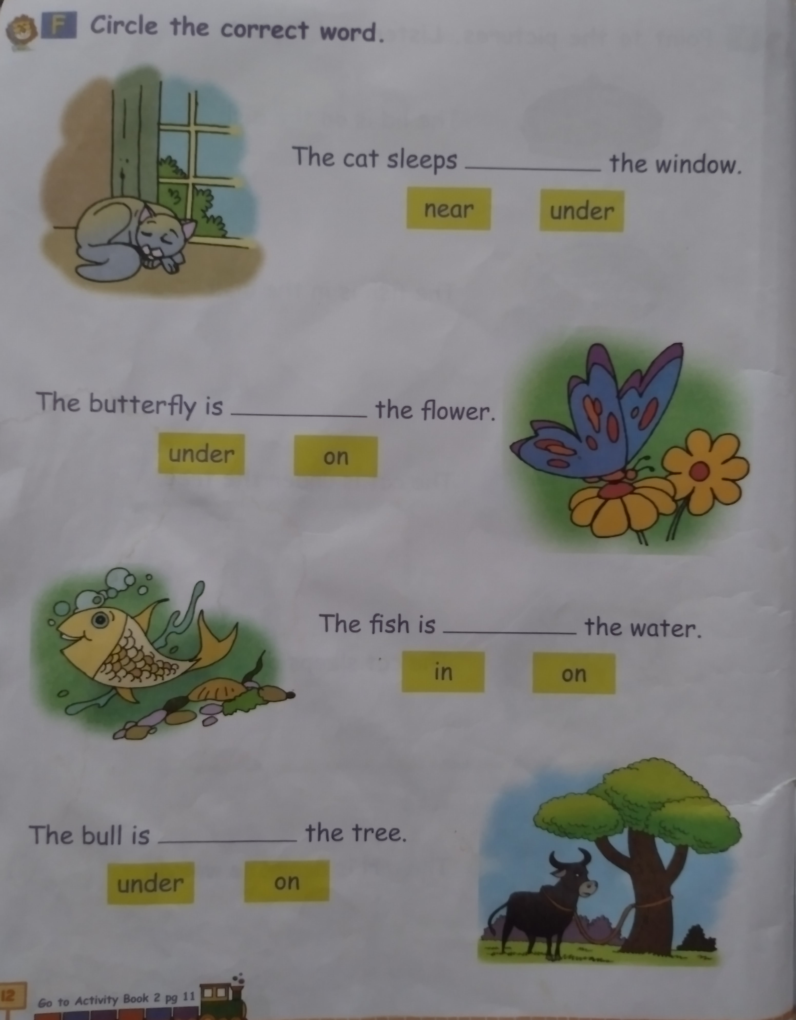
HOME ASSIGNMENT (DO BOOK PAGE 12

Slide 6

THANKING YOU
ODM EDUCATIONAL GROUP

