Slide 1


WELCOME TO ODM ONLINE CLASS
CLASS-UKG
SUBJECT-MATHEMATICS
T0PIC- AFTER, BEFORE
& BETWEEN NUMBER

Slide 2
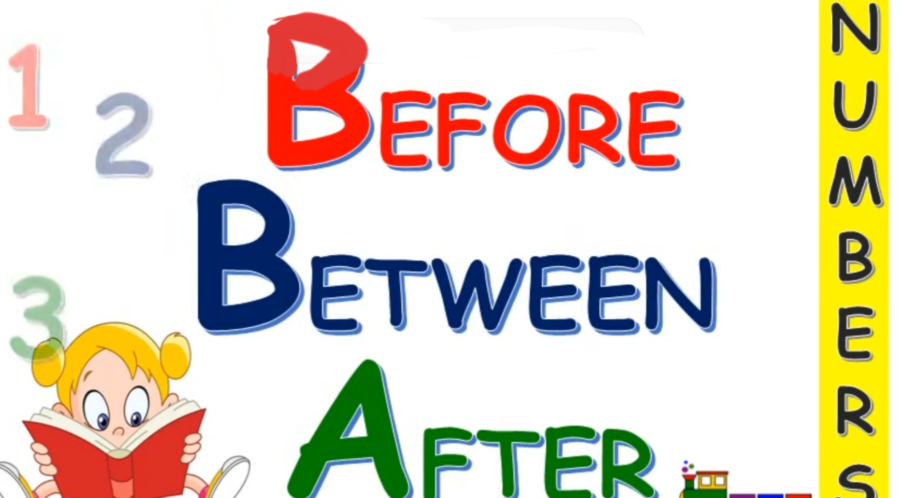

Slide 3

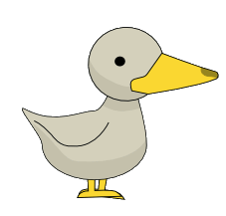

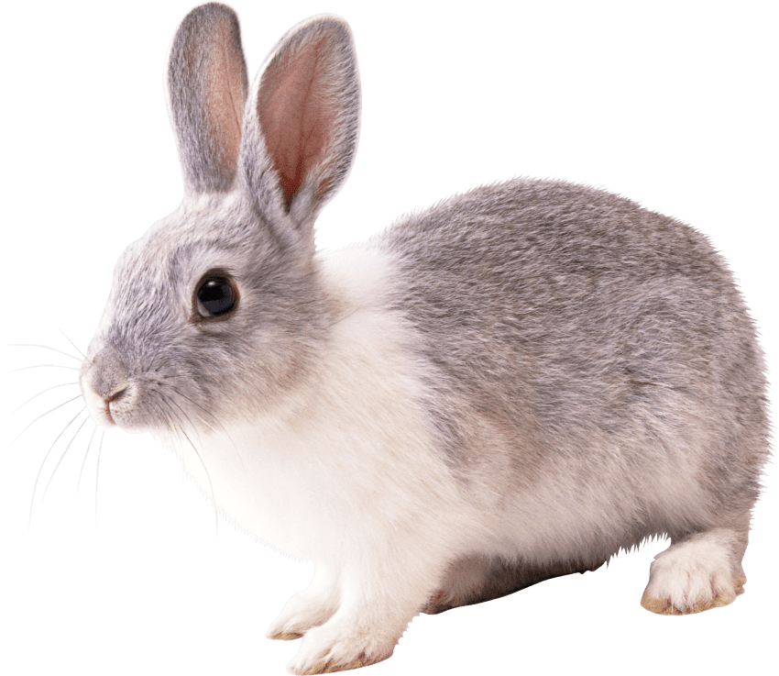
WHERE AM I ?
Where is the RABBIT ?
In the middle or between Duck and Grasshopper.
Where is the DUCK ? After the rabbit.
Where is the GRASSHOPPER ?
Before the rabbit.
AFTER
BETWEEN
BEFORE

Slide 4

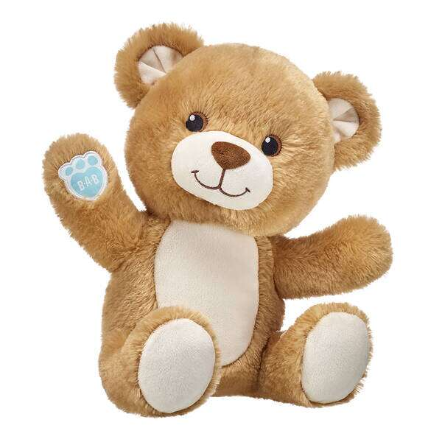
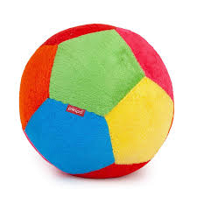
LET’S PLAY A GAME
BETWEEN
RIGHT
2
3
1
AFTER
AFTER
BEFORE
BEFORE
BETWEEN
LEFT

Slide 5
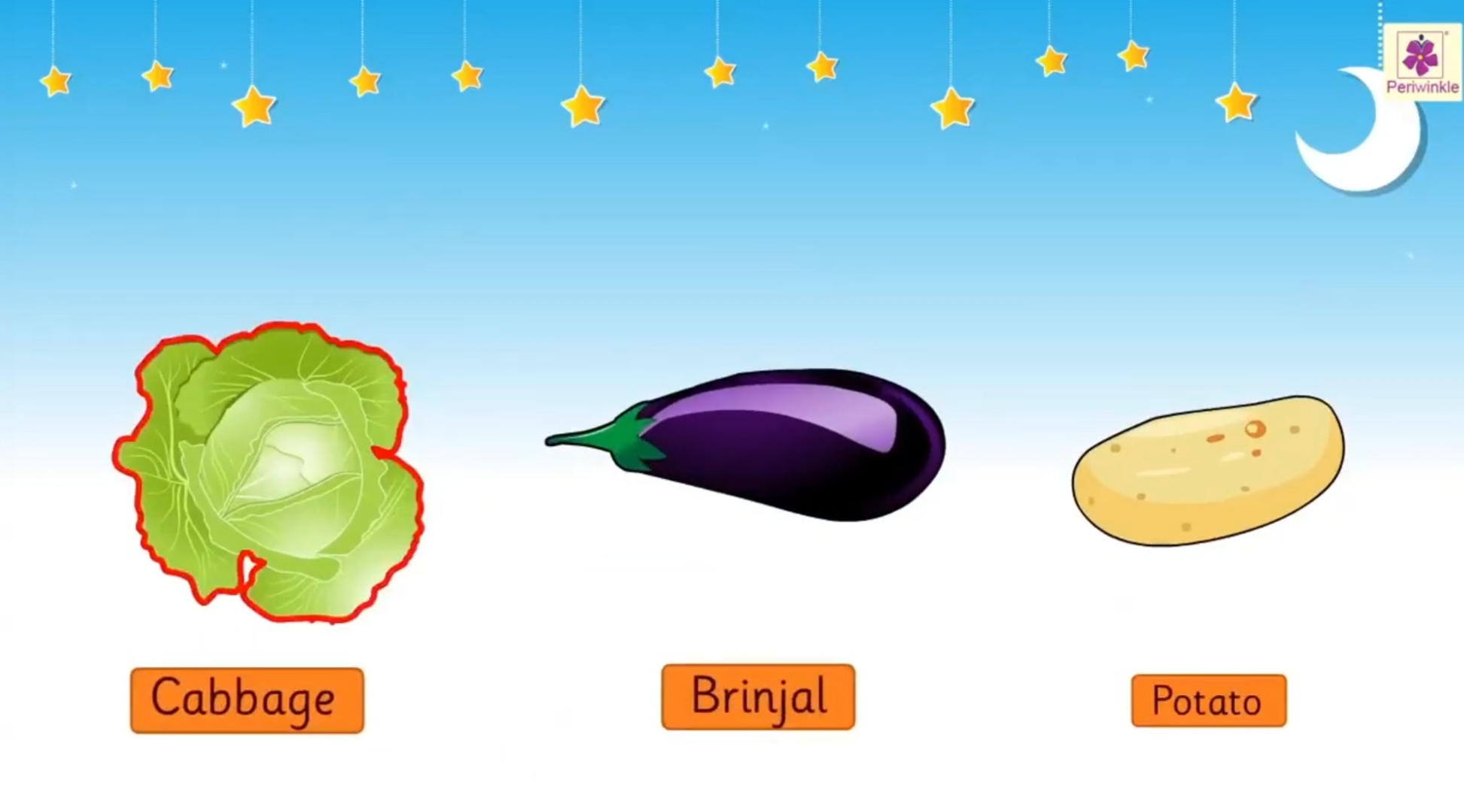
WHERE AM I ?
BETWEEN
AFTER
AFTER
BEFORE
BEFORE

Slide 6

LET’S PLAY WITH NUMBERS
BETWEEN NUMBER
5
6
7
5
7
BEFORE NUMBER
AFTER NUMBER

Slide 7



COLOUR THE BEFORE OBJECT YELLOW, BETWEEN OBJECT RED AND AFTER OBJECT PINK.
Dt.
30/6/21
HOME ASSIGNMENT

Slide 8
THANKING YOU
ODM EDUCATIONAL GROUP

