Slide 1


GRAMMAR
STD-VIII
SUBJECT : ENGLISH
CHAPTER NUMBER: 8
PERIOD NUMBER : 1
CHAPTER NAME :VERB PHRASE

Slide 2
EXPECTED LEARNING OUTCOMES
GENERAL OBJECTIVES Understand the basics of grammar Being acquainted with the chapter and its tenets Understanding the idea Appreciate the beauty of grammar and use in day to day life Developing LSRW Skills
SPECIFIC OBJECTIVES/ EXTENDED OBJECTIVES develop your knowledge of expanded verb phrases understand how verb phrases can improve clarity of writing have a greater understanding of how to use verb phrases.

Slide 3
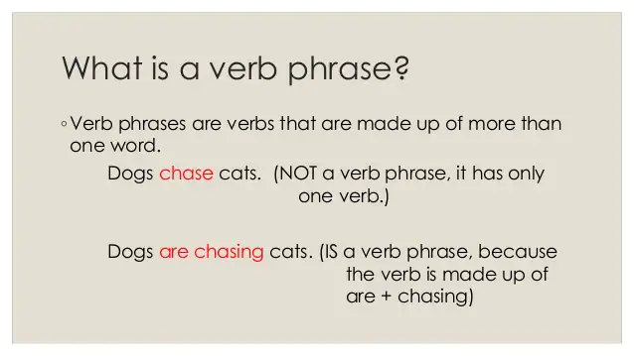

Slide 4
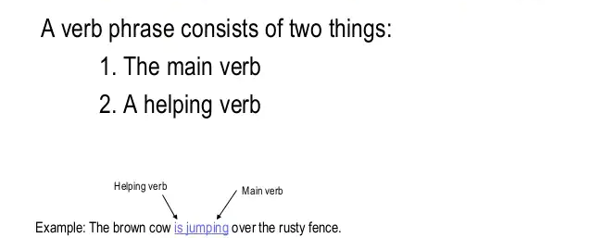
What does it contain?

Slide 5
Examples
Brandon will be graduating from middle school in a few weeks.
Josiah can spell almost any word in the dictionary.
I might go to the birthday party this weekend.
H.W- Exercise - 1 (Page -56)

Slide 6
Verbs Phrases as Predicates Predicate is the part of a sentence or clause containing a verb and stating something about the subject.
My puppy drinks milk.
I am studying linguistics.
The vase was broken by the cat.
We have eaten all the pie.
The students will finish their homework.
She will have earned her degree in May.

Slide 7
Verb Phrases as Noun Phrase Modifiers
Noun phrase modifiers are defined as words and phrases that describe a noun or noun phrase.
The woman reading the book just yelled at me.
My dog is the puppy chewing on the rawhide.
I saw the man sleeping on the bus.
Do you have a book to read in the car?
The food to eat is on the table.
H.W- Exercise - 2 (Page -60)

Slide 8
THANK YOU
ODM EDUCATIONAL GROUP

