Slide 1


REVISION-2
STD-VI
The Sentence, Nouns

Slide 2
Unscramble sentences worksheet
1. drive do so carelessly not
2. with do work sincerity your
3. woman a rich lives the street across
4. fly birds in winter south
5. day what warm it was a

Slide 3
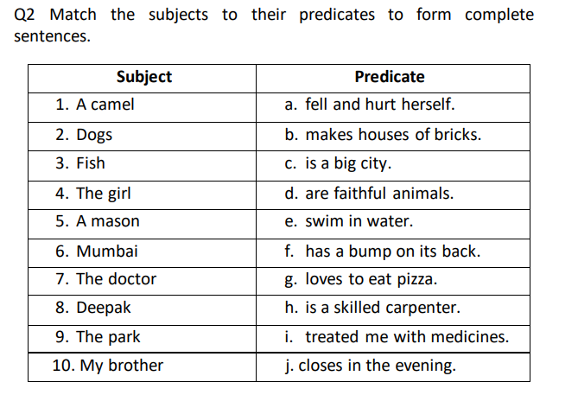

Slide 4
Identify the type of sentence.
1. How well she sings!
2. What is your name?
3. Did I say anything to make you angry?
4. What is your name?
5. Who told you this?

Slide 5
Underline the nouns in each sentence.
1. In the summer we go to the lake.
2. Last month was my birthday.
3. Many birds fly south in the winter.
4. My brother gave the best speech.
5. Her dog had four puppies.

Slide 6
Fill in each blank with a noun.
1. The _______________________________________has grown a foot since last year.
2. The trip to ______________________________will take two __________________.
3. My teacher, ____________________________, has redecorated her ____________________.
4. Bob rode to school on a ___________________________________________.
5. I gave my ____________________________ a ________________________for her birthday.

Slide 7
Underline the common nouns in the sentences below; circle the proper nouns.
1. I’ve just read a play by Shakespeare.
2. The Drama Club elected a new president.
3. Soon our family plans to visit Miami.
4. A new house is being built on Elm Street.
5. My father has been transferred to Colorado.

Slide 8
Point out the nouns in the following sentences and state whether they are common, proper, collective or abstract.
1. The angry mob pelted stones at the police.
2. Honesty is the best policy.
3. You must always speak the truth.
4. Julie is my youngest sister.
5. Solomon was famous for his wisdom.
6. Birds make their nests in trees.
7. A committee was appointed to study the situation.
8. Nelson is known for his victory at Trafalgar.
9. The boys were congratulated on their performance.
10. He gave me a bunch of grapes.

Slide 9
THANK YOU
ODM EDUCATIONAL GROUP

