Slide 1


GRAMMAR
STD-VI
SUBJECT : ENGLISH
CHAPTER NUMBER:
PERIOD NUMBER : 1
CHAPTER NAME :PRONOUNS

Slide 2
EXPECTED LEARNING OUTCOMES
General Objective: -
1. Students will understand the meaning of determiners.
2. They will learn different types of determiners.
3. They will learn the ways in which they work in sentences.
Specific or Extended objectives: -
Know that a pronoun is a word that refers to or takes the place of a noun.
Identify pronouns within sentences.
Use pronouns accurately within sentences.

Slide 3

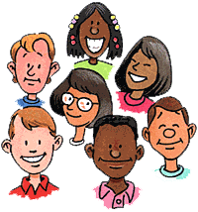
What are Pronouns?
She
I
He
Us
We
We

Slide 4
Why do we need pronouns?
When Susie arrived at the party, Susie knew Susie had made a mistake. Susie saw that Susie did not fit in with Susie’s new friends. Susie wondered if Susie should leave, or if Susie should just act like it was normal for Susie to be involved in such activities. Drinking and smoking were not things in which Susie normally participated. Susie decided Susie was not going to allow Susie to behave in such a ridiculous manner.

Slide 5
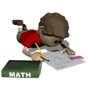
Pronouns
Pronouns make our
speech and writing
less boring.
We do not have to continually repeat our subject.
We can identify our subject in a variety of ways, other than by “name”.
Pronouns

Slide 6
What are pronouns?
Pronouns take the place of nouns. The word or phrase replaced by a pronoun is called an antecedent.

Slide 7
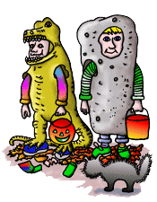
Example:
  Halloween is one of America's holidays. It is celebrated in October.
  (Halloween is a noun. It is a pronoun that refers to the antecedent, Halloween.)

Slide 8
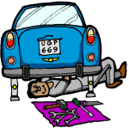
Example:
  When Robert was fixing the car, he cut his hand.
  (Robert is a noun. He is a pronoun that refers to the antecedent, Robert.)

Slide 9
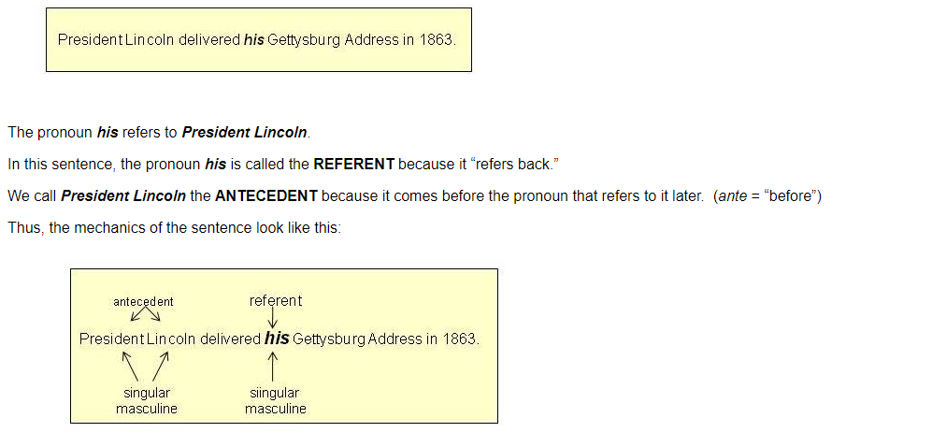
‘Antecedent’ means a noun that comes before a pronoun in a sentence. Antecedent and its pronoun must agree with each other. A few examples:
Vijay and Sujay lost their books. (Vijay and Sujay are compound antecedents of the pronoun ‘their’)
The boy took his exam yesterday. (‘The boy’ is the antecedent of ‘his’)
Martha visited her native place. (‘Martha’ is the antecedent of ‘her’)
‘

Slide 10
Types of Pronouns
Personal pronoun
the subject of a verb
the object of a verb
Possessive pronoun
Indefinite pronouns
Reflexive pronoun
Demonstrative pronoun
Emphatic pronoun
Relative Pronoun
Interrogative pronouns
Distributive pronouns

Slide 11
1. Personal Pronouns
The subject of a verb : -
I, you, he, she, it, we and they can all be used as the subject of a verb.
Examples :-
Lisa likes cats.
She has four cats.
Lisa – proper noun (subject)
She – pronoun (subject)
Sharma is a good teacher. He is a good player

Slide 12
The objects of a verb : -
me, you, him, her, it, us and them can all be used as the object of a verb.
Ex : -
Lisa likes cats. She likes to stroke them.
noun
Pronoun
the object of the verb
the object of the verb

Slide 13
Personal pronouns
 | Subject | Object
First person singular | I | Me
Second person singular | You | You
Third person singular | He | Him
 | She | Her
 | It | It
First person plural | We | Us
Second person plural | You | You
Third person plural | They | them

Slide 14
2. Possessive Pronouns
Possessive pronouns are used to talk about things that belong to people. The words mine, yours, his, hers, ours and theirs are possessive pronouns.
Examples :-
This book is mine.
Have you lost yours, Tom ?

Slide 15
Singular personal pronoun | Possessive pronouns
I , me | Mine
You | Yours
He ,him | His
She, her | hers
Plural personal pronoun | Possessive pronouns
We ,us | Ours
You | Yours
They , them | theirs

Slide 16
3. Indefinite Pronouns
An indefinite pronoun does not refer directly to any other word. Most indefinite pronouns express he idea of quantity.
Examples :-
Everybody is welcome at the meeting.
Many prefer their coffee with sugar.
Does anybody care for a cheese sandwich?
Few choose to live in the arid desert.

Slide 17
Can you find indefinite pronoun in each sentence.
1. One never knows who might be listening.
2. Many are called but few are chosen.
3. I finished my cookie and asked for another.
4. Both were punished for the crime they committed.
5. Several applied for the job, but no one was hired.

Slide 18
Indefinite Pronouns :-
All | Each | Most | Other
Another | Either | Neither | Several
Any | Everybody | Nobody | Some
Anybody | Everyone | No one | Somebody
Anyone | Few | None | Someone
both | Many | One | such

Slide 19

4. Reflexive pronouns
Reflexive pronouns are personal pronouns that have "-self" or "-selves" added to the end. These are used when the subject and the object refer to the same person/persons.
Bob finished the homework himself.
The reflexive pronoun is "himself."

Slide 20
THANK YOU
ODM EDUCATIONAL GROUP

