Slide 1


GRAMMAR
STD-VI
SUBJECT : ENGLISH
CHAPTER NUMBER:
PERIOD NUMBER : 1
CHAPTER NAME :DETERMINERS

Slide 2
EXPECTED LEARNING OUTCOMES
General Objective: -
1. Students will understand the meaning of determiners.
2. They will learn different types of determiners.
3. They will learn the ways in which they work in sentences.
Specific or Extended objectives: -
Know that a determiner appears before a noun (and its adjectives) to help us identify which person or thing the sentence is about, or how much or how many of them there are
Identify determiners within sentences
Use determiners accurately within sentences

Slide 3
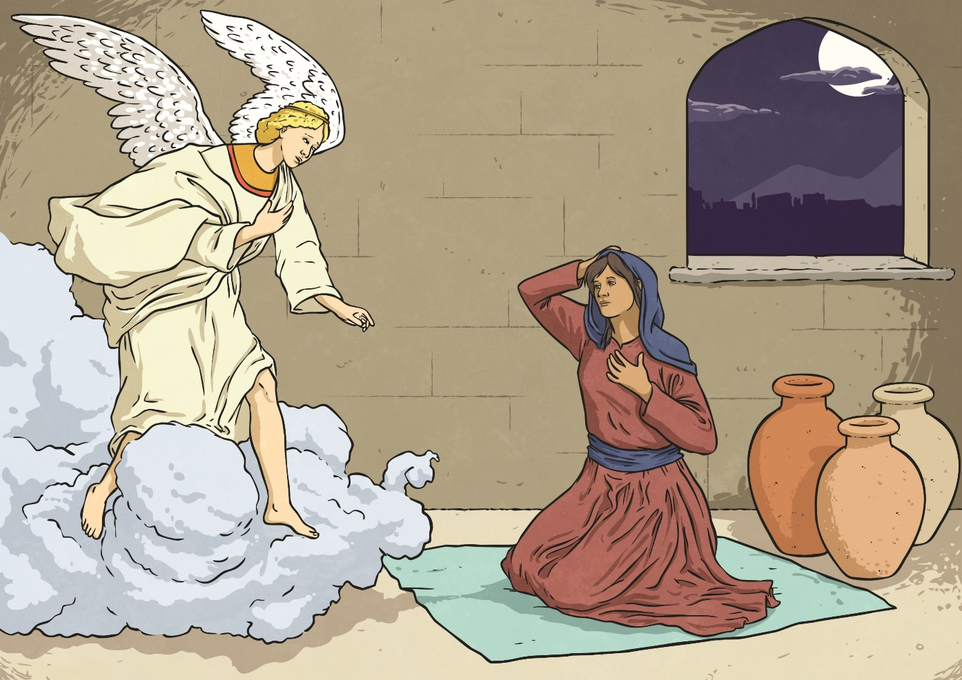
What Can You See?
Look at this scene. Talk to your partner and tell them what you can see.

Slide 4
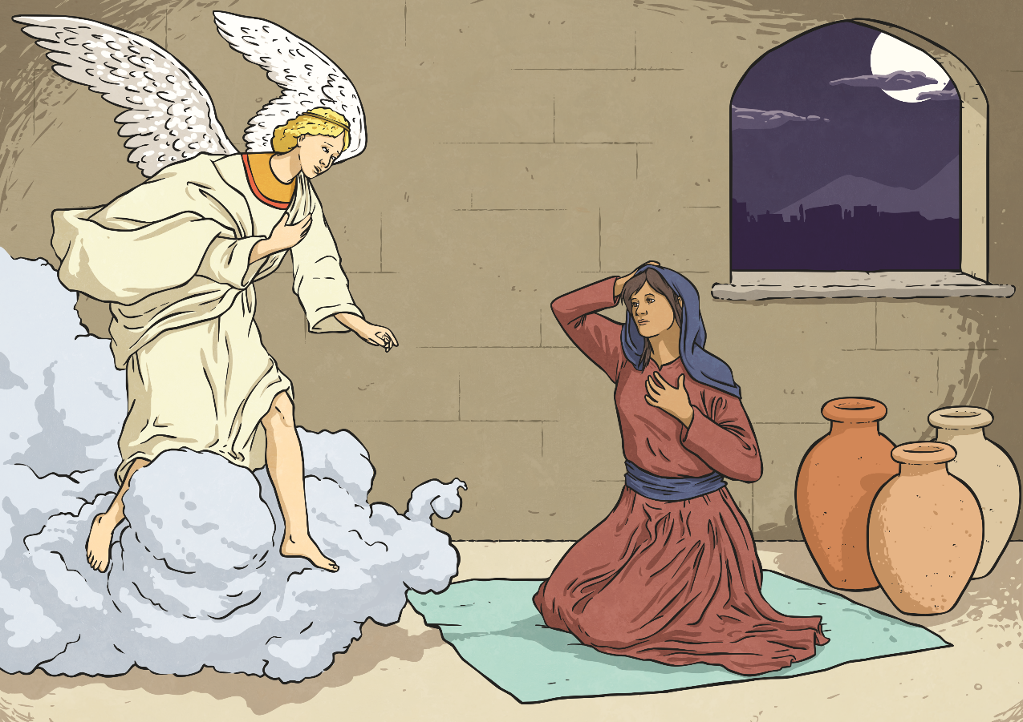
What Can You See?
Whilst you have been speaking, you have been using determiners before your nouns. Determiners come before nouns (or noun phrases) to introduce the noun and give the reader important information about them.
×
3
the moon
×
1
an angel
4
×
a window
×
2
some clouds
×
5
three vases
×
5
a lady

Slide 5
INTRODUCTION
Determiners
Determiners are words which come before nouns determining or limiting the use of the noun by giving some additional information. They indicate the singularity or the plurality of a noun, amount or quantity of a noun, possessive aspect of a noun, the number and order of a noun or the distributive or demonstrative aspect of a noun.
Adjectives and determiners must be carefully distinguished from each other.
An adjective is used to limit the application of a noun by describing it i.e. by giving information about the size , colour, beauty, age and other such qualities whereas a determiner is used to limit the application of a noun without describing it. We don’t know anything about the quality of the noun from a determiner.

Slide 6
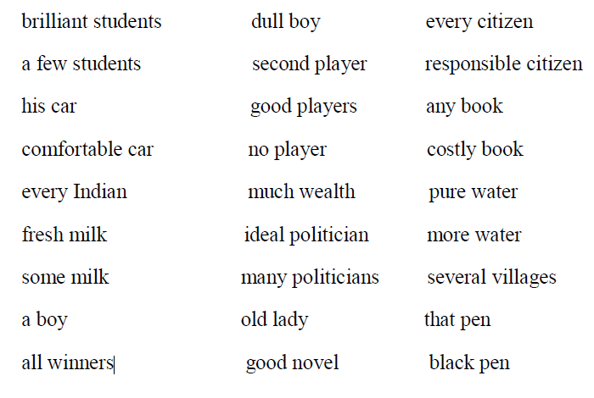
Identify the Adjectives and the Determiners in the following

Slide 7
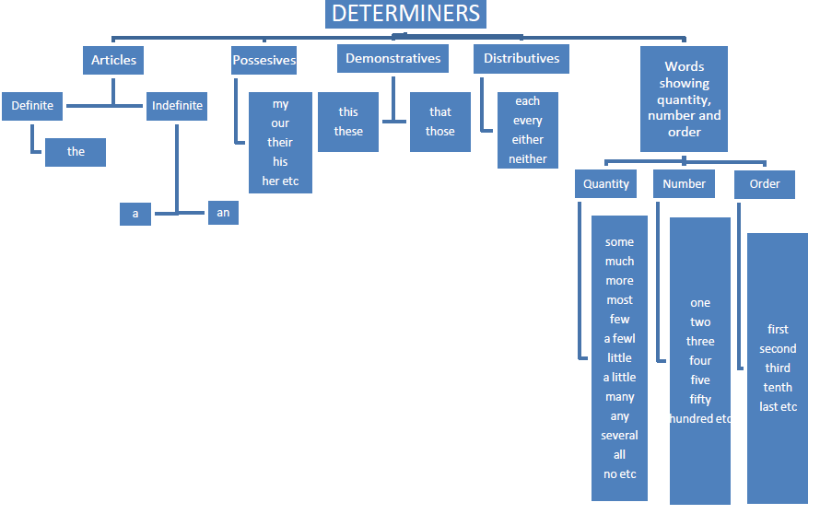
Several classes of words come under the heading ‘Determiners’
Interrogatives
Whose
What
Which

Slide 8
Specific determiners
The specific determiners are:
the definite article: the
possessives: my, your, his, her, its, our, their, whose
demonstratives: this, that, these, those
We use a specific determiner when we believe the listener/reader knows exactly what we are referring to:
Can you pass me the salt, please?
Thank you very much for your letter.
Whose coat is this?
Look at those lovely flowers.

Slide 9
General Determiners
We use a general determiner when we are talking about things in general and the listener/reader does not know exactly what we are referring to.
The general determiners are:
a/an 0 (no determiner) any another other
The most frequent general determiner is the indefinite article a/an used with singular nouns:
A man came this morning and left a parcel.
He was wearing a big coat and a cap.
We use no determiner with plural nouns and uncountable nouns:
Girls normally do better in school than boys. (plural nouns)
Milk is very good for you. (uncountable noun)
Health and education are very important. (uncountable nouns)

Slide 10
We use the general determiner any with a singular noun or an uncountable noun when we are talking about all of those people or things:
It's very easy. Any child can do it. = All children can do it.
With a full license you are allowed to drive any car. = all cars
I like bananas, oranges, apples – any fruit. = all kinds of fruit
(Note that any is also used as a quantifier in negative and interrogative sentences.)
We use the general determiner another to talk about an additional person or thing:
Would you like another glass of juice?
The plural form of another is other:
I spoke to John, Helen and a few other friends.

Slide 11
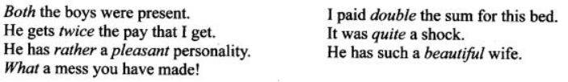
Pre-determiners: Pre-determiners are the words which occur before a determiner to limit the meaning of a noun:
Articles: The article system in English consists of the definite article ‘the’ and the indefinite article ‘a’ or ‘an'.We can think of nouns in a specific or general way. When we refer to particular people or things or something that has already been mentioned or can be understood, we use the definite article ‘the’. When we refer to singular nouns for the first time, or refer to things in a general way, we use the indefinite article ‘a’ or ‘an’.

Slide 12
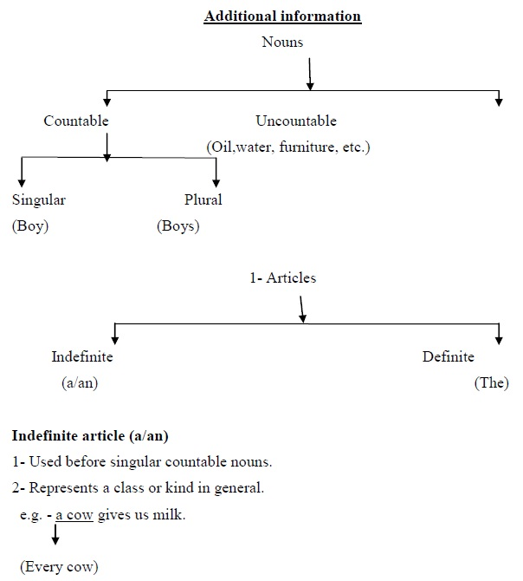
A- Used before singular countable nouns beginning with consonant sound.
Example- a one-eyed man, a unique place, a European, a University, a Mango etc.
An– Used before singular countable nouns beginning with vowel sound.
Example- an Indian, an hour, an umbrella, an honest boy (Mute ‗h‘)
Definite article (the) – Used before both countable and uncountable nouns.
Usage:-
1- When we talk about something for the second time in the same context or anything qualified by a phrase.

Slide 13
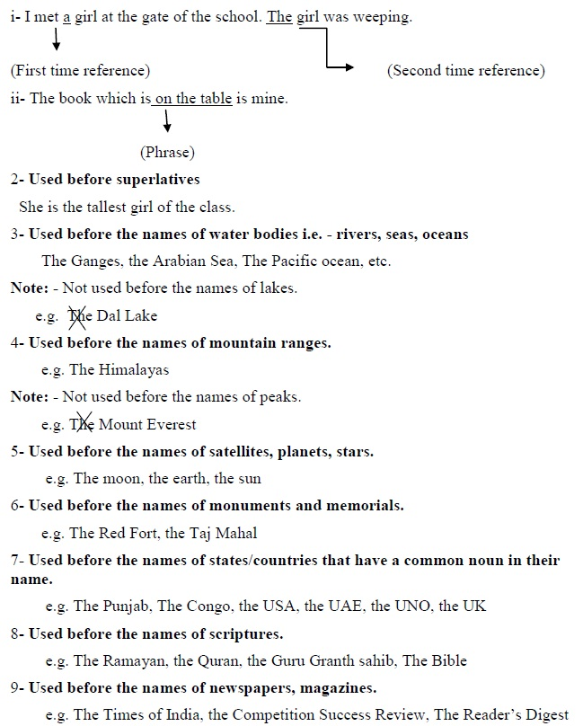

Slide 14
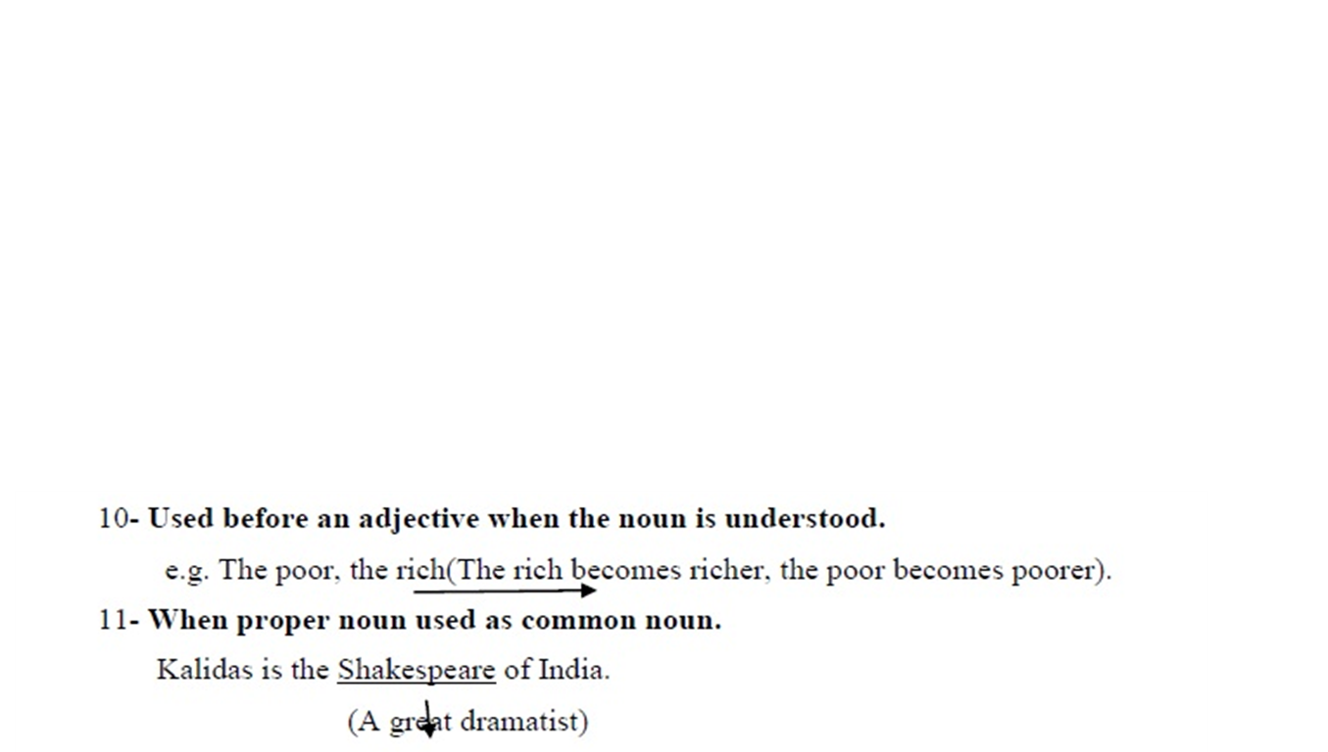
HOME-ASSIGNMENT: Exercise 1, Page 33,one page handwriting

Slide 15
THANK YOU
ODM EDUCATIONAL GROUP

