Slide 1

WELCOME TO ONLINE CLASSES
SUBJECT : ENGLISH
CLASS : UKG
CHAPTER : Unit - 4
TOPIC : -ing sound words(Introduction)

Slide 2
-ing sound
If we see letters “–i-n-g” together at the end of a word , they make the sound “eeng” .

Slide 3
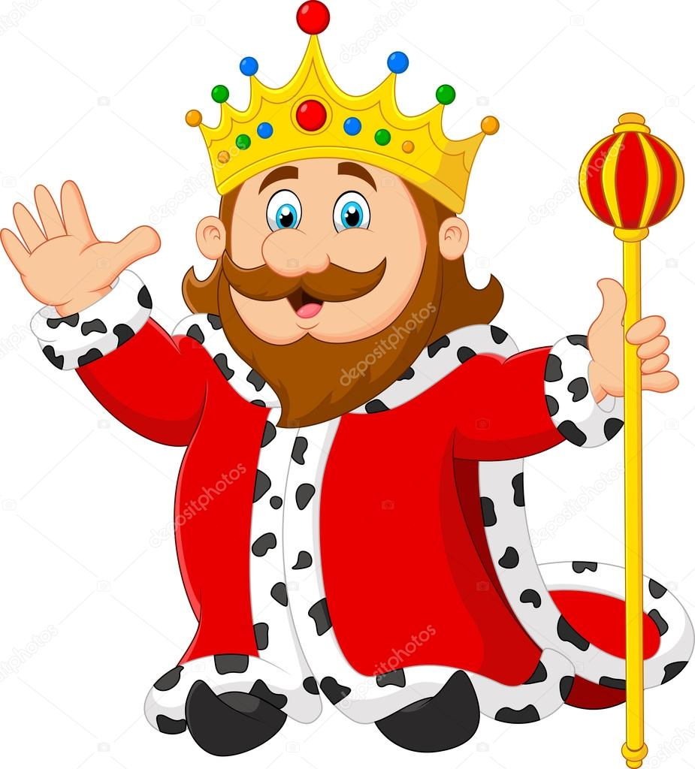





“ - ING ” SOUND WORDS
king
sing
swing
string
ring

Slide 4
REPEAT THE FOLLOWING WORDS
King
Sing
Ring
4. Swing
5. String
6. wings

Slide 5
ACTIVITY
Let’s make words using ‘ing’
sing
wing
string
ring
swing
king
s
w
str
- ing
r
sw
k

Slide 6
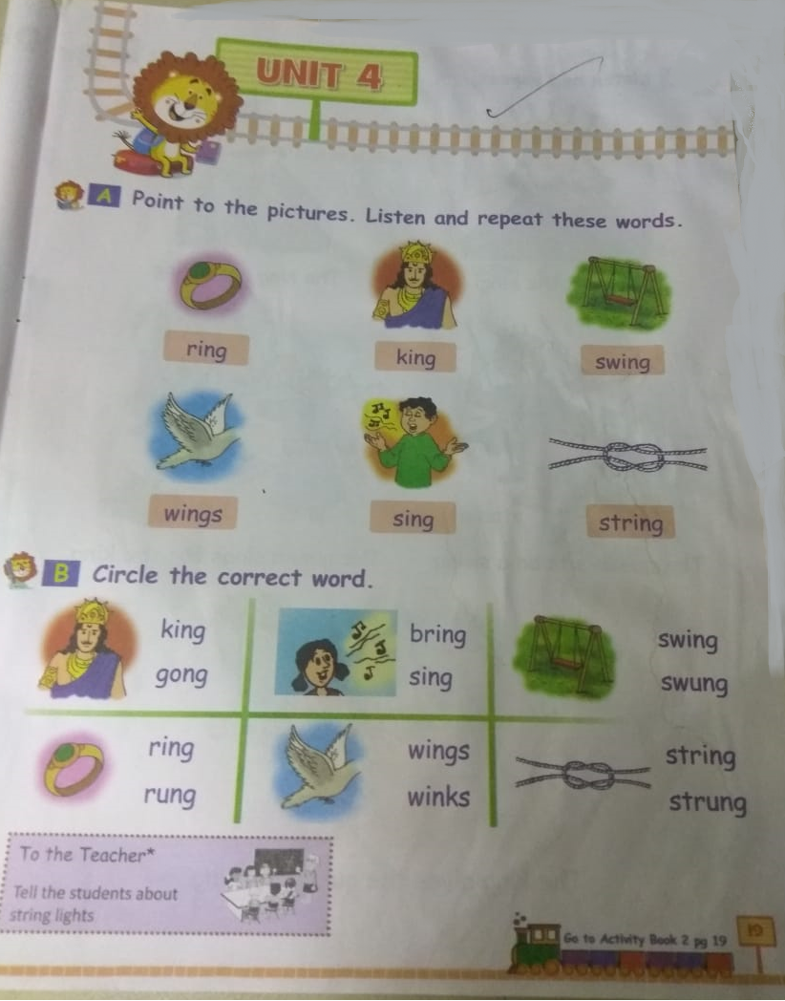
Book Page-19 : Point to the pictures and read the words

Slide 7
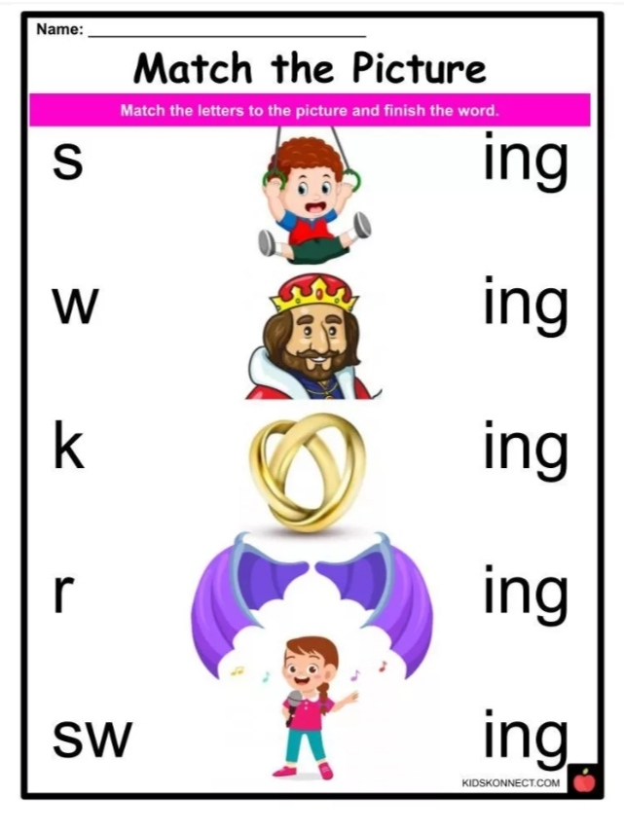
Home Assignment
Match the letters with the pictures and form a word.

Slide 8
THANKING YOU
ODM EDUCATIONAL GROUP

