Slide 1


GRAMMAR
STD-VIII
SUBJECT : ENGLISH
CHAPTER NUMBER: 3
PERIOD NUMBER : 1
CHAPTER NAME :THE PRESENT

Slide 2
EXPECTED LEARNING OUTCOMES
GENERAL OBJECTIVES Understand the basics of grammar Being acquainted with the chapter and its tenets Understanding the idea Appreciate the beauty of grammar and use in day to day life Developing LSRW Skills
SPECIFIC OBJECTIVES/ EXTENDED OBJECTIVES Develop your knowledge of expanded verb phrases Hnderstand how verb phrases can improve clarity of writing Have a greater understanding of how to construct sentences in present tense.

Slide 3
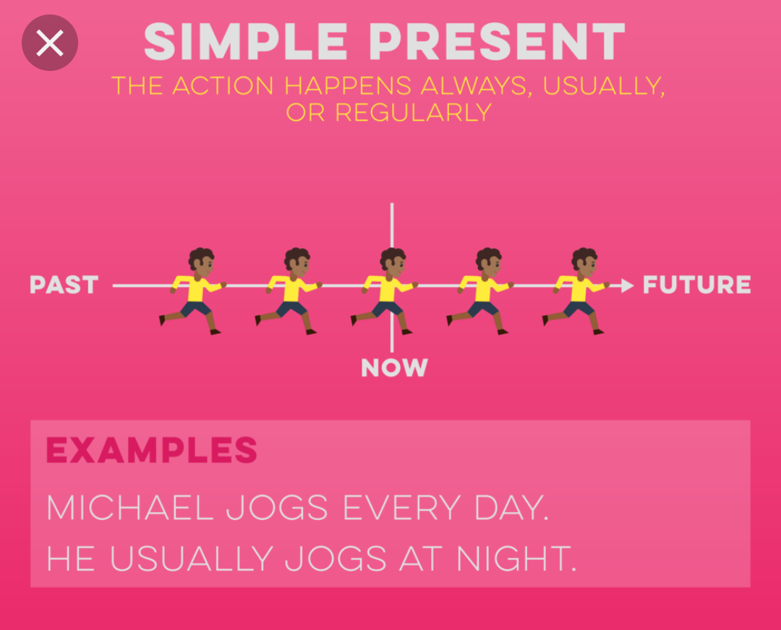
The Present
In English grammar, we use present tense to talk about something that is going on now(currently) or that is true now and at any time.

Slide 4
Types of Present Tense
The present tense is of four types.
Simple present tense
Present continuous tense
Present perfect tense
Present perfect continuous tense

Slide 5
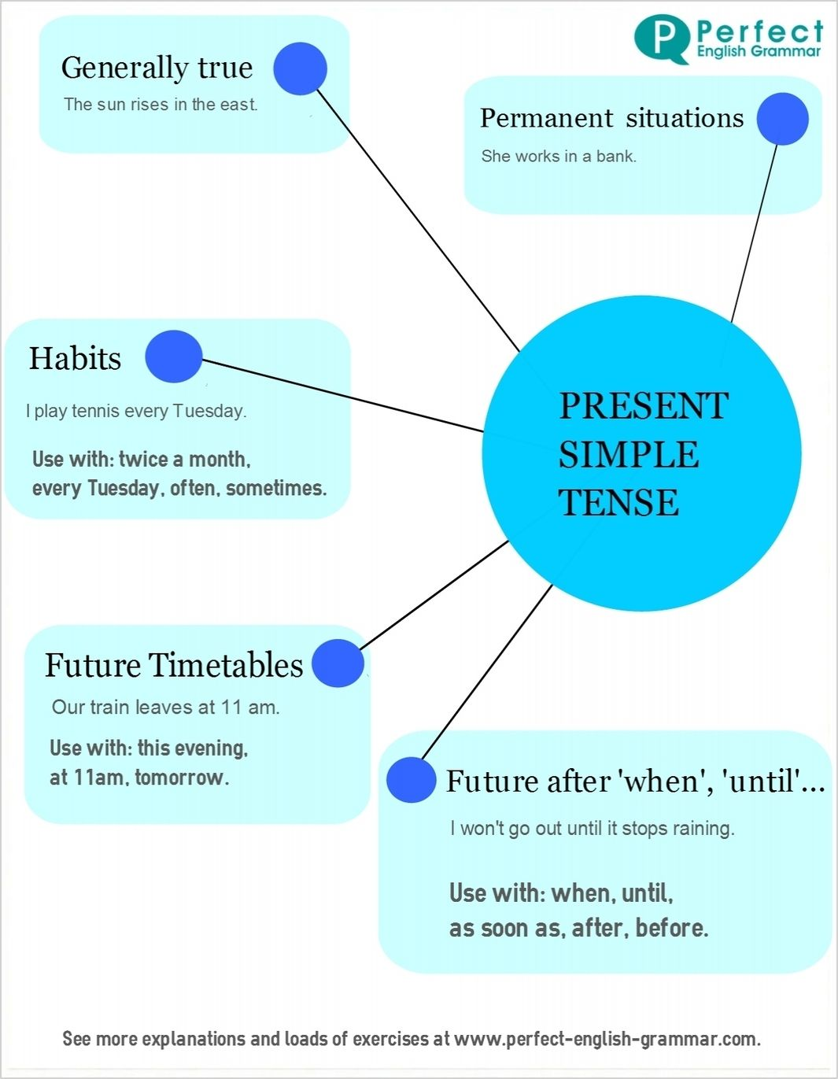
Simple Present Tense
The simple present tense uses the same verb form as the root form of the verb.

Slide 6
Formulating a Simple Present Tense
When the singular form of the subject or a singular pronoun is used, the verb is used in the simple present tense by adding a ‘-s’ to it. For example,
This person goes to the library often.
When does the flight to Seychelles depart from Mumbai airport?
I always wake up at 6 am.
We agree with most of your plan.
I like chocolates.

Slide 7
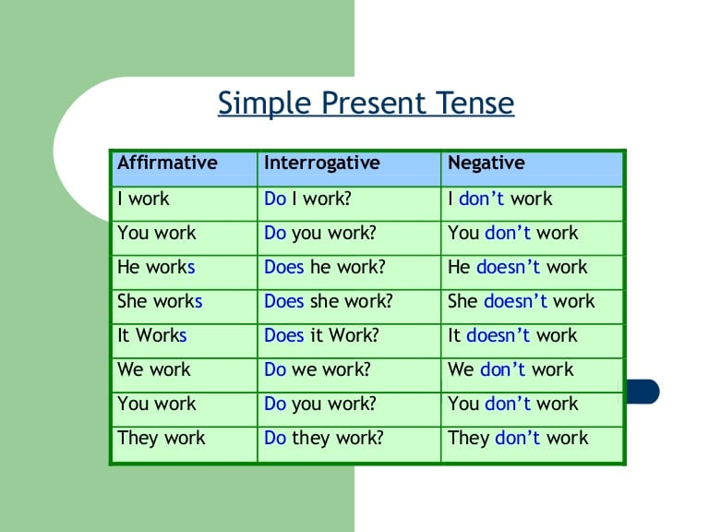

Slide 8
THANK YOU
ODM EDUCATIONAL GROUP

