Slide 1


SUPPLEMENTARY
STD-VIII
SUBJECT : ENGLISH
CHAPTER NUMBER: 8
PERIOD NUMBER : 1
CHAPTER NAME : THANK YOU, MA’AM
BY LANGSTON HUGHES

Slide 2

EXPECTED LEARNING OUTCOMES
GENERAL OBJECTIVES Understanding the concept Being acquainted with prose and author’s biography Understanding the idea Appreciate the language of the prose Developing LSRW Skills
SPECIFIC OBJECTIVES/ EXTENDED OBJECTIVES Understanding the concept Being acquainted with prose and author’s biography Understanding the idea Appreciate the language of the prose Developing LSRW Skills

Slide 3
INTRODUCTION TO THE STORY-TELLER
James Mercer Langston Hughes (February 1, 1901 – May 22, 1967) was an American poet, social activist, novelist, playwright, and columnist from Joplin, Missouri. One of the earliest innovators of the literary art form called jazz poetry, Hughes is best known as a leader of the Harlem Renaissance. He famously wrote about the period that "the Negro was in vogue", which was later paraphrased as "when Harlem was in vogue."
Growing up in a series of Midwestern towns, Hughes became a prolific writer at an early age. He moved to New York City as a young man, where he made his career. He graduated from high school in Cleveland, Ohio and soon began studies at Columbia University in New York City. Although he dropped out, he gained notice from New York publishers, first in The Crisis magazine, and then from book publishers and became known in the creative community in Harlem. He eventually graduated from Lincoln University. In addition to poetry, Hughes wrote plays, and short stories. He also published several non-fiction works. From 1942 to 1962, as the civil rights movement was gaining traction, he wrote an in-depth weekly column in a leading black newspaper, The Chicago Defender.

Slide 4
THEME OF THE STORY
The story begins with an encounter between Roger, a teenage boy, and Mrs. Luella Bates Washington Jones, an older woman walking home from work late one night. He attempts to steal her purse, but because it is so heavy, and Mrs. Jones is quite stout, he merely ends up breaking the strap instead. She kicks him and grabs him by the shirt, asking if he feels ashamed of himself.
Roger admits that he does. Mrs. Jones notices that his face is dirty and his hair is uncombed; she asks if there is anyone looking after him. When he answers 'no', she drags him home with her, saying when she's finished with him, he'll be sure never to forget he met her.
When Roger and Mrs. Jones arrive at her house, she asks if he's had supper. She assumes that since he was trying to steal her purse, he must be hungry. But we learn that he wanted her money to buy a pair of blue suede shoes. When Mrs. Jones tells Roger that he could've asked her for the money, he doesn't quite believe her.
Mrs. Jones explains to Roger that she was young once, too, and also couldn't afford the things she wanted. She confides that, like the teenage boy, she used to do some pretty shameful things, too. While they eat, she refrains from embarrassing Roger by not asking him anything else about his life; instead, she talks about her job in a hotel beauty shop, where she meets women with all different colors of hair.
At the end of the story, Mrs. Jones gives Roger ten dollars to buy the blue suede shoes and tells him not to steal her purse or anyone else's for that matter, as shoes purchased with stolen money cause more trouble than they're worth. When she leads him to the door and bids him good night, Roger wants to say something other than 'thank you, ma'am,' but nothing suitable comes to mind. As he turns to look at Mrs. Jones in the doorway, he can barely get the words, 'thank you,' out of his mouth before she shuts the door. According to Hughes, Roger never sees her again.

Slide 5
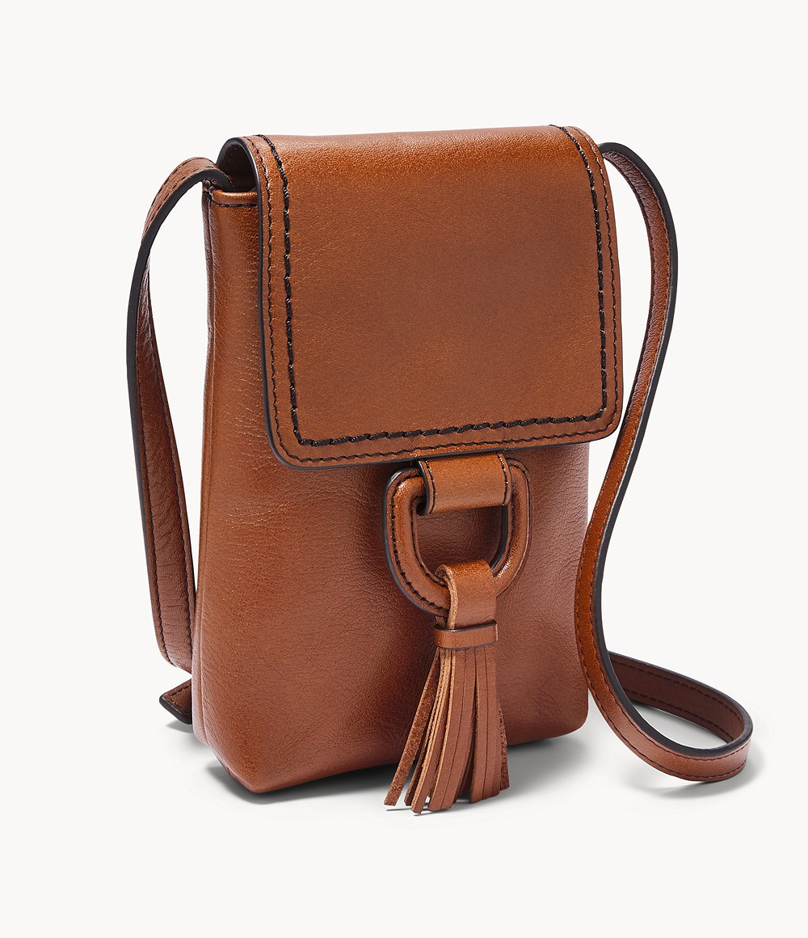
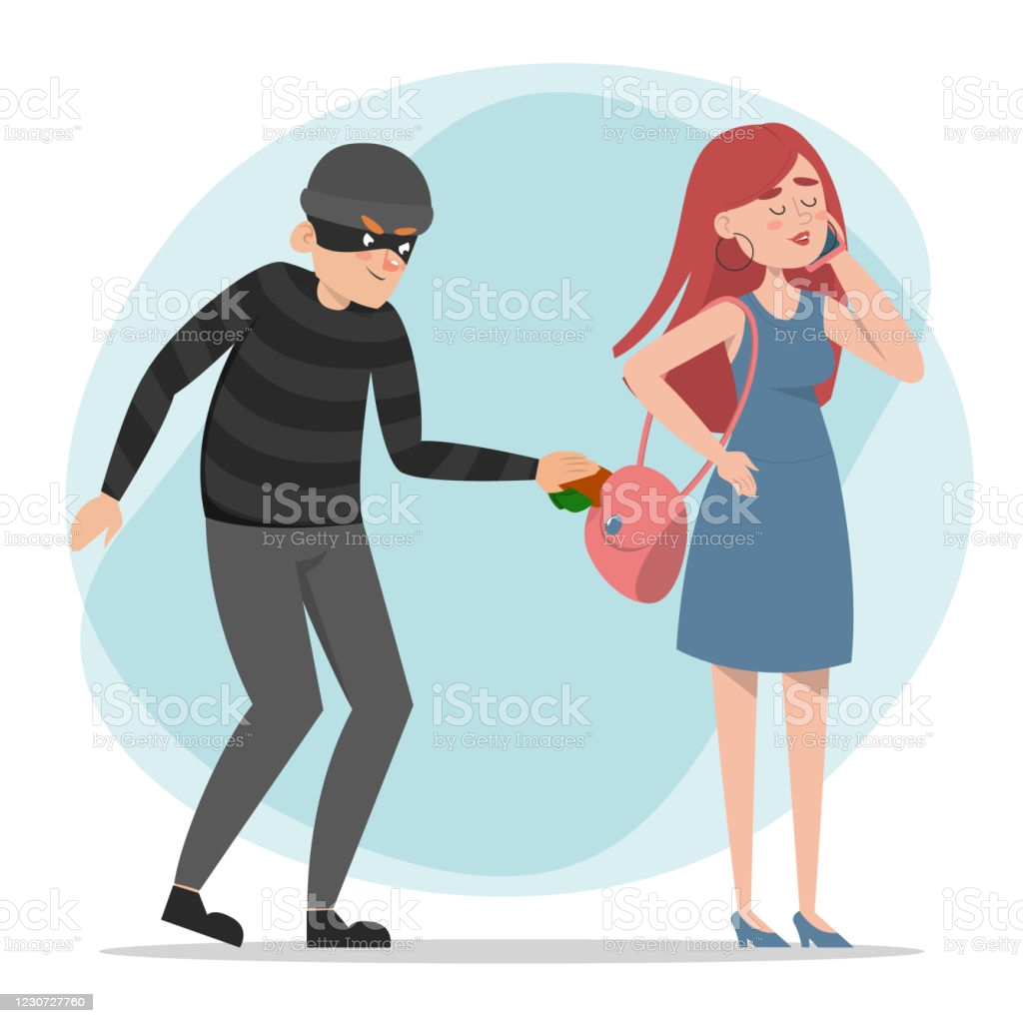
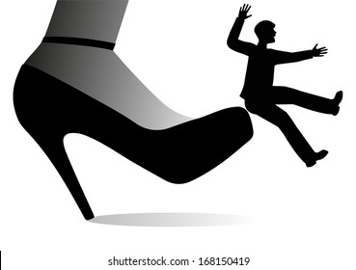
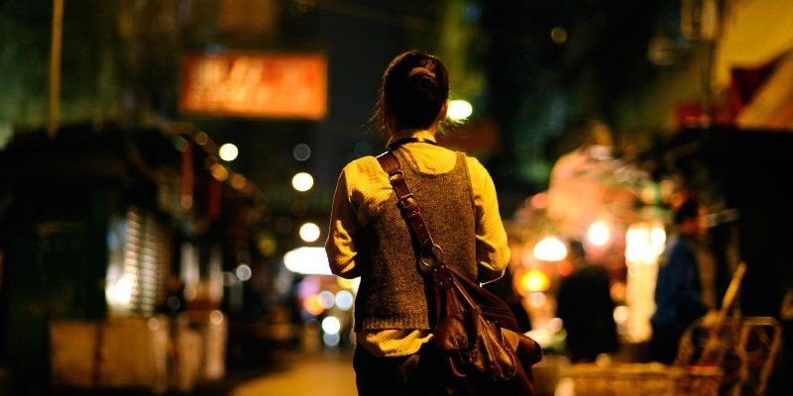
Page-58 (The stout woman)
A strong woman with a large purse
The woman’s return at night
Attracting a pick pocket
The boy gave a tug to the woman’s bag
and lost his balance resulting in his fall
The woman turned around and kicked him

Slide 6
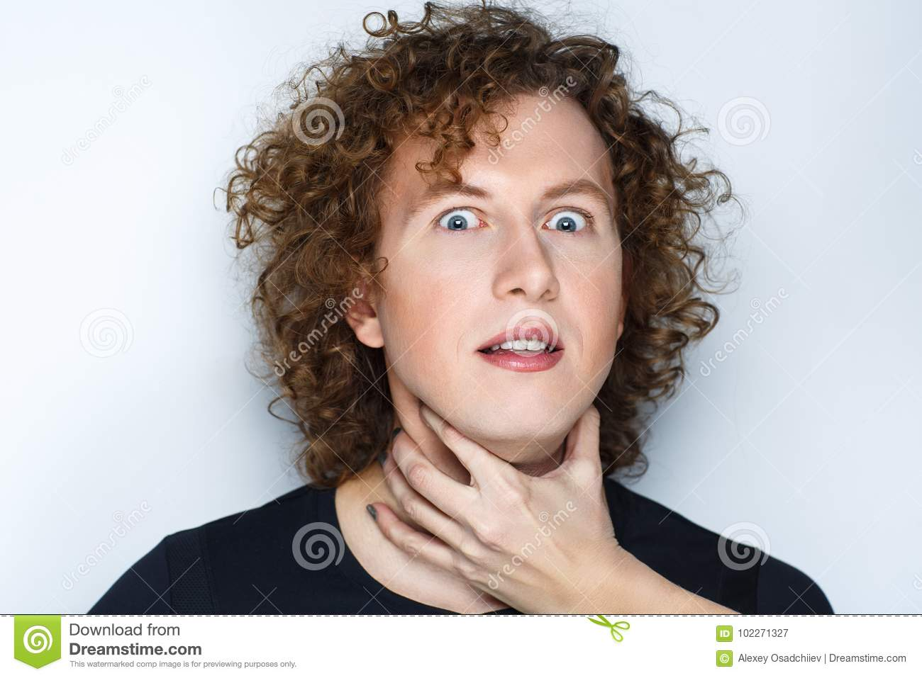
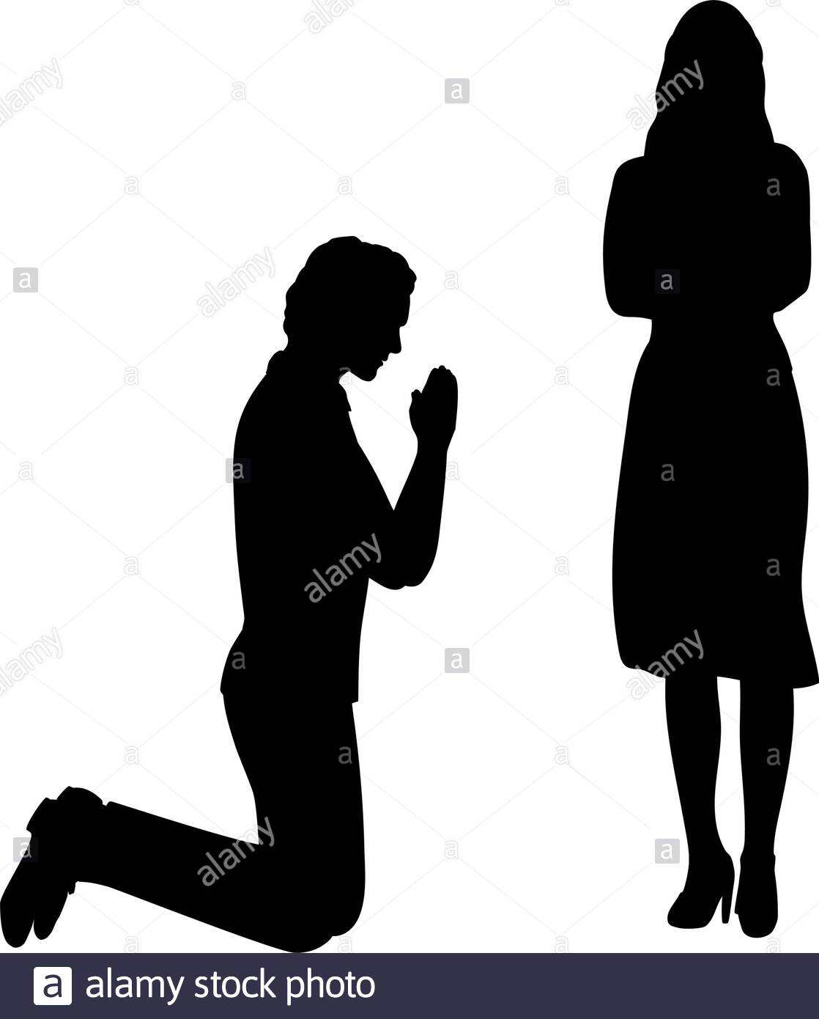
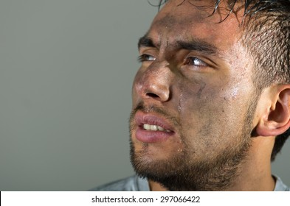
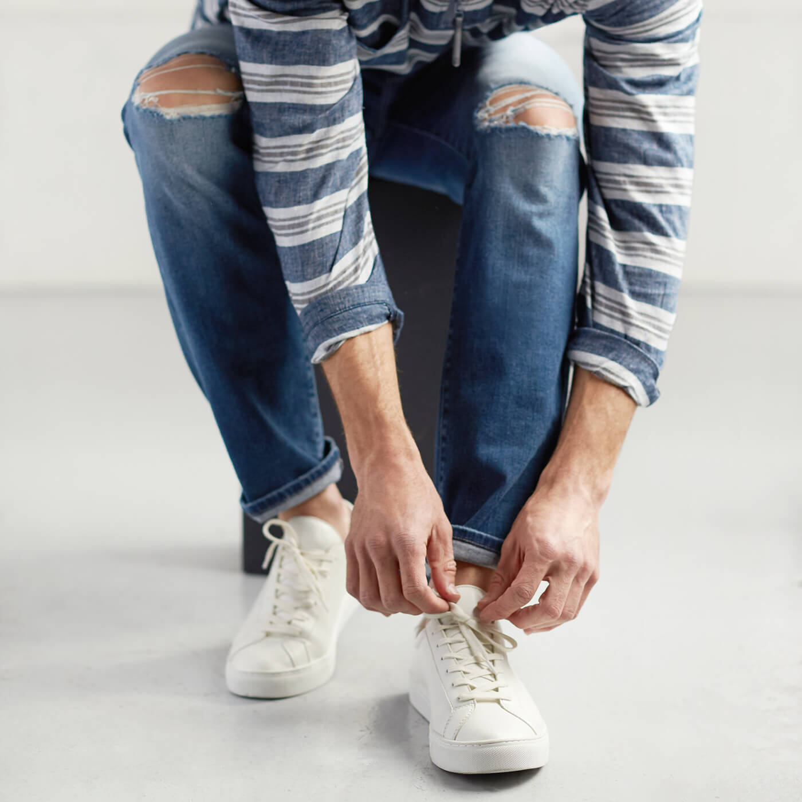
Page 59 (Conversation)
The woman ordering the boy to pick up her pocketbook
The boy didn’t answer why he wanted to steal the purse
She didn’t turn her loose
The boy begged for forgiveness
The boy’s face was dirty, no one to take care of him
He was frail wearing tennis shoes and blue jeans

Slide 7
VOCABULARY
A sitter-a person’s backside
Ain’t-aren’t
I got a great mind to- I have a strong urge to
Frail-weak, thin
Home Assignment:
Narrate the incident the woman faced while returning home

Slide 8
THANK YOU
ODM EDUCATIONAL GROUP

