Slide 1

WELCOME TO ONLINE CLASS
CLASS : UKG
SUBJECT : ENGLISH
CHAPTER : 3 ( ‘oa’ sound words)
TOPIC : Revision

Slide 2
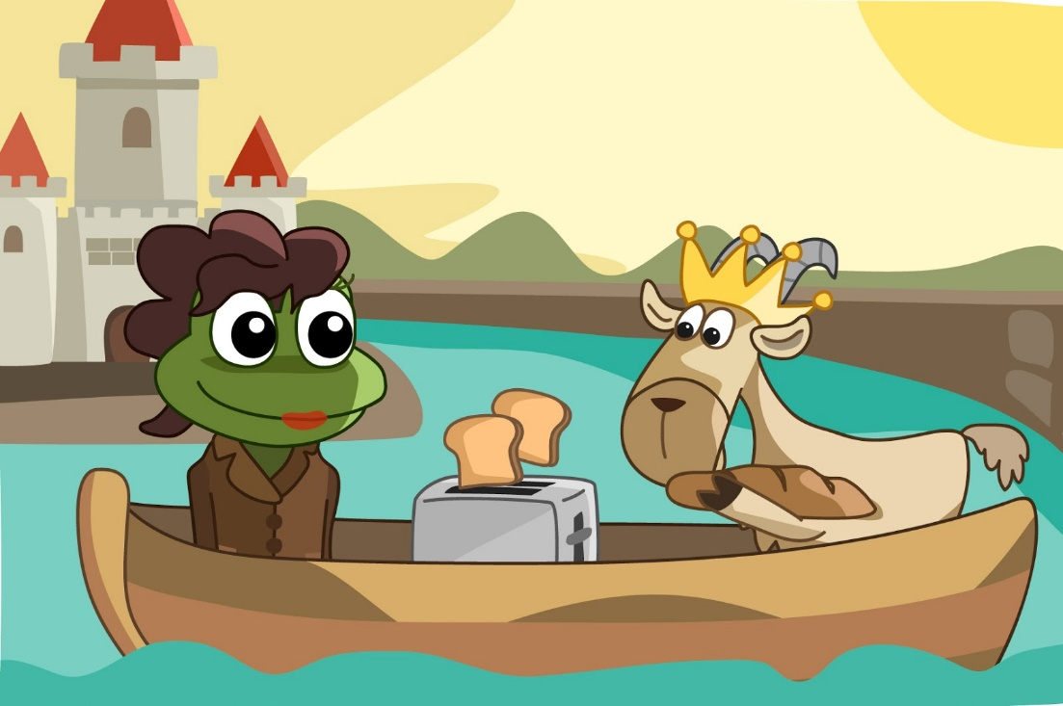
UNSEEN PASSAGE READING
A toad and a goat were best friends.
They were in a boat.
They like to eat toast.
They made a loaf from oats and enjoyed the toast.

Slide 3
Identify and write the “oa” sound words from the given passage.
1.Toad 2. Goat
3.Boat 4.Toast
5.Loaf 6. Oats

Slide 4

Write a rhyming word for given words :
Toast –
2. Toad –
3. Goat –
Roast
Road
Coat

Slide 5
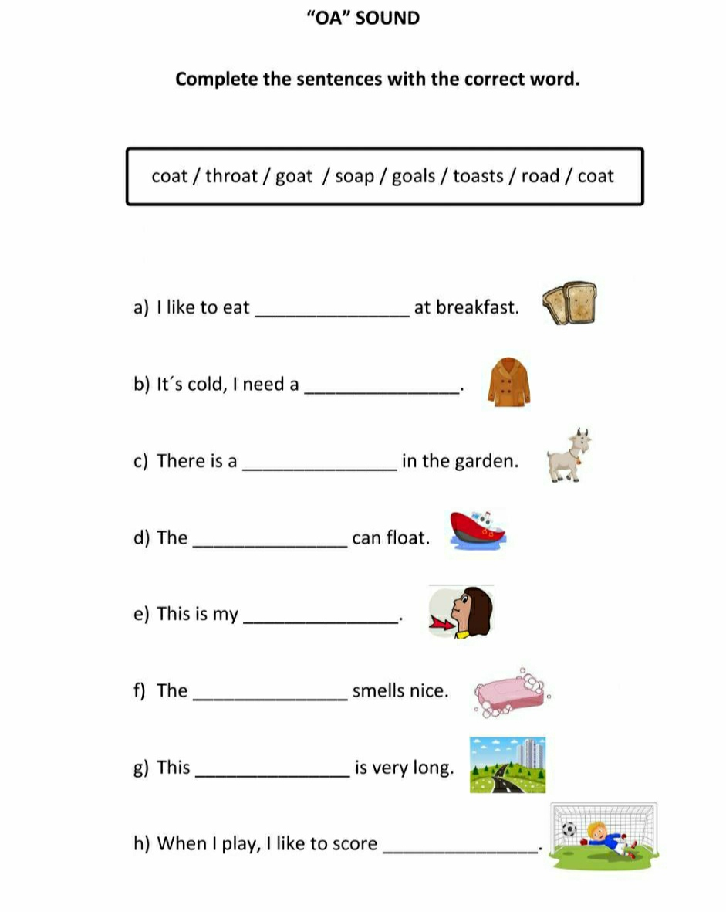
Home assignment

Slide 6

THANKING YOU
ODM EDUCATIONAL GROUP

