Slide 1
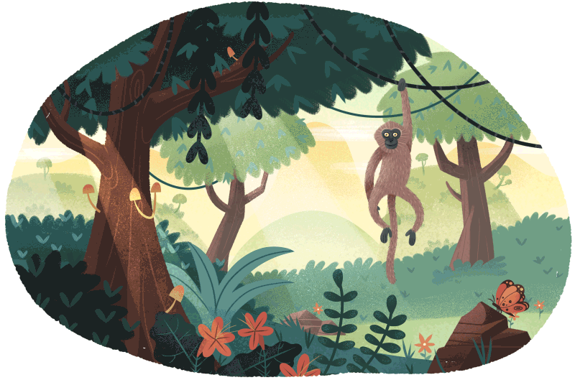

CLASS : NURSERY
DATE : 22.06.2021
SUBJECT : RHYMES
CHAPTER NUMBER-BK PG NO-4
RHYMES: FRUITS

Slide 2
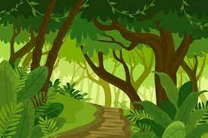
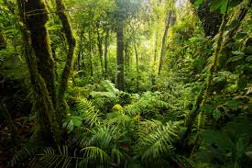

JUNGLE

Slide 3
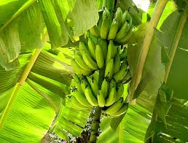
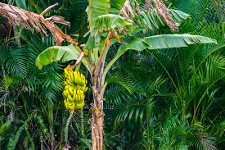
BANANA

Slide 4
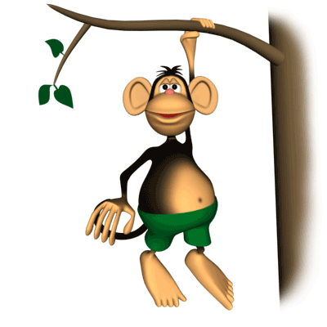
I walked through the jungle
What did I see??
Big green banana Hanging from the tree.

Slide 5
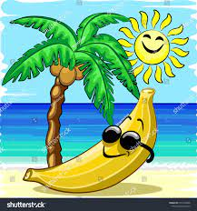
I chopped down a bunch
And set them in the sun
When they turned yellow
I ate each one

Slide 6
THANKING YOU
ODM EDUCATIONAL GROUP
THANKING YOU
ODM EDUCATIONAL GROUP

