Slide 1

WELCOME TO ON LINE CLASS
CLASS-UKG
SUBJECT-MATHS
TOPIC-POSITION
BK PG 35-36

Slide 2
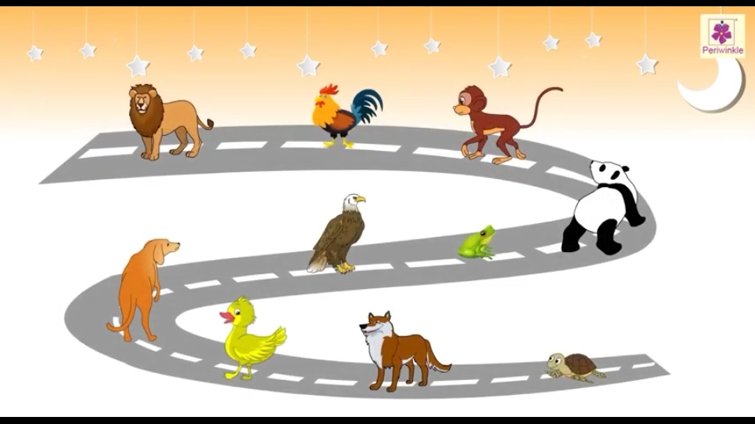
LET’ REVISE
1st
2nd
3rd
4th
6th
5th
7th
8th
9th
10th

Slide 3
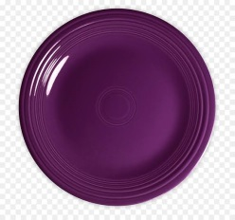
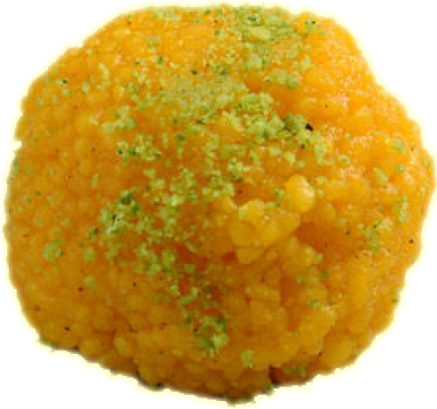
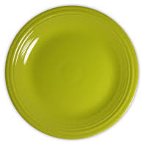
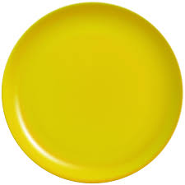
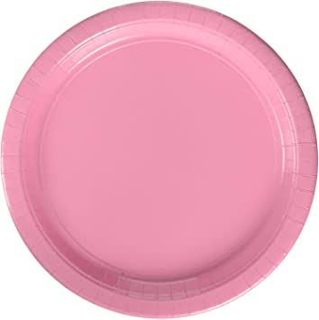
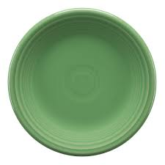
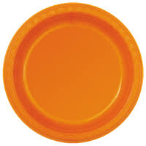

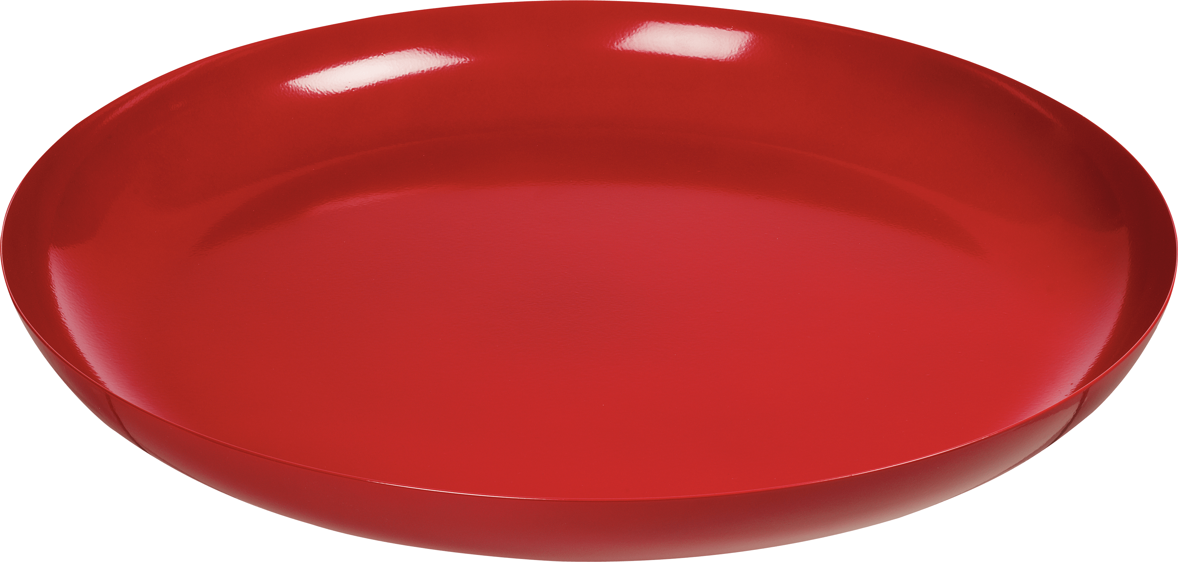
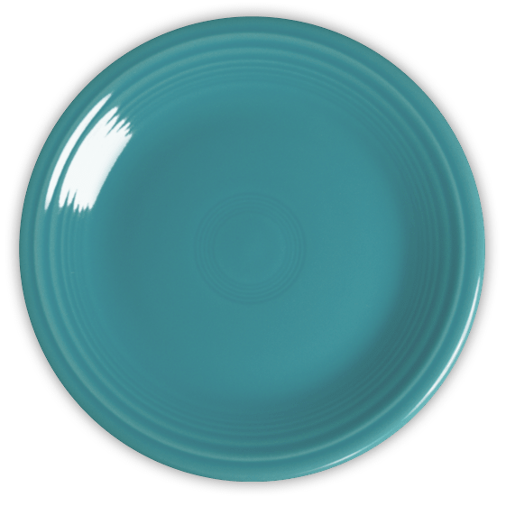

OBSERVE THE PICTURES AND ANSWER
What is the position of red colour plate ?
What is the position of blue colour plate ?
What is the position of pink colour plate ?
8th
3rd
1st

Slide 4

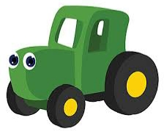
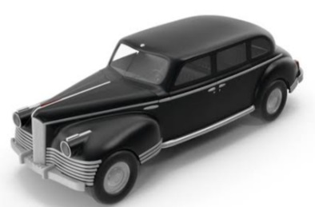
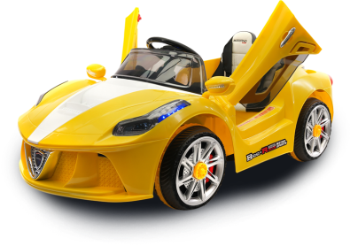
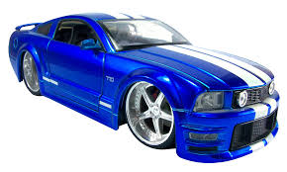
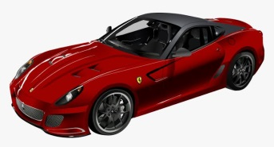

IT’S GAME TIME TOY CAR RACE
Circle the first car .
Circle the sixth car .
Circle the fourth car .
3rd
What is the position of green car ?
WELL
DONE

Slide 5

COUNT THE BALLLS & SAY THE POSITION
1st
6th
10th
What is the position of the moving balls ?

Slide 6
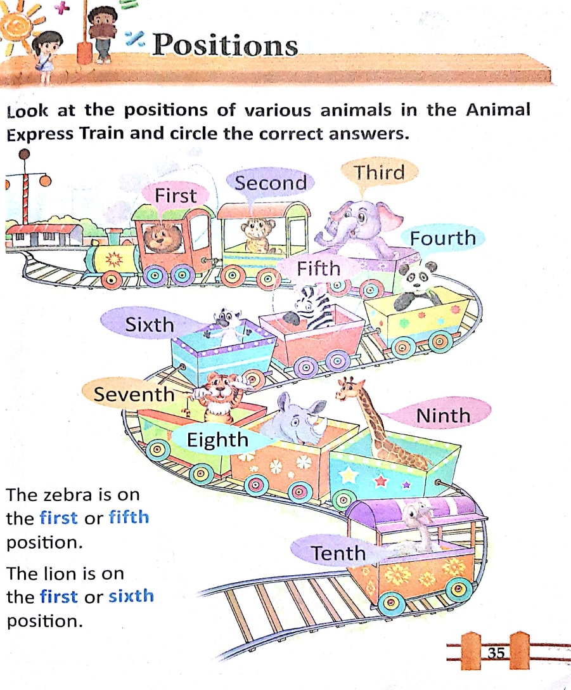
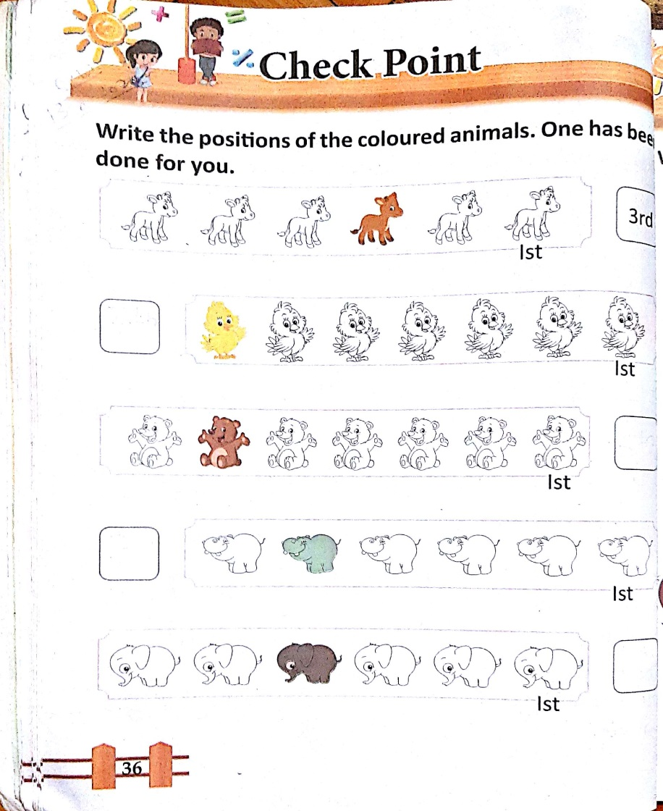
CW-28.6.21 BK PG 35 & 36

Slide 7

THANKING YOU
ODM EDUCATIONAL GROUP

