Slide 1

WELCOME TO ON LINE CLASS
CLASS-UKG
SUBJECT-MATHS
TOPIC-POSITION

Slide 2


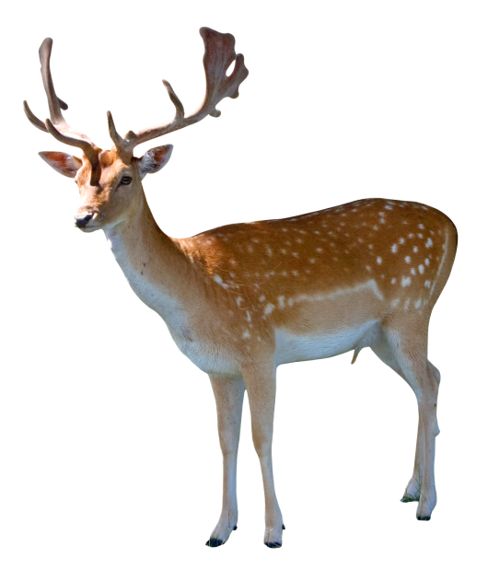

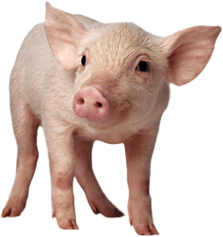

5th
4th
3rd
2nd
1st

Slide 3




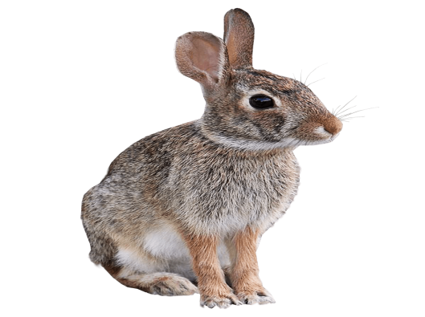
10th
8th
9th
7th
6th

Slide 4
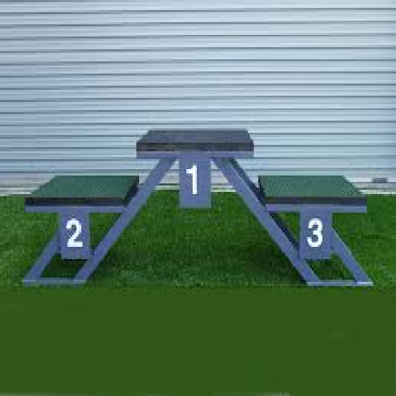


THIS IS CALLED POSITION

Slide 5








7th
4th
5th
6th
3rd
2nd
1st

Slide 6
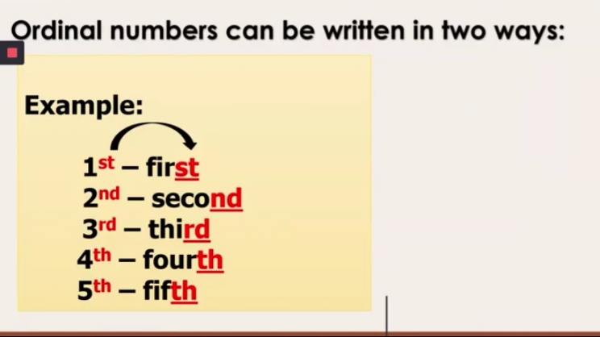
POSITIONS CAN BE WRITTEN IN TWO WAYS.
EXAMPLE-
1st - First
2nd - Second
3rd - Third
4th -Fourth
5th - Fifth
EXAMPLE-
6th - Sixth
7th - Seventh
8th - Eighth
9th - Ninth
10th - Tenth

Slide 7
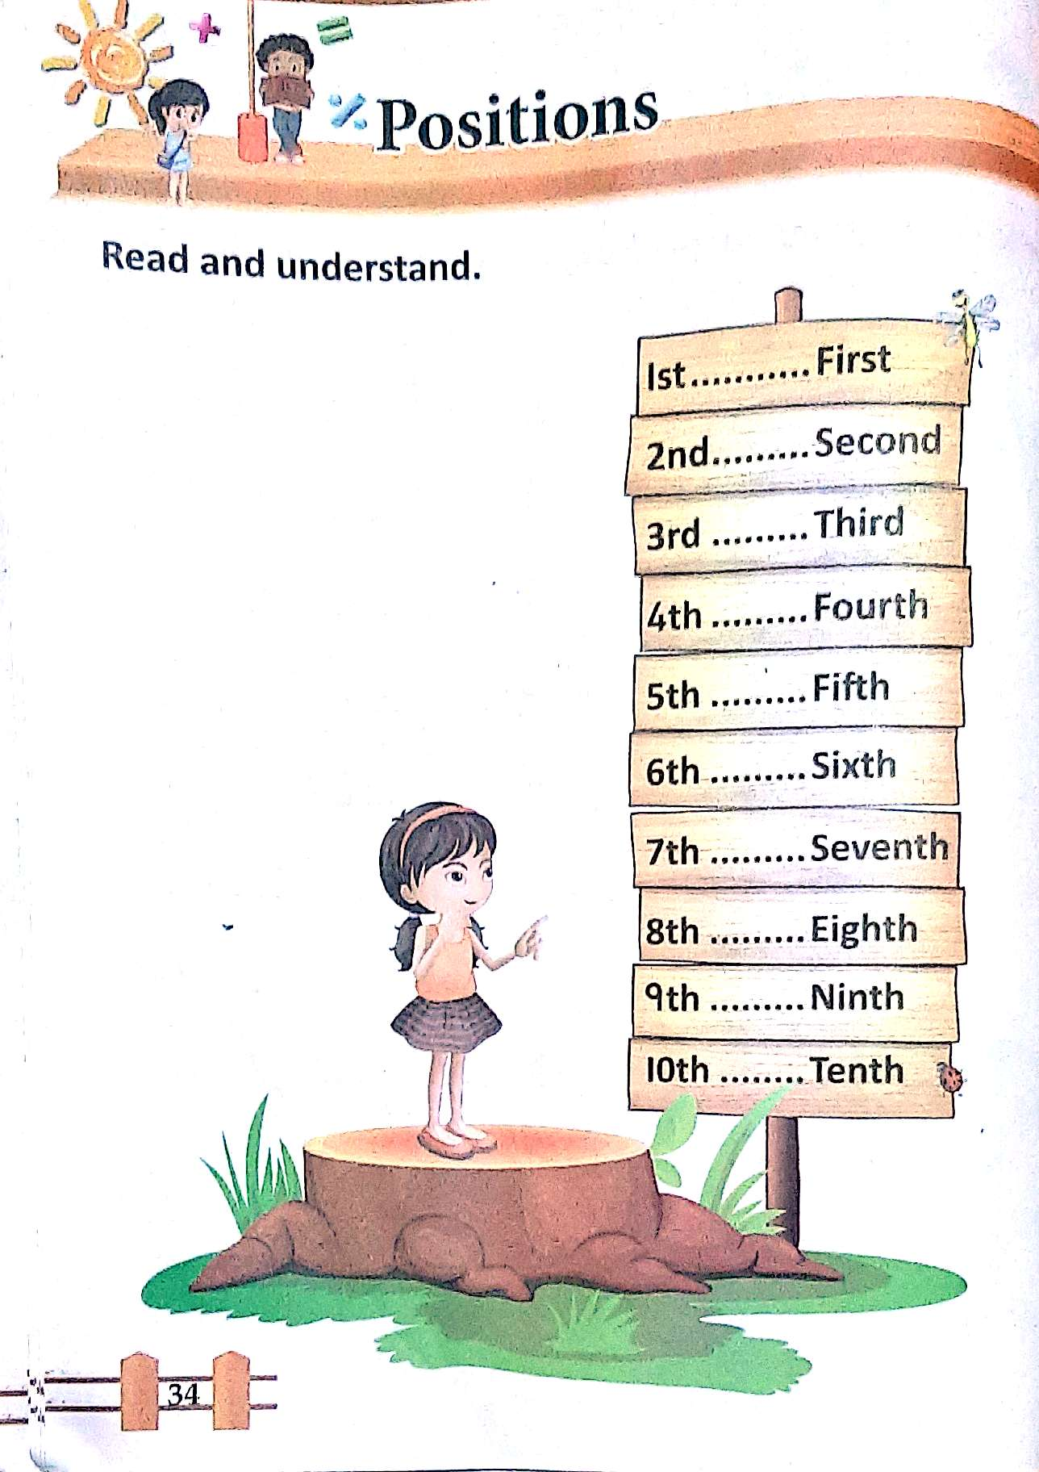
cw
23.06.21

Slide 8

THANKING YOU
ODM EDUCATIONAL GROUP

